Slide 1
Fraction Introduction

Slide 2
What is a Fraction?
A fraction is a part of a whole
For example, half of an apple is a fraction of an apple.

Slide 3
FRACTIONS
3
= the number of these parts being counted (numerator)
4
= the number of equal parts into which a
whole is divided. (Denominator)
Notes:
The denominator tells the number of equal parts into which a whole is divided. The numerator specifies the number of these parts being counted.

Slide 4
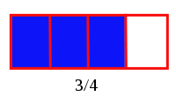
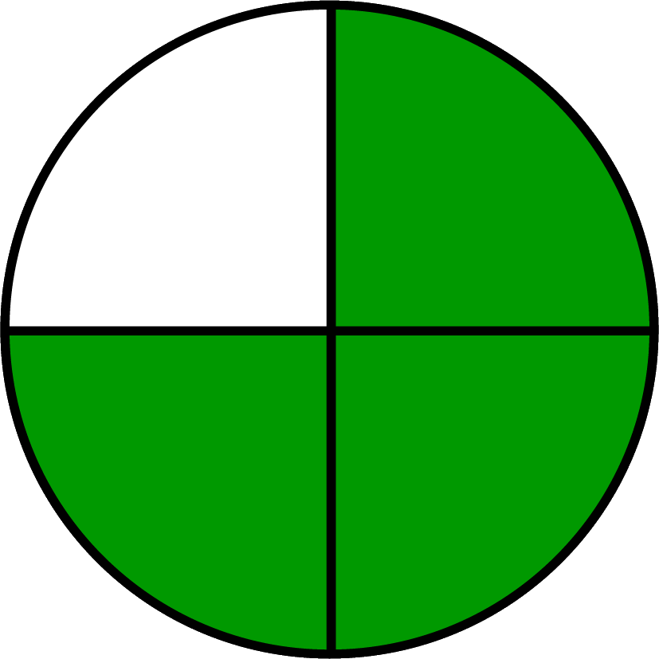
¾ looks like
3
4

Slide 5
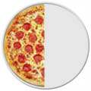
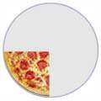
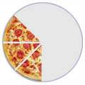
ALSO FOR EXAMPLE
1/2
1/4
3/8
Notes:
The top number tells how many slices you have and the bottom number tells how many slices the pizza was cut into.

Slide 6
Finding a fraction of an amount
Vocabulary
What is a unit fraction?
Example:
What is a non unit fraction?
Example

Slide 7
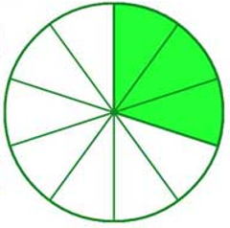
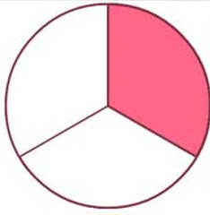
What fractions are shown for each diagram?

Slide 8
Finding a Unit Fraction
of 40 M &Ms
40

Slide 9
5 x ? = 40
40
8 8 8 8 8

Slide 10
of 40 = 40 ÷ 5 =
40
8 8 8 8 8

Slide 12
Find a non – unit fraction of an amount.
How would you show working for
$$\frac{3}{5}$$
of 40 =
40
8 8 8 8 8

Slide 13
Solve:
of 30
of 60
of 27
of 40
of 14

