Slide 1
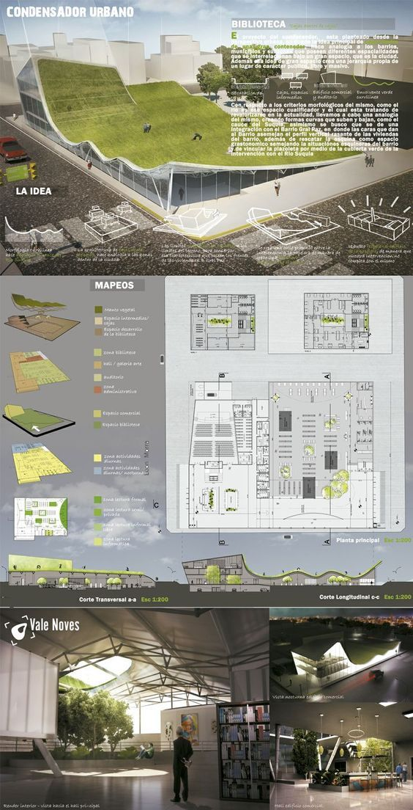
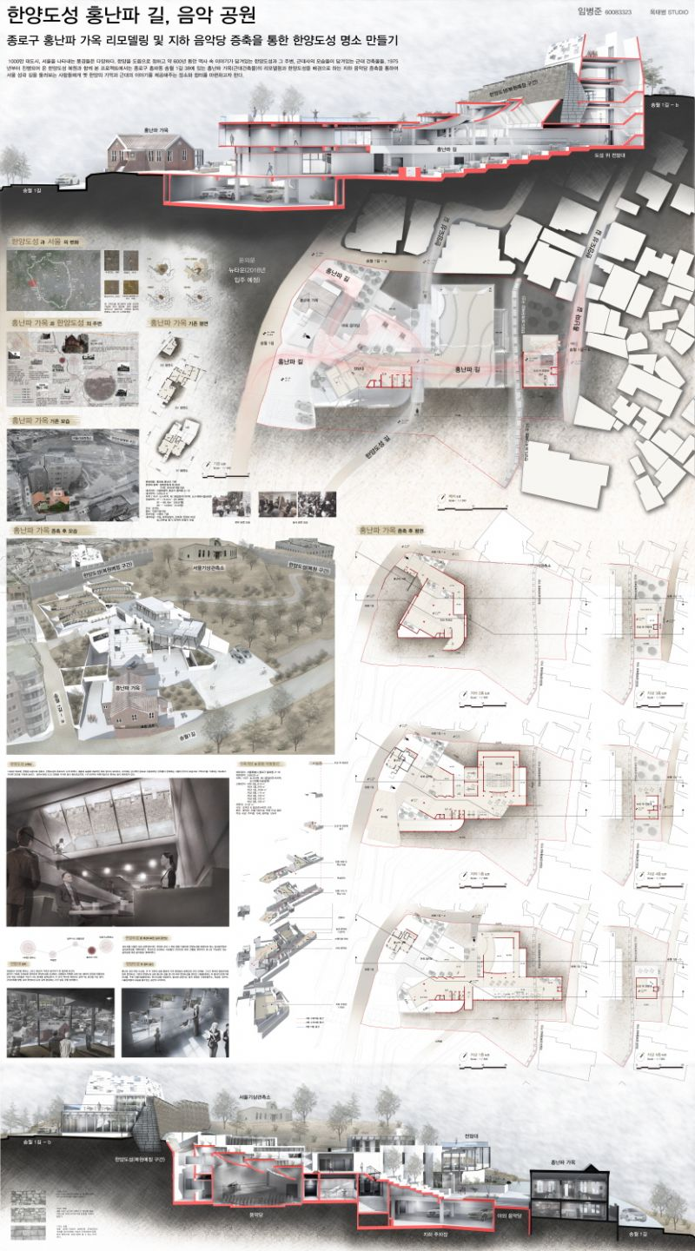
CIBC 5022 Site Analysis

Slide 2
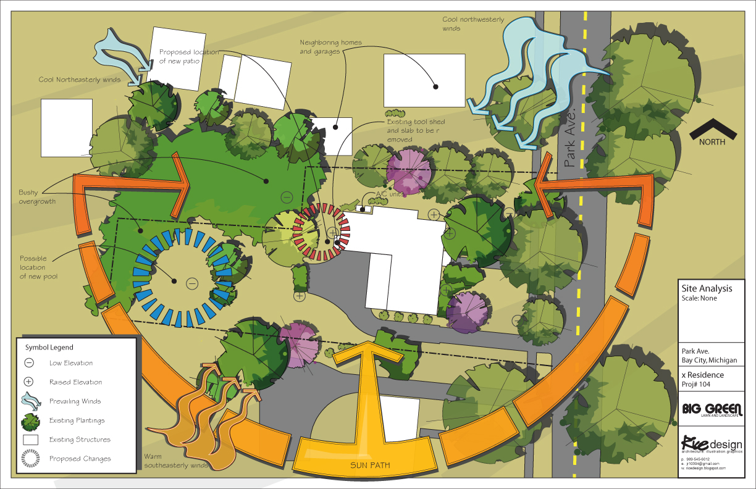
Site Analysis

Slide 3
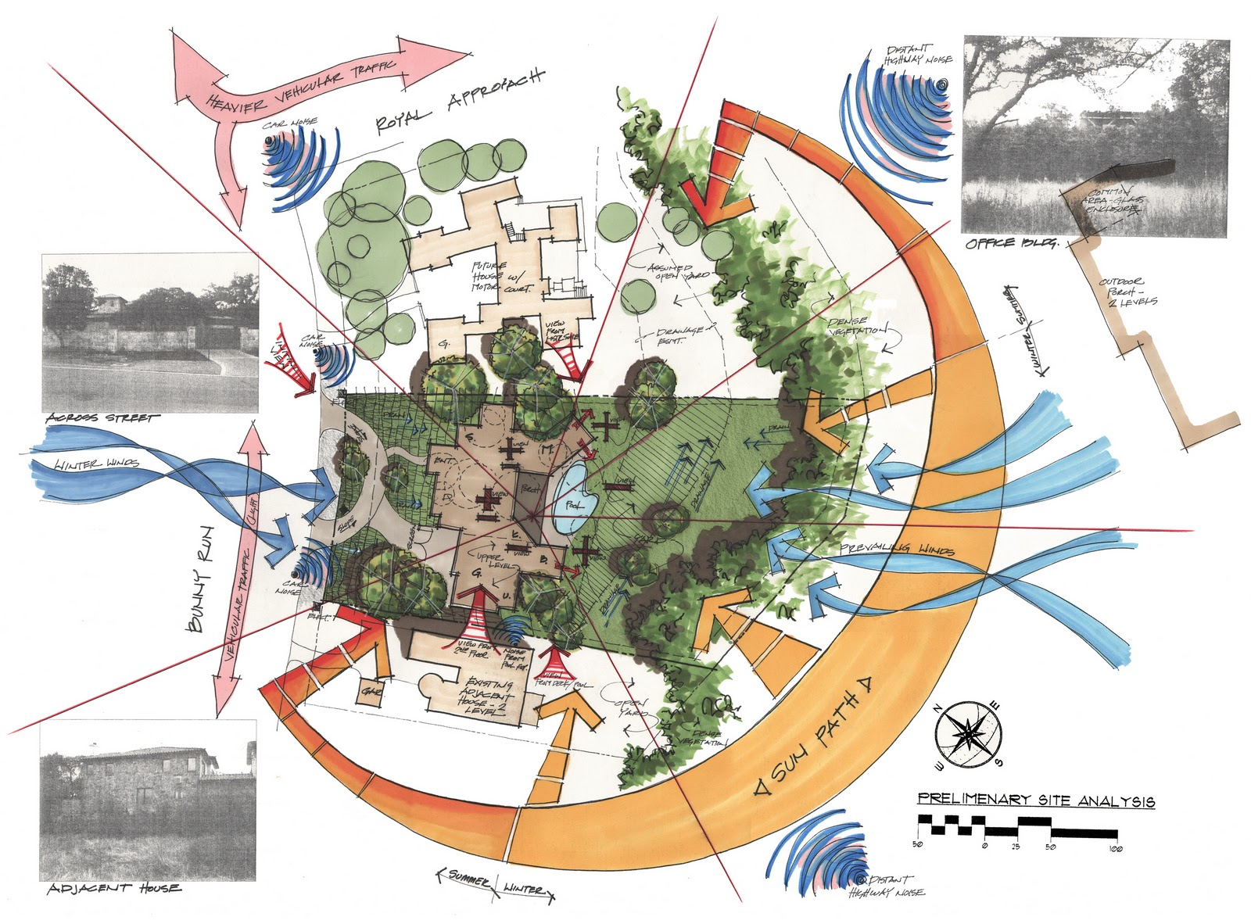
Site Analysis

Slide 4
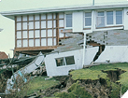
Site conditions and ground stability
A thorough investigation and assessment of ground conditions and stability is essential to determine whether a site is suitable for building on, where the best place may be to locate a building and the type and size of foundations that will be required.

Slide 5
Preliminary survey
bearing pressure - ability to carry the load of the building without excessive settlement
soil types of insufficient bearing pressure
Peat
Sand
Clay
water table - A high water table means the water pressure in the soil is high and that the soil is likely to be correspondingly weaker
trial holes - to take soil samples at lower levels
locating information – council, Pim/Lim, site visit

Slide 6
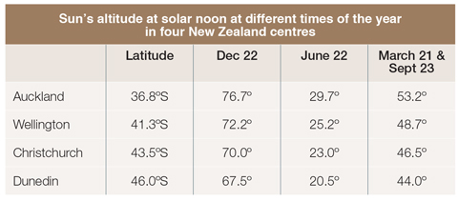
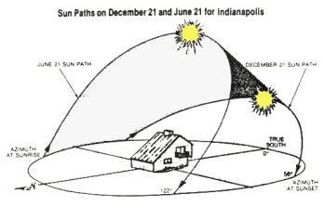
Solar Azimuth
By analysing the impact of the sun on a site, as well as the building’s location, the spatial arrangement, orientation, window placement, daylight access and other design features, the designer can take full advantage of passive solar design features and increase the energy efficiency and comfort of the building.
http://www.level.org.nz/site-analysis/sun/

Slide 7
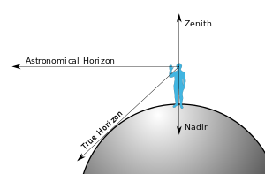

Slide 8
Site setup
Facilities required on site
The Health and Safety at Work (General Risk and Workplace Management) Regulations 2016 requires the person in charge of the business to ensure a workplace (i.e. building site) has certain facilities. They include:
There is enough lighting and ventilation for workers to carry out work safely.
Workers doing their job in extreme heat or cold can do so safely.
Adequate facilities are provided for workers, including: – toilets – drinking water – hand-washing facilities – a place where workers can eat and take breaks – adequate and accessible first aid equipment – facilities where workers who become unwell can rest if it is not reasonable for them to leave the site.
An adequate number of workers on site are trained in first aid, or workers have access to other people trained to give first aid.

