Slide 1
Revision Fractions

Slide 2
1) Simplify $\frac{30}{45}$

Slide 3
1) Simplify $\frac{30 }{45}$
= 30 ÷ 15
45 ÷ 15
= $\frac{2}{3}$

Slide 4
2) Simplify $\frac{175}{150}$

Slide 5
2) $\frac{175}{150}$
= $\frac{175 ÷ 25 }{150 ÷ 25}$ = $\frac{7}{6}$
= 1 $\frac{1}{6}$

Slide 6
3) Simplify $\frac{1.5}{6}$

Slide 7
3) Simplify $\frac{1.5}{6}$
$\frac{1.5 x 10}{6 x 10}$ = $\frac{15 ÷15}{60 ÷15}$
= $\frac{1}{4}$

Slide 8
4) Simplify $\frac{0.09}{150}$

Slide 9

4) Simplify $\frac{0.09}{150}$
$\frac{0.09 x 100}{150 x 100}$ = $\frac{9 ÷ 3}{15000 ÷ 3}$
= $\frac{3}{5000 }$

Slide 10

5) Write as a mixed number
$\frac{28}{\begin{aligned}3 \\ \end{aligned}}$

Slide 11

5) Write as a mixed number
$\frac{28}{\begin{aligned}3 \\ \end{aligned}}$ = 9 $\frac{1}{\begin{aligned}3 \\ \end{aligned}}$

Slide 12
6) Write as an improper fraction
6 $\frac{3}{\begin{aligned}4 \\ \end{aligned}}$

Slide 13
6) Write as an improper fraction
6 $\frac{3}{\begin{aligned}4 \\ \end{aligned}}$ = $\frac{27}{\begin{aligned}4 \\ \end{aligned}}$

Slide 14
7) Solve $\frac{3}{\begin{aligned}8 \\ \end{aligned}}$ + $\frac{7}{\begin{aligned}8 \\ \end{aligned}}$

Slide 15
7) Solve $\frac{3}{\begin{aligned}8 \\ \end{aligned}}$ + $\frac{7}{\begin{aligned}8 \\ \end{aligned}}$
= $\frac{10}{\begin{aligned}8 \\ \end{aligned}}$ = 1 $\frac{2 ÷2}{\begin{aligned}8 \\ \end{aligned}÷2}$ = 1 $\frac{1}{\begin{aligned}4 \\ \end{aligned}}$

Slide 16
8) Solve $\frac{5}{\begin{aligned}9 \\ \end{aligned}}$ - $\frac{2}{\begin{aligned}9 \\ \end{aligned}}$

Slide 17
8) Solve $\frac{5}{\begin{aligned}9 \\ \end{aligned}}$ - $\frac{2}{\begin{aligned}9 \\ \end{aligned}}$
= $\frac{3 ÷3}{\begin{aligned}9 \\ \end{aligned}÷3}$ = $\frac{1}{\begin{aligned}3 \\ \end{aligned}}$

Slide 18
9) Solve $\frac{2}{\begin{aligned}3 \\ \end{aligned}}$ + $\frac{4}{\begin{aligned}15 \\ \end{aligned}}$

Slide 19
9) Solve $\frac{2}{\begin{aligned}3 \\ \end{aligned}}$ + $\frac{4}{\begin{aligned}15 \\ \end{aligned}}$
= $\frac{2 x 5}{\begin{aligned}3 x \\ \end{aligned} 5}$ + $\frac{4}{\begin{aligned}15 \\ \end{aligned}}$
= $\frac{10}{15}$ + $\frac{4}{\begin{aligned}15 \\ \end{aligned}}$
= $\frac{14}{\begin{aligned}15 \\ \end{aligned}}$

Slide 20
10) Solve $\frac{2}{\begin{aligned}7 \\ \end{aligned}}$ + $\frac{1}{\begin{aligned}3 \\ \end{aligned}}$

Slide 21
10) Solve $\frac{2}{\begin{aligned}7 \\ \end{aligned}}$ + $\frac{1}{\begin{aligned}3 \\ \end{aligned}}$
= $\frac{2 x 3}{\begin{aligned}7 x \\ \end{aligned} 3}$ + $\frac{1 x 7}{3 x 7 }$
= $\frac{6}{21}$ + $\frac{7}{\begin{aligned}21 \\ \end{aligned}}$
= $\frac{13}{\begin{aligned}21 \\ \end{aligned}}$

Slide 22
11) Solve $\frac{1}{\begin{aligned}8 \\ \end{aligned}}$ of $64$

Slide 23
11) Solve $\frac{1}{\begin{aligned}8 \\ \end{aligned}}$ of $64$
= 64 ÷ 8 = 8

Slide 24

12) Solve $\frac{2}{\begin{aligned}3 \\ \end{aligned}}$ of $276$

Slide 25
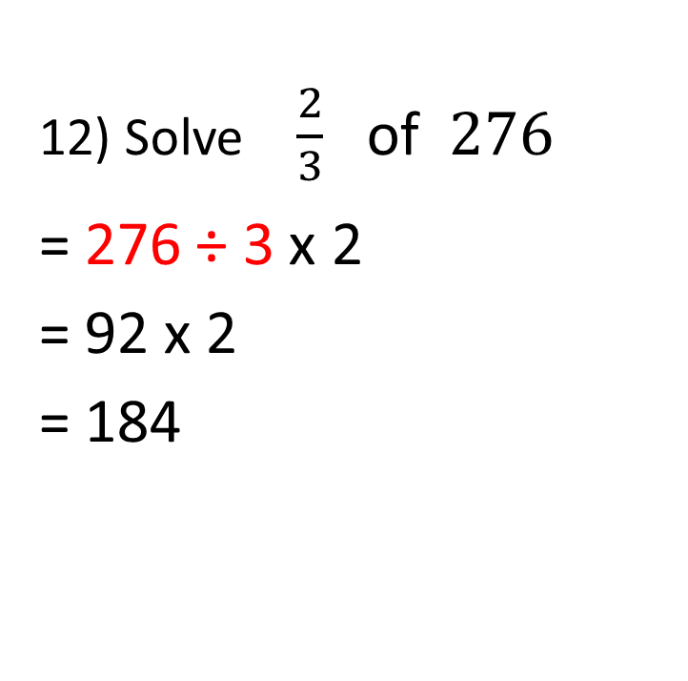
12) Solve $\frac{2}{\begin{aligned}3 \\ \end{aligned}}$ of $276$
= 276 ÷ 3 x 2
= 92 x 2
= 184
Hint: Estimate to check place value 270 ÷ 3 = 90

Slide 26
13) Solve $\frac{9}{\begin{aligned}10 \\ \end{aligned}}$ x $\frac{15}{16}$

Slide 27
13) Solve $\frac{9}{\begin{aligned}10 \\ \end{aligned}}$ x $\frac{15}{16}$
= $\frac{9}{2}$ x $\frac{3}{16 }$
= $\frac{27}{32}$

Slide 28
14) Solve 6 x $\frac{3}{7}$

Slide 29
14) Solve 6 x $\frac{3}{7}$
= $\frac{6}{1}$ x $\frac{3}{7 }$
= $\frac{18}{7 }$ = 2 $\frac{4}{7 }$

Slide 30
15) Change to a fraction and simplify where possible:
a) 0.35
b) 0.375

Slide 31

15) Change to a fraction and simplify where possible:
a) 0.35
= $\frac{35 ÷5}{100 ÷5}$ = $\frac{7}{20}$
b) 0.375
= $\frac{375 ÷25}{1000 ÷25}$ = $\frac{15 ÷ 5}{40÷ 5}$ = $\frac{3}{ 8}$

