Slide 1
NZECPs

Slide 2
Acts
Regulations
Wiring Rules
AS/NZS
NZ Electrical Codes of Practice

Slide 3
Electrical Codes of Practice (ECPs) are issued by WorkSafe under Section 36 of the Electricity Act 1992.
Their purpose includes the setting of standards and requirements for those involved in working with electricity and any electrical installations or appliances.
These standards and requirements include training and qualifications, design and construction, operation and supply, and safety around people and property.

Slide 4
ECP 34 - New Zealand Electrical Code of Practice for Electrical Safe Distances
ECP 35 - New Zealand Electrical Code of Practice for Power Systems Earthing
ECP36 - New Zealand Electrical Code of Practice for Harmonic Levels
ECP 50 - New Zealand Electrical Code of Practice for Repair and Maintenance of Domestic Electrical Appliances by the Owner of the Appliance
ECP 54 - New Zealand Electrical Code of Practice for the Installation of Recessed Luminaires and Auxiliary Equipment
ECP 55 - New Zealand Electrical Code of Practice for Managing Electrical Risks Associated with Electrically Conductive Thermal Insulation

Slide 5
NZECP 54. The installation of Recessed Luminaires and Auxiliary Equipment
SECTION 1
SCOPE, REFERENCED DOCUMENTS, INTERPRETATION AND GLOSSARY
SECTION 2
INSTALLATION REQUIREMENTS
2.1 GENERAL
2.2 ELECTRICAL SAFETY
2.3 CLEARANCES
2.4 SUPPORTS
2.5 MOISTURE
2.6 THERMAL INSULATION
2.7 FIRE RESISTANCE RATING
2.8 ACOUSTIC RATING

Slide 6
INTRODUCTION
This Code sets out the electrical and physical installation requirements for recessed luminaires (“commonly known as downlights” or something similar) and their auxiliary equipment, such as transformers and control gear in residential, commercial and industrial buildings.
The Code gives guidance on the selection of recessed luminaires and their installation requirements to ensure that the integrity of the building is maintained. This integrity includes building elements, thermal, acoustic, fire and moisture.

Slide 7
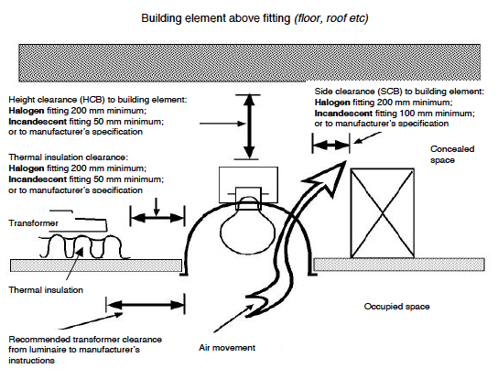
MINIMUM CLEARANCES FOR RECESSED LUMINAIRES

Slide 8
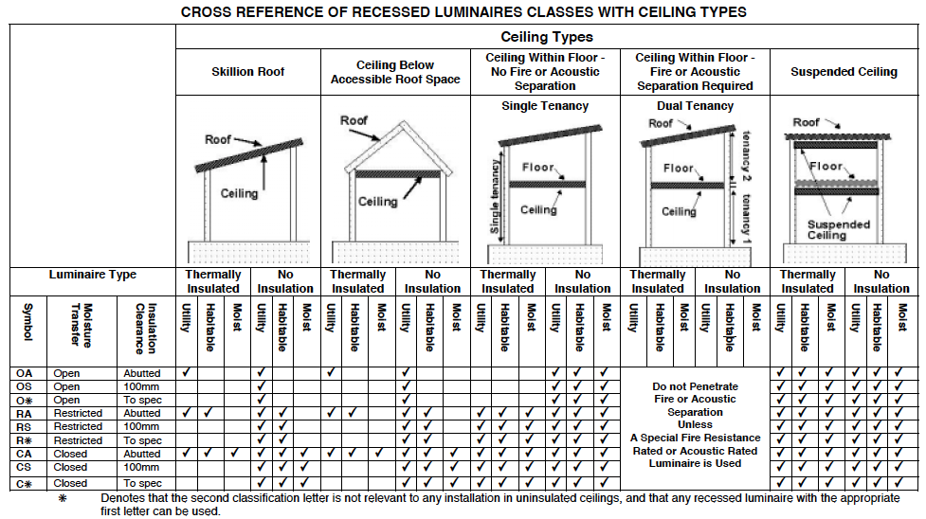

Slide 9
NEW ZEALAND ELECTRICAL CODE OF PRACTICE FOR MANAGING ELECTRICAL RISKS ASSOCIATED WITH ELECTRICALLY CONDUCTIVE THERMAL INSULATION NZECP 55:2016

Slide 10
The risk with working with or near conductive thermal insulation occurs when the insulating foil becomes live, for instance from accidental stapling into wiring.
Improperly installed conductive thermal insulation has resulted in fatalities in both New Zealand and Australia in recent years.
This Code sets out good practice applying to licensed electrical workers, people carrying out electrical work in reliance on the domestic wiring exemption, and professional insulation installers.
It will also help residential property owners and industry to manage electrical safety risks associated with new electrical installations and fittings where conductive thermal insulation is present, and with working safely in the presence of existing installed conductive thermal insulation.

Slide 11
SCOPE
The use of conductive thermal insulation (due to its ability to conduct electricity) requires the provision of additional controls to minimise the potential for the conductive thermal insulation to become electrically live.

Slide 12
2.2.1 Separation or protection of cabling
(a) Every electrical Low Voltage and Extra Low Voltage electrical cable used as installation wiring must:
have a minimum of 100 mm separation from the conductive thermal insulation in all locations; or
(ii) be mechanically protected in one or more of the following ways:
all cabling must be fully contained in earthed metallic conduit
(B) all cabling must be fully contained in heavy-duty plastic conduit (plain and/or corrugated types);
(C) all cabling must be fully contained in heavy-duty trunking securely fixed to the building structure.

Slide 13
Additional RCD protection
(c) Subject to subparagraphs (f) and (g) below, all final sub circuits of the electrical installation that are located in the same building structure area as conductive thermal insulation must be protected by a RCD
Warning signs
(h) A warning sign must be fixed at every entry point to the area where conductive thermal insulation is fitted. The warning sign is specified in Appendix A.

Slide 14
Connection to conductive thermal insulation
(i) Conductive thermal insulation should be unearthed as this will ensure safer working conditions than if it is earthed, even if entry is made to the area(s) containing earthed conductive thermal insulation without first turning OFF the power at the main switch on the main switchboard as required by this Code.

