Slide 1
HTML5 –Images on canvas

Slide 2
Announcements
Test is next week (Week 10)
2 hours – Offline Open Book
1 double-sided A4 sheet for notes
3 parts – 40 mins each
Part 1: Canvas Drawing
Part 2: HTML CSS Animation
Part 3: Dynamic page elements using JavaScript (No XML)
Each part is submitted before starting the next part
Part 2 & 3 have starter files provided

Slide 3
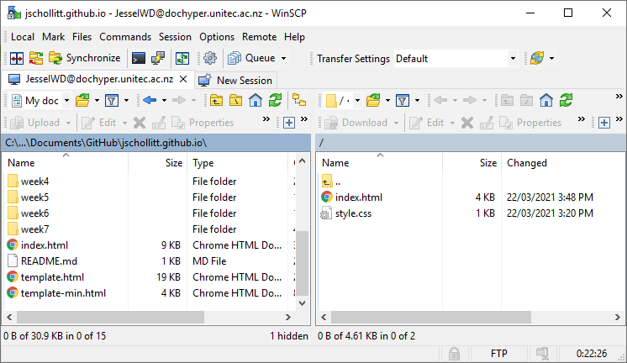
DocHyper FTP Server
FTP: File Transfer Protocol
Used to send/receive data with a remote device
Used in web dev to deploy web sites to remote web servers
Required for your Project submission

Slide 4
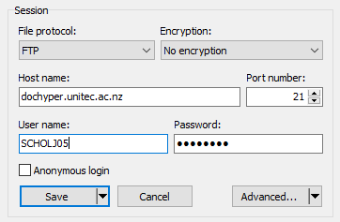
DocHyper
Remote FTP Server
Hostname: dochyper.unitec.ac.nz
Port: 21
Login credentials
Username: Unitec username (5 chars lastname + 1 char firstname + 2 numbers)
EG: SMITHJ01
Password: Birthdate
URL Endpoint: http://dochyper.unitec.ac.nz/iwd21s1/1834/USERNAME/
Note: If your login doesn’t work, inform your lecturer to request access

Slide 5
Connecting
FTP Client software
FileZilla – very popular
WinSCP – easier to use/navigate
Command line – not recommended unless familiar with cli navigation
WinSCP: https://winscp.net/eng/index.php
FileZilla: https://filezilla-project.org/
Win10 CLI: https://www.thewindowsclub.com/access-ftp-server-windows-command-prompt

Slide 6
HTML Canvas Images

Slide 7
HTML5
We can set up style for the canvas background:
<canvas id="myCanvas" width="600" height="400"
style="background-image:url('sky.png');"></canvas>

Slide 8
Good use for background http://www.codeproject.com/Articles/221180/HTML-Canvas-Self-drawn-Persistent-Background

Slide 9
We can add image to canvas as well
<script>
var canvas = document.getElementById('myCanvas');
var context = canvas.getContext('2d');
var myImg = new Image();
myImg.onload = function() {
context.drawImage(myImg, 250, 250);
};
myImg.src = 'bird.gif';
</script>

Slide 10
Example

Slide 11
Make more complex:
We can add drawing shapes on top of the image
Add animation on top of the image

Slide 14
Family Album
http://faculty.purchase.edu/jeanine.meyer/html5/buildfamily.html

Slide 15
Save canvas as image file
http://weworkweplay.com/play/saving-html5-canvas-as-image/
<a href="#" class="button" id="btn-download" download="my-file-name.png">Download</a>
var button = document.getElementById('btn-download');
button.addEventListener('click', function (e) {
var dataURL = canvas.toDataURL('image/png');
button.href = dataURL;
}); // works only on firefox //we can’t save canvas background!

Slide 16
Dynamic canvas images
If an image is loaded and drawn onload, what happens after a canvas clear?
Image is cleared. No longer visible in the window
Instead, add images to the webpage in a hidden element

Slide 17
Load image from webpage element
In javascript, save a reference to the image:
Then draw it:

Slide 18
Resources:
http://www.w3schools.com/tags/canvas_drawimage.asp
http://www.html5tutorial.info/html5-canvas-image.php
http://www.html5tutorial.info/html5-canvas-image.php
http://faculty.purchase.edu/jeanine.meyer

