Slide 1
Units of Mass (weight)
and converting between them

Slide 2
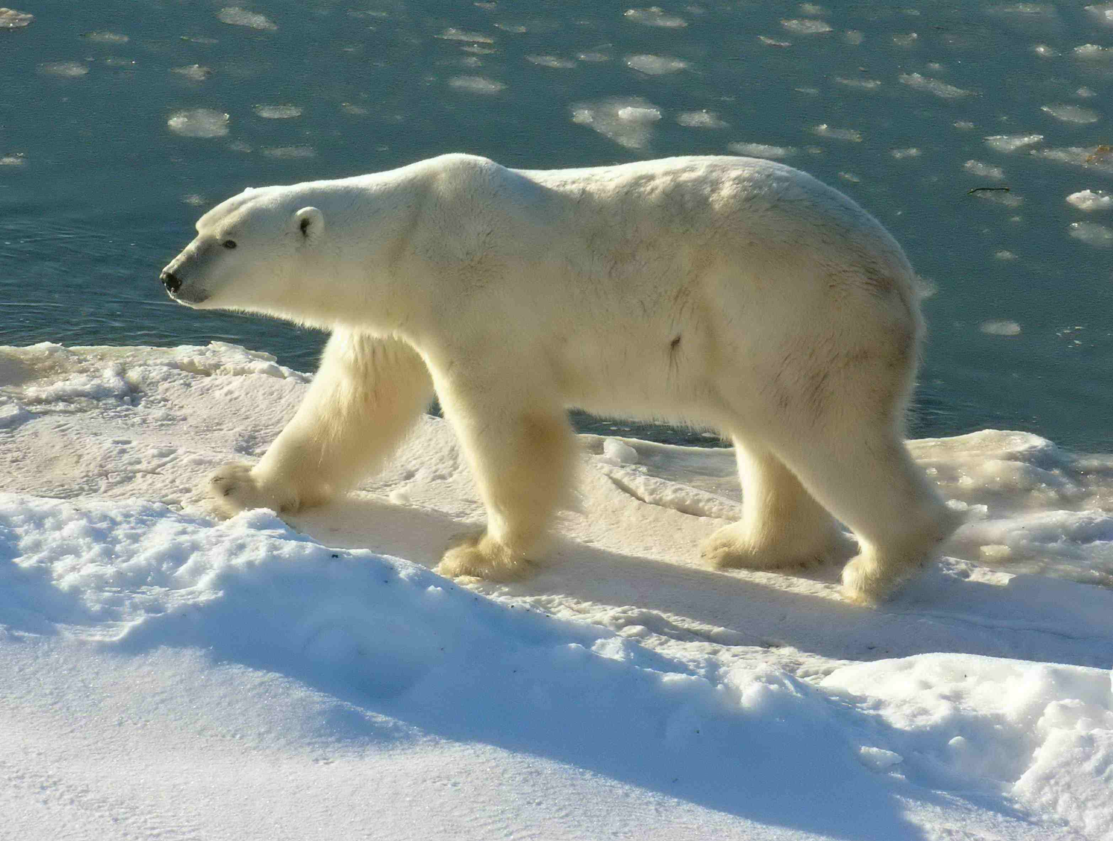
How much is a tonne?
1 tonne (t) = 1000 kilograms or kg
About the weight of a large polar bear…

Slide 3
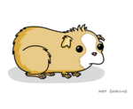
1 kilogram?
1 kg = 1000 grams, the mass of 2 normal packs of butter in NZ
Or about the mass of a guinea pig.

Slide 4
1 gram ( the basic unit )
1g = the mass of 1mL of water
(about 1 fifth of a teaspoon)

Slide 5
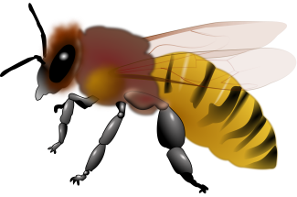
1 milligram?
1 mg = 0.001g or 1/1000 of a gram
The brain of a honeybee might weigh a mg.

Slide 6
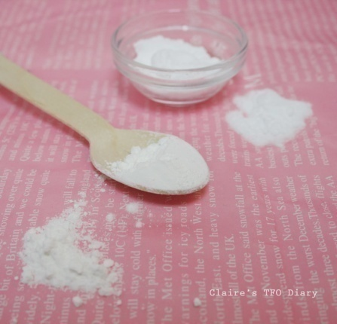
1 microgram ?
(mcg or μg) (1 millionth of a gram)
- maybe one particle of baking powder

Slide 7
Convert to grams
120 kg =
120 000 g

Slide 8
Convert to grams
3.65 kg =
3,650 g

Slide 9
Convert to kg
2000 g =
2 kg

Slide 10
Convert to kg
350 g =
0.35 kg

Slide 11
Convert to kg
305 g =
0.305 kg

Slide 12
Convert to grams
365 mg =
0.365 g

Slide 13
Convert to grams
28 mg =
0.028g

Slide 14
Convert to grams
25000 μg =
0.025g

Slide 15
Convert to milligrams
95 μg =
0.095 mg

Slide 16
Convert to milligrams
4.8 g =
4800 mg

Slide 17
Convert to milligrams
67.5 g =
67,500 mg

Slide 18
Convert to micrograms
6.38 mg =
6,380 μg

Slide 19
Convert to micrograms
0.87 g =
870 000 μg

Slide 20
Convert to micrograms
3.1 grams
= 3,100,000 μg

