Slide 1
Measurement Intro
Week 5

Slide 2
Measurement - Metric system Base units & Prefixes
 | Base Units
Linear measurement | metre m gram g Litre L
Mass (weight)
Liquid capacity (volume)
Prefix​ | Relationship with base units​ | ​
Deci ​ | tenths​ | 0.1​
centi​ | hundredths​ | 0.01​
milli​ | thousandths​ | 0.001​
micro ​ | millionths​ | 0.000001​
nano​ | billionths​ | 0.000000001​
Kilo ​ | thousand​ | 1,000​
mega​ | million​ | 1,000,000

Slide 3
Measurement More Prefixes
Prefix | Measurement | Scientific Notation
Kilo- | 1000 m | 1 x 10³ m
Hecta- | 100 m | 1 x 10² m
Deka- | 10 m | 1 x 10¹ m
BASE | 1 m | 1 x10⁰ m
Deci- | 0.1m | 1 x 10⁻¹m
Centi- | 0.01 m | 1 x 10⁻² m
Milli- | 0.001m | 1 x 10⁻³ m
Micro- | 0.000001 m | 1 x 10⁻⁶ m
Nano- | 0.000000001 m | 1 x 10⁻⁹ m
Pico- | 0.000000000001 m | 1 x 10⁻¹² m
Femto- | 0.000000000000001 m | 1 x 10⁻¹⁵ m

Slide 4
Measurement Units
Measurement notation and estimation:
Exercise 1 and Exercise 2 (Pages 3 – 4)

Slide 5
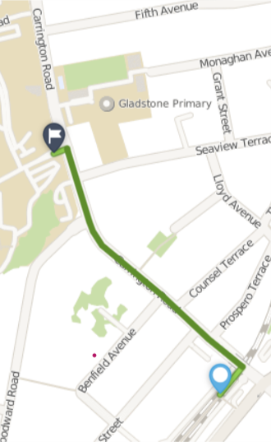
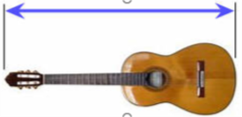
Linear Measurement - Benchmarks
How big is a kilometre?
kilometres km
A kilometre is about the distance from Mt Albert train station to Unitec Mt Albert.
1km = 1,000m
How big is a metre?
metre m
A metre is about the length of an acoustic guitar
or
Stretch out one arm to the side, then measure the length from your fingertip towards your opposite shoulder. Where does a metre come to?

Slide 6
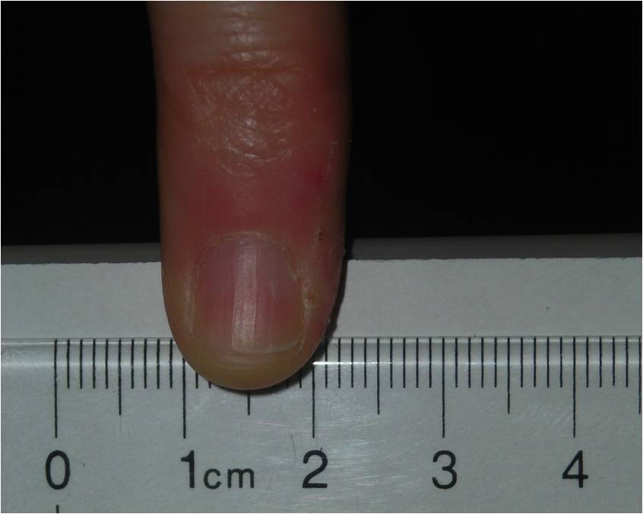
Linear Measurement - Benchmarks
How big is a centimetre?
centimetre cm
A centimetre is about the width of your “pinky” fingernail.
Retrieved from https://chem.beloit.edu/edetc/nanoscale/index.html 24/08/22
How big is a millimetre?
millimetre mm
A millimetre is about the thickness of your ID card or a credit card.
Retrieved from https://chem.beloit.edu/edetc/nanoscale/index.html 24/08/22

Slide 7
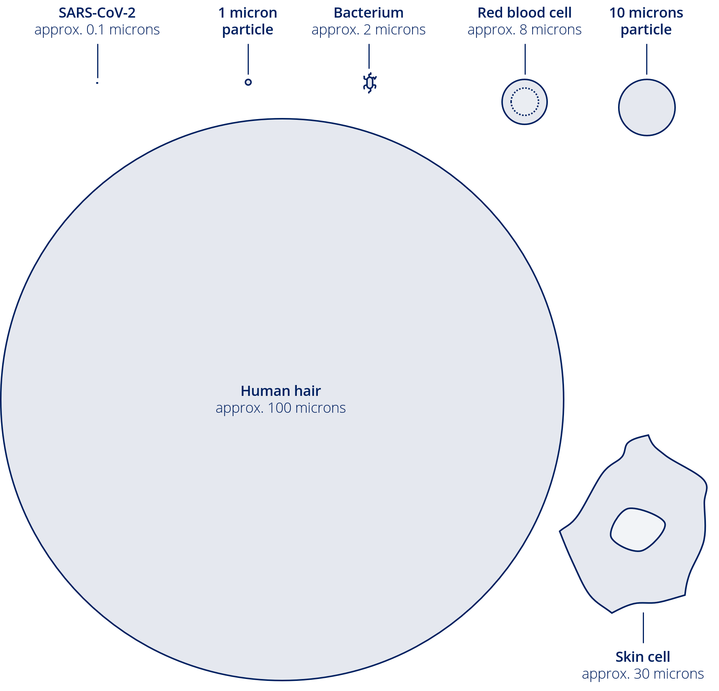
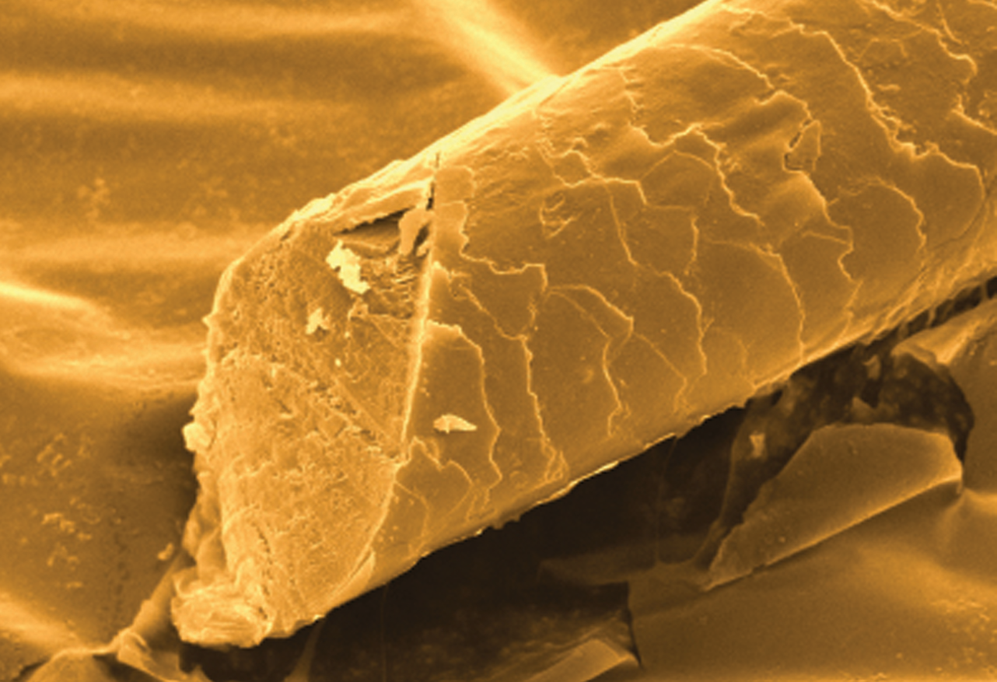
Linear Measurement – smaller lengths
How big is a micrometre?
A micrometre is called a micron
It is 1,000 times smaller than a millimetre.
It is one millionth of a metre.
The diameter of a hair is about 50 -100 micron.
Retrieved from https://chem.beloit.edu/edetc/nanoscale/index.html 24/08/22
Human hair magnified 200 times

Slide 8
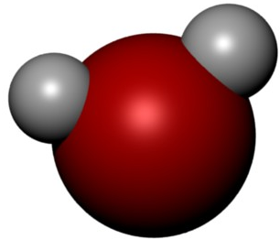
Linear Measurement – smaller lengths
How big is a nanometre? (nm)
A nanometre is one billionth of a metre
Atoms and molecules could be measured with nanometres, for example, a water molecule (H₂O), is less than a nanometre

Slide 9
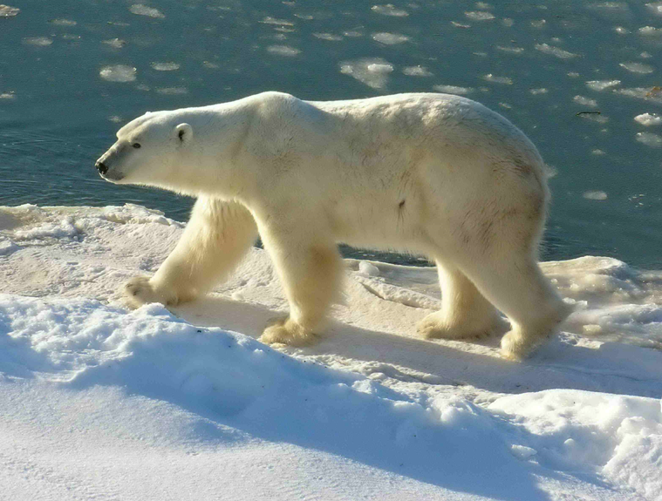
Measurement Benchmarks - Mass
How much is a tonne?
1 tonne (t) = 1000 kilograms or kg
About the weight of a large polar bear…

Slide 10
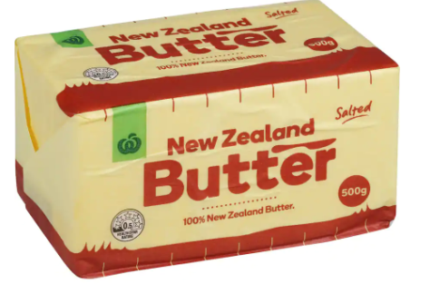
Measurement Benchmarks - Mass
How much is a kilogram? (kg)
1kg = 1000g, which is 2 x 500g packs of butter
How much is a gram? (g)
1 gram is about the weight of a metal paperclip.
How much is a milligram? (mg)
1 milligram is about the weight of a bee’s brain
1 mg = 0.001g or 1/1000 of a gram

Slide 11
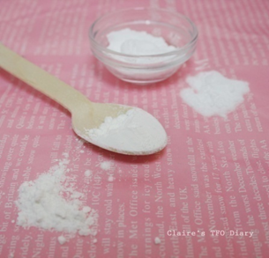
Measurement Benchmarks – Smaller units of Mass
How much is a microgram? (mcg)
1 mcg maybe about 1 particle of baking powder.
1 mcg (or μg) = 1 millionth of a gram 0.000001g
How much is a nanogram? (ng)
1 nanogram is one billionth of a gram (0.000000001g , 1 x 10⁻⁹ g)

Slide 12
Measurement Benchmarks – liquid capacity (volume)
How much is 1 litre? (L)
How much is 1 millilitre?
1 millilitre is about 20 drops of water
How much does a teaspoon hold?
A teaspoon holds about 5 mL

Slide 13
Reading scales
YouTube video on reading measuring scales:
https://www.youtube.com/watch?v=6JyDRJBJQgU#
PPT on reading scales examples
Workbook Exercises 3 & 4
Pages 5-15 (Excluding pages 8 and 14)

Slide 14
Reading Syringes
Before your next class:
Read page 16.

