Slide 1
EDUC6006
Session 9: Reflecting on ethical practice
By Galina Stebletsova

Slide 2
Karakia timatanga
Ma te Rangatiratanga
Te Whakaritenga
Te Kaitiākitanga
Te Kōtahitanga
Me Te Ngākau Māhaki
Ka tau i raro i te whakaaro kōtahi
Hei ōranga mo tātou katoa
Haumi ē! Hui ē! Taiki ē!

Slide 3
Reflection…
A reflection can be many things. We can see a reflection in a mirror or in a puddle of water, and we can think about an experience and ponder what happened and why. On the other hand, sceptics might argue that what you see is whatever you are looking for. While the concept of reflective practice has been around since ancient times, in recent years we have seen a renewed interest in reflective practice as a way of understanding and learning from experiences (Hickson, 2011, p. 829).

Slide 4
What is ‘critical’ reflection?
Critical reflection involves both a theory and a practice – that is, a clear rationale and analysis, and a clearly structured process for reflection. ‘Critical’ in critical reflection involves reflection through the lens of critical theory. This involves analysis in the context of knowledge, power and reflexivity to understand how assumptions are influenced in the context of social and structural assumptions (Fook & Askeland, 2006, as cited in Hickson, 2011, p.830).

Slide 5
Reflection and ethical practice
What are the links?
Why engage in it?
What are the gains for an ECE Kaiako?

Slide 6
Reflect on the following…
Recognition of self and other is not value neutral; it is permeated with figures of desire: what self and other want, what self and other need, what we value, what we seek, what we fear, what we avoid. Put differently, our encounters with Others can be understood as a ‘collision and commingling of separate desires.
… when we encounter another person, our own needs, wants, values, fears and so forth have potential to over-ride the other person’s needs and wants before we even pause for reflection.
(Dillon, 2012; Elwick et al., 2014)

Slide 7
Relate your ethical decision-making to…
Your identity
Your culture
Your family background
Your personal experiences
How can you justify your ethical lens?

Slide 8
Let’s have a korero
Ghosts in the system: the price of lockdown for vulnerable children and families | Stuff.co.nz
Your thoughts?
Critically reflect on what makes you think this way: as an ECE Kaiako, as an individual?
In what way does understanding who you are influence your judgments?

Slide 9
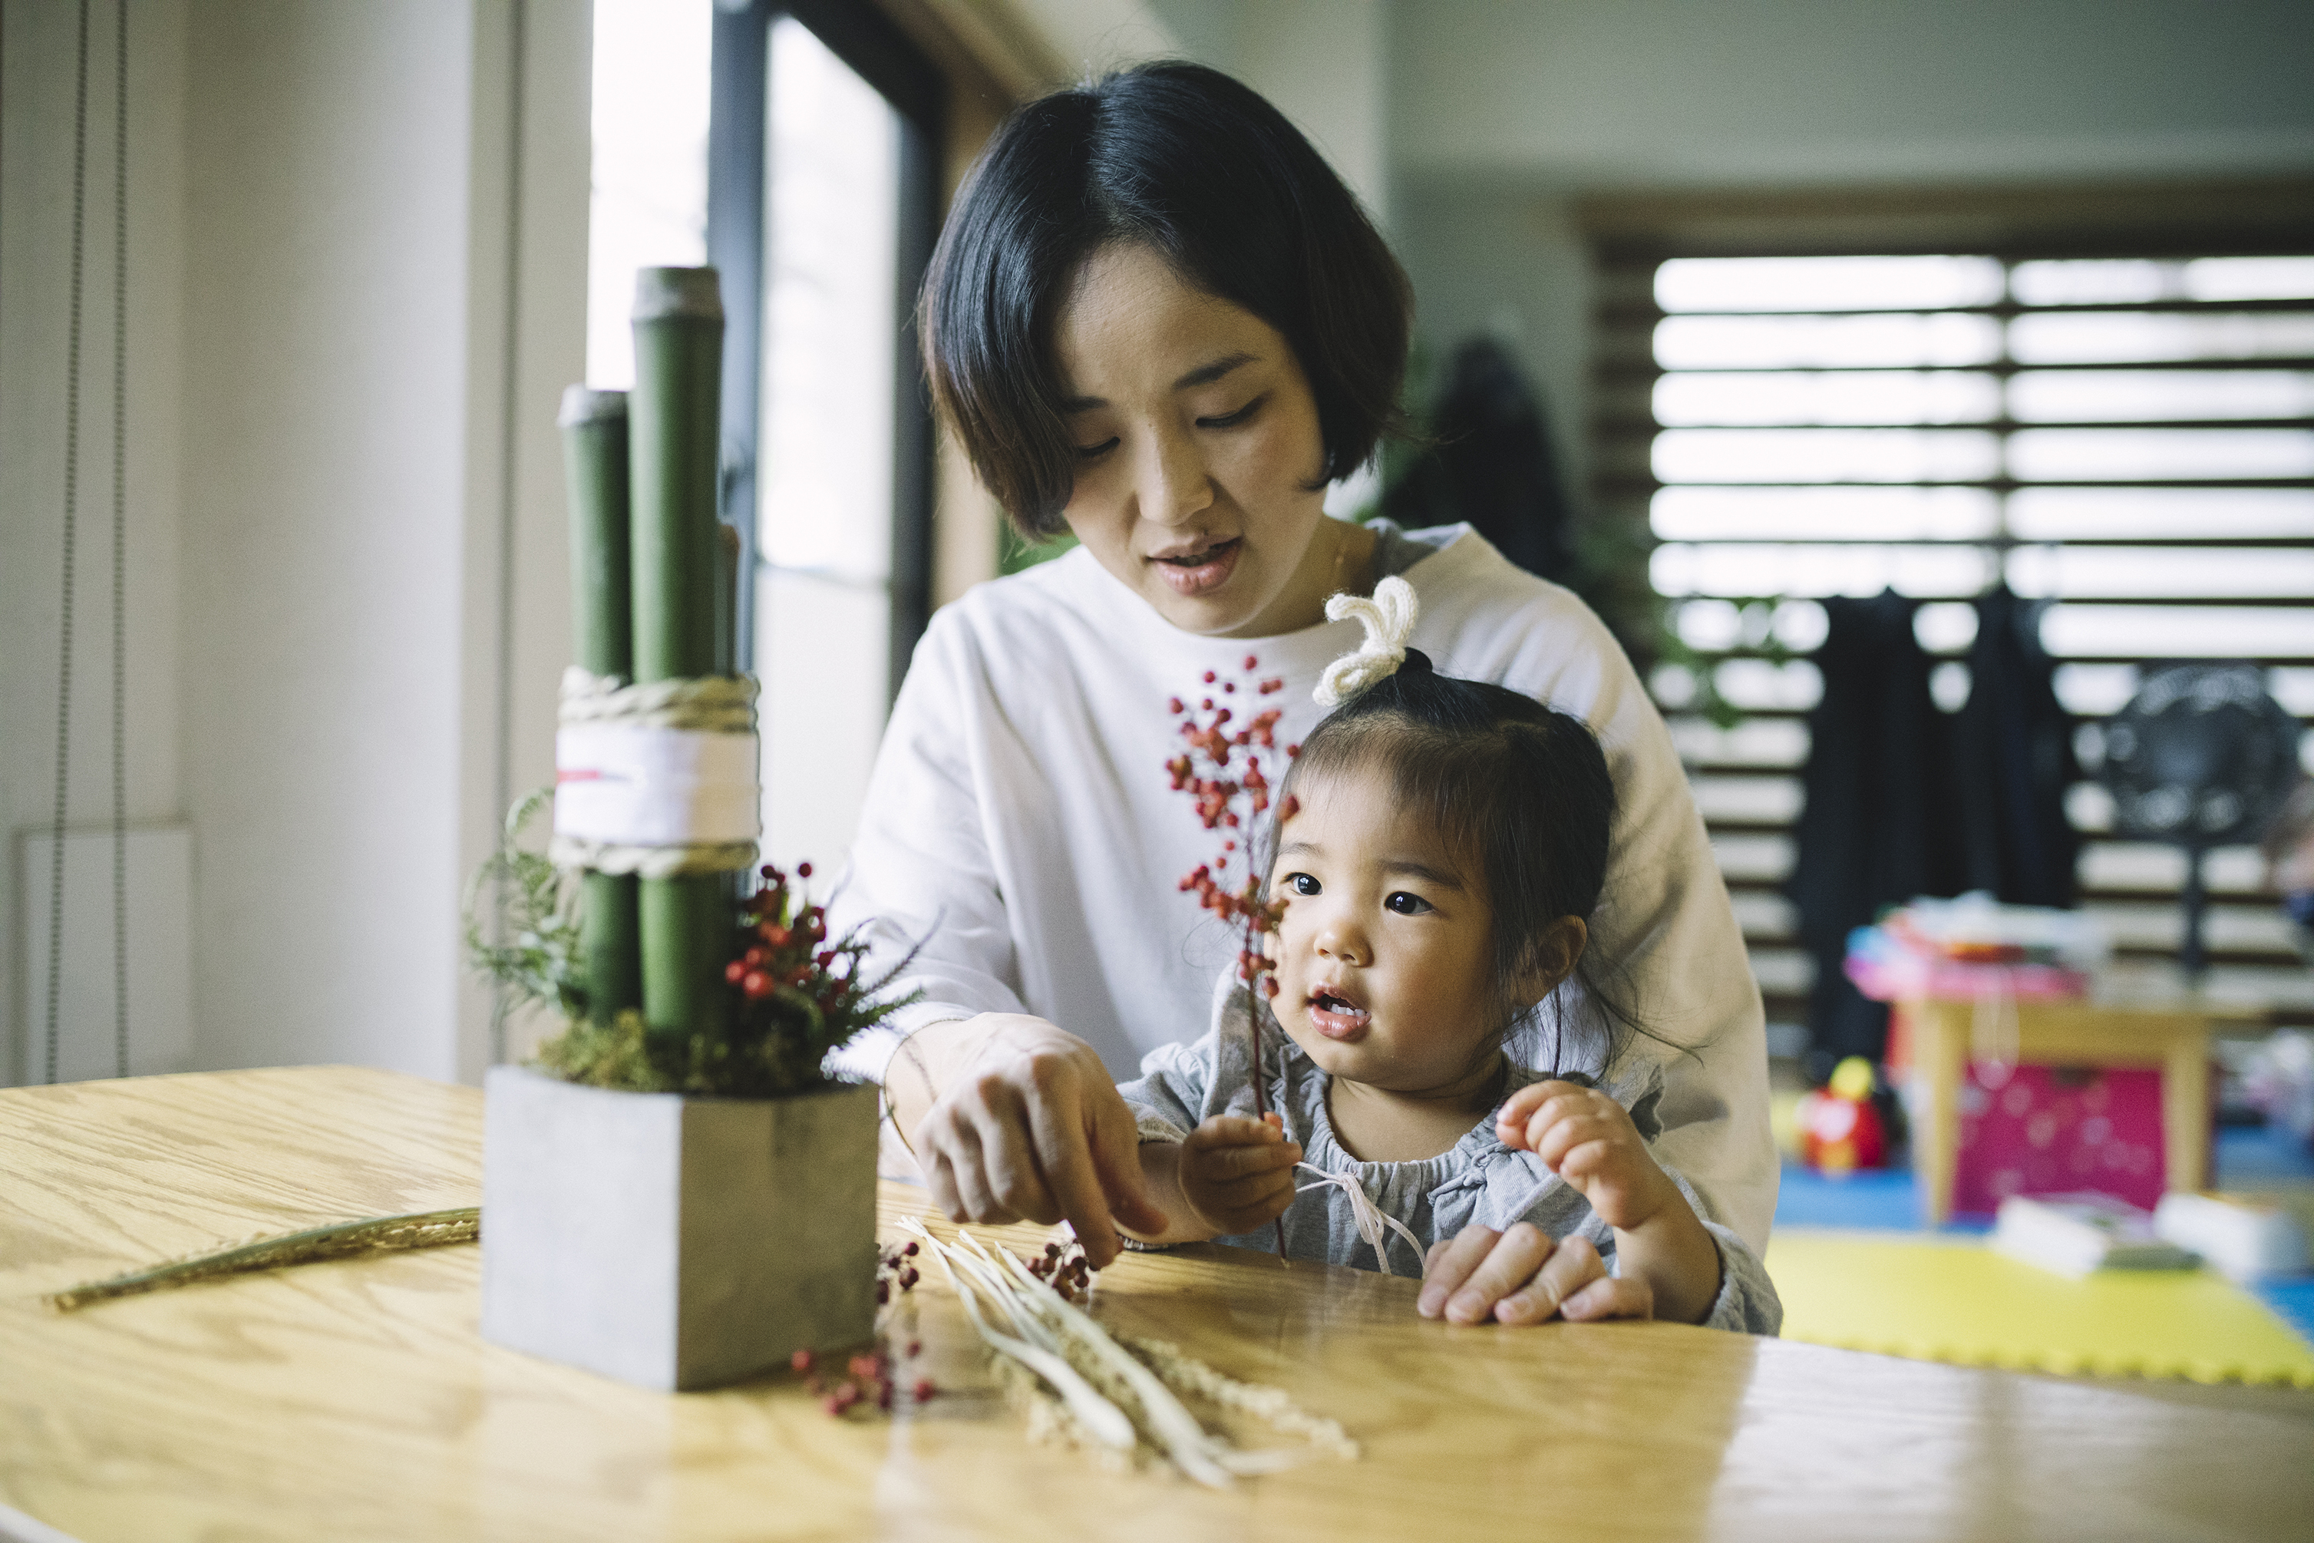
Children, rights and powers
Read and reference the article by Giesinger (2019) – see our Week 10 on Moodle.
Reflect on the following and share with the class:
‘Everything that is morally and legally relevant is already expressed in the concept of duty’ (Giesinger, 2019, p. 253)
Are our rights grounded in interests? Why/why not?
‘Children do not have the same kind of powers with regard to their rights as adults’ (Giesinger, 2019, p.257)
Children being in special normative position: “the right they may have might be waived by someone else on their behalf” (Giesinger, 2019, p.260)

Slide 10
Reflect on…
The issue with personalisation of ethics
Individual ‘moral competence’ and its impact on ethical decision-making
Image credit: https://www.britannica.com/topic/The-Thinker-sculpture-by-Rodin
(The thinker, sculpture by Auguste Rodin)

Slide 11
The ‘DECIDE’ framework
.. Supports the complexity of decision-making, suggesting to:
Define the problem
Ethical review
Consider options
Investigate outcomes
Decide on action
Evaluate results
(Lonne et al., 2016, p.46)

Slide 12
DECIDE…
Define the problem: What are the facts that have a particular bearing ont eh situation and what ethical issue/s demand a decision?
Ethical review: identify which ethical principles are relevant to this issue and reflect on which of the principles have priority for particular stakeholders.
Consider options: brainstorm choices with your team, be realistic and ethical in your proposals.
Investigate outcomes: consider likely outcomes for each stakeholder.
Decide on action: have clear plan on action, clearly articulate the reason for the decision
Evaluate the results: engage in critical reflection – was your decision ethical and effective? Why/why not?

Slide 13
Consider a dilemma…
One of the aspects of your centre’s philosophy is to use real dishes (glass/ceramic) for all age groups and no plastic. One of the parents approaches you with concern over their toddler’s safety in case of broken glass.
Approach your decision:
As an ECE Kaiako
As a parent
As a community member
Justify your decision by the relevant literature sources

Slide 14
Karakia whakamutunga
Kia tau tō rangimārie
Ki runga I ngā iwi o te ao
Let your peace reign
On all the people of the world

