Slide 1
EDUC6006 Leading ethical practice
Session 6 by Galina Stebletsova

Slide 2
Karakia timatanga
Ma te Rangatiratanga
Te Whakaritenga
Te Kaitiākitanga
Te Kōtahitanga
Me Te Ngākau Māhaki
Ka tau i raro i te whakaaro kōtahi
Hei ōranga mo tātou katoa
Haumi ē! Hui ē! Taiki ē!

Slide 3
Whakatauki
Ko te tamaiti te pūtake o te Kaupapa.
The child – the heart of the matter.

Slide 4
In this session…
Working in a team
The role of communication
The place of policies

Slide 5
The ethical teacher…
Teaching is an activity in which ethical issues are central. For one thing, teaching involves close personal relationships: between teachers and students, between one student and another and between one teacher and another. ..Finally, the school exists for an ethical purpose: to change people in certain ways. Teaching, then, involves ethics in its aims, its methods, and its relationships
(Snook, 2003).

Slide 6
Working in a team (class korero)
Share with class:
What does being in a team mean to you?
Why are teams important in ECE?
What is your role in a team?

Slide 7
What do we mean by a ‘team’?
“A small number of people with complementary skills, who are committed to a common purpose, performance goals and approach, for which they hold themselves mutually accountable” (Clutterbuck, 2011, p. 2).

Slide 8
What makes a team?
Complementary skills are important, because they allow more value to be created by harnessing a range of talent and knowledge.
Commitment to a common purpose emphasizes the requirement for a shared sense of direction. Without a common purpose, individual priorities and intentions will dominate what people do and there will be little coordination.
Commitment to the same performance goals is similarly needed to ensure that everyone has the same understanding of what the outcomes of their work should be (Clutterbuck, 2011, p. 2).

Slide 9
Te Whāriki reminds us that…
The New Zealand early childhood curriculum, Te Whāriki, also envisages ECE teachers working in teams with parents and communities to support children as competent and confident learners

Slide 10
Types of decision-making
1. Leader Decides: The leader makes the decision without any feedback from the team – this works for quick and simple decisions.
2. Majority rules: Teams can take a vote, this ensures the team feels included but there are winners and losers.
3. Consensus: There is an agreement in the team that there is support for the decision to some extent. This does not mean everyone gets their way
(Gambhir et al., 2017)

Slide 11
In your team…
Does everyone in our team listen to others and respect and value different ideas and viewpoints?
Does everyone in our team feel comfortable and confident to share their thoughts and concerns?
Does the team have a common understanding of our shared goals and work together to achieve them?
Do we engage in collective learning by observing each other’s teaching, offering and accepting feedback, and sharing and evaluating new approaches?

Slide 12
What guides or restricts Kaiako behaviour?
Centre’s philosophy, policies, and procedures
Personality
Education Act + the Law, Licensing Criteria
Qualification level allowing responsibilities & rights
Ratios, time, routines,
Teacher shortage, staff retention
Different generations, hierarchies,
families’ values and beliefs (eg keeping clothes on them even if it is hot…)
The children – their interests and responses to your ideas
Language
For student teachers – being vulnerable & dependent
Lack of knowledge
Ethics, Our Code Our Standards
What children might learn
Commitment
Gender, personalities, sexuality, tattoos,
Cultural & religious background
Health
Parental knowledge & experience as a teacher vs one with no children.
Own opinions and beliefs - Philosophy

Slide 13
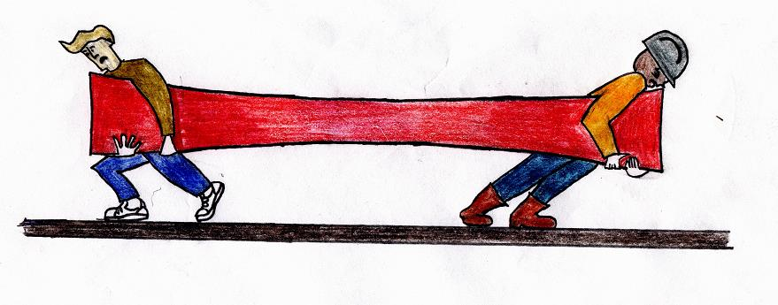
Tensions: Teachers face complex ethical dilemmas and professional tensions every day.
Fairness to some children vs autonomy of others
Truth to be honest with others & self vs responsible care for individuals & differences
Teacher as a parent vs teacher as a teacher
Cultural differences – between centre & home
Staff not pulling their weight vs team practice
Qualified vs unqualified teachers
Quality teaching vs funding and resources
Teaching vs management of children
Quality experiences for children vs routines of the day
Valuing learning through play (and providing for it) vs valuing formal learning
Creativity vs control/mess

Slide 14
What are some of the ways we communicate in the centre?
Phone
Portfolios
Public notice – noticeboard
Newsletter
Communication book – for whanau and/or for staff
Routine charts, accident charts, planning records
E-portfolios
Whānau nights

Slide 15
The basics of communication
Encoding: A person will select appropriate words or non-verbal techniques to convert the idea into the message, which is called as encoding.
Decoding: The act of interpreting message by the receiver, is termed as decoding. The receiver’s outlook, experience, and attitude play a vital role in decoding message.
Feedback: The process of communication can never be completed, if the response of the receiver is missing. It enables the communicator of a message to know whether the message has been received and interpreted in the same manner as directed.

Slide 16
Your way of ethical communication with whānau (class korero)
Find ethical ways to communicate the following to parents/whānau:
Their child has hit another child and it resulted in bleeding
Their child has gone outside and wet his/her feet and sandals, despite you hearing parents in the morning telling him/her not to go outside as ‘it’s too cold’.
Their child accidentally ate lunch of another child.

Slide 17
Policies
What are they for?

Slide 18
Policies…
Policies identify agreed processes and procedures that ensure:
key legislative requirements are met;
those involved in the service have a shared understanding of agreed processes and procedures so that these are consistent, safe and appropriate; and
those involved in the service have the opportunity to discuss policy and suggest change through regular review processes.
(See regulation 47, criterion GMA4).
https://www.education.govt.nz/early-childhood/running-a-service/starting-a-service/starting-a-centre-based-ece-service/new-cd-page/

Slide 19
Developing a policy
Title of the policy
Why do we need this policy?
What do we want to achieve with this policy – our objective?
How will the policy work?
The date we agreed on this policy and the date it will next be reviewed
Who authorised this policy (signed and dated)

Slide 20
Reflective patai
To what extent are trust-based relationships enabling open communication, challenging professional conversations, and risk taking?
What role is your service taking in sharing information about Te Whāriki and how it informs your curriculum?

Slide 21
When developing policies…
Wherever possible, develop policies before you need them and be prepared to introduce new policies and procedures when the need for this arises. Consultation with staff and parents will help to ensure your policies and procedures are robust and realistic for implementation on a daily basis.
https://www.education.govt.nz/early-childhood/running-a-service/starting-a-service/starting-a-centre-based-ece-service/new-cd-page/

Slide 22
What do policies include?
a rationale (a reason for having the policy)
objectives (what you hope to achieve through the policy)
procedures that clearly describe the actual practices that will occur
how the policy will be implemented
when the policy should be implemented
who is responsible for its implementation
when the policy is planned to be reviewed.
If your policy is not working well, consult with staff, contractors and families and change it! The content of your policies belongs to your service.

Slide 23
Reflective patai
What is the role of consultation with stakeholders? Why is this important?

Slide 24
Consultation starts with effective communication
Communicate effectively with the larger ECE community, whānau and other groups. This may be groups with different values and concerns. The process of consultation allows us to take on board feedback and can increase community understanding of the centre and ensure consistency in expectations between, whānau,

Slide 25
consultation
Consultation, by definition is when the decision-makers seek the views of others. The decision on what to include in a policy statement is for the decision-maker to make. The decision-maker has a right to accept, or not, the product of any consultation. Consultation does not mean to seek agreement or consensus. It means that groups affected by a policy have had their views considered. The typical steps in carrying out consultation are:
Decide who is to be consulted
Advise those to be consulted of the issues being considered
Invite ideas, suggestions, and feedback
Provide an opportunity for direct discussion and clarification
Allow a reasonable period of time for response
Consider all responses (ECC, 2009)
https://www.ecc.org.nz/Folder?Action=View%20File&Folder_id=84&File=PolicyHandbook_Oct09.pdf

Slide 26
class korero
1. A whānau comes to your centre to enrol their tamaiti. What is your centre policy regarding enrolments? How do you introduce it to the new whānau?
2. A whānau is not happy with their tamaiti settling into your centre. What is your centre policy regarding this? How can you reassure them and involve them positively in the solution?
3. The staff in your centre are having difficulty connecting with whānau to get feedback regarding policy review. What can you do to encourage positive communication?
4. You have been asking for information about the children in your centre. It is hard work. Think of some strategies that you might use to encourage whānau to share.
5. Your centre is reviewing the child protection policy. What strategies will you apply to consult with the centre whānau for feedback to inform the process?

Slide 27
Patai?
?

Slide 28
Karakia whakamutunga
Kia tau tō rangimārie
Ki runga I ngā iwi o te ao
Let your peace reign
On all the people of the world

Slide 29
references
Clutterbuck, D. (2011). Coaching the Team at Work, Nicholas Brealey Publishing.
Gambhir, R., Joubert, S., Laporte, P., McFarland, A., Oosten, M., & Vrooman, H. (2017). Learning communication & teamwork. Classroom Complete Press.
Snook, I. (2003). The ethical teacher. Dulmore Press.

