Slide 1
Overview
Live on 23rd July 2018

Slide 2
What is happening?
All classes currently entered into the timetabling system and PeopleSoft will be interfaced to the SEAtS application. Students will be able to register for these classes using the SEAtS app on their phone.
However, classes that are not timetabled will need to continue to use the existing process of paper registers which are created from PeopleSoft. Attendance data is entered into PeopleSoft at a later time.
Class Attendance Register Data Entry will be completed by teaching staff on all classes:
Teaching staff record attendance for all scheduled classes using SEAtS
Teaching staff enter data only for non-scheduled classes using PeopleSoft
Why?
Students are able to use an app to Check In themselves, so assisting Unitec in tracking their attendance.
Unitec is better able to react to unlikely to succeed students due to low attendance & guide Student Success.
Students will be able to check their attendance history.
We can report on attendance which is required for auditing purposes.

Slide 3
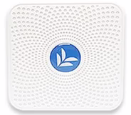
Student Experience
Students Register on SEAtS website, which sends a security code sms to their phone. This does 2 things, identifies them as a Unitec Student and links their phone to be used to record attendance.
Students Download the SEAtS app and enter the security code.
When student walks into a classroom, students (with Bluetooth activated), can open app and use a Check In button on their timetable, 10 minutes before class start or during the session. The app finds the iBeacon in the room and the student selects the icon to complete Check In.
The Student can view attendance records.
Note: Students without a smart device or with connection problems can be added by teaching staff as present. Students in Mataaho will use their RFID cards.

Slide 4
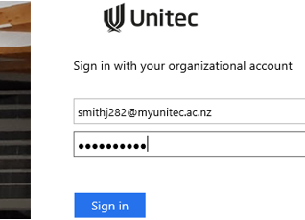
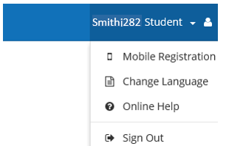
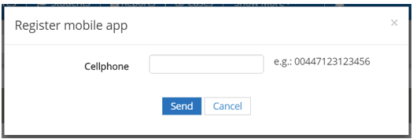
Student Registering Views
Step 1: Register on SEAtS website using your mobile device or PC. https://attendance.unitec.ac.nz
Login using your Unitec Student Email and Password.
On SEAtS website, select your name (top right) and Mobile Registration.
Enter your mobile number with area codes as shown and press Send.
When you have received your security code via SMS, you can sign out of website.

Slide 5
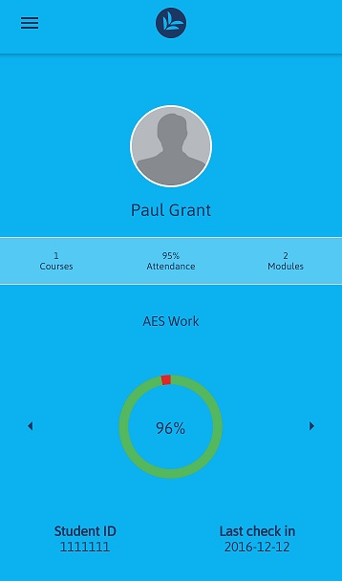
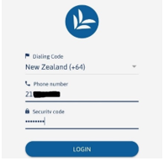
Student App Views
Search for Seats Mobile in iTunes (Apple) or Play Store (Android)
Install, then open.
Important: Never log out of the app. Verification is required on every login unless you retain their first code.

Slide 6
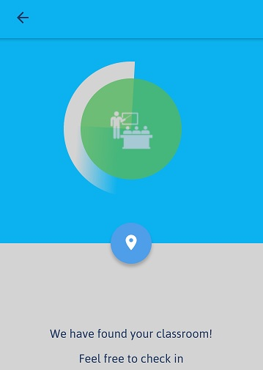
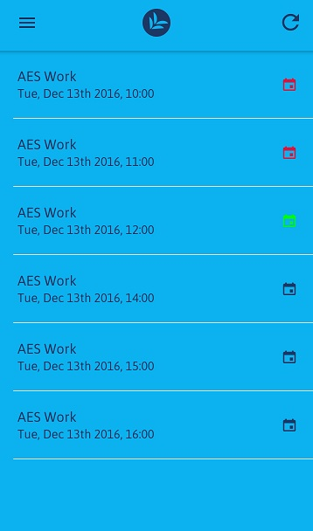
Checking in using the app for Students
Use the Check In button – 10 minutes before class and during class.
Select iBeacon icon when found in app.
Check attendance
Not attended
Attended
Check-in later

Slide 7
Teaching Staff Overview
Click icon on Desktop to open SEAtS website.
Link to Help on The Nest will be available under quick link Staff Portal (this will have link to SEAtS and PeopleSoft Entry). Future delivery. Moodle has Attendance Tracking help on front page.
Sign in using your Unitec login.
Locate the class, click Classes at top left, then find by Date and Time. Select from the list. Click Scheduled to see the list of your students.
Encourage students to use the app, run through the process for them in first session. Second session will be easier that way.
Check attendance record is correct and change if required.
Add students in the room to Attended, if they are unable to Check In.
Important to Cancel Class in SEAtS if class was cancelled.

Slide 8
Standard view of Class page (left screen side)
Here will also show student panels depending what is selected on the right side of the page (see next slide)

Slide 9
Standard view of Class page (right side)
Room Actions include:
Move Rooms – this is if the class has to move on the day due to relocating to another room. It does not involve permanent room changes which must be handled by Timetabling Office.
Cancel Class – this needs to be completed if class did not run.
Swap Rooms – Same as Move Rooms, but swapping with another timetabled class with mutual agreement. Only on the day.
Enrolled Students not Checked In yet
Automatic at end of class or moved by teaching staff
Via the app (Student) or moved by teaching staff
Absent but with good reason classed as acceptable for attendance eg: Assessment
Moved by teaching staff

Slide 10
Teaching Staff action with Screenshots
Select Classes (Top Left)
Search for Date and Time
Optional use the Search field at right to define further.
you can select by any fields visible in search results for example:
Location (115-3016), Course (8885) or lecturer name (if appearing).
Select your class from the list.

Slide 11
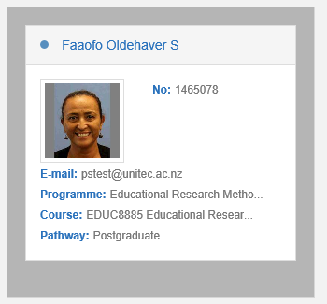
Teaching Staff action with Screenshots
Select Scheduled to see expected Students.
Photos will appear if available.
To see Students who have already Checked In, Select
To move a student from Scheduled to Attending, highlight their panel
then select Attending at top left.
Tip: All moves are completed this way.
10 minutes before the end of the class scheduled finish time, students not Checked In will automatically move to Absent. You can move them to Attending.

Slide 12
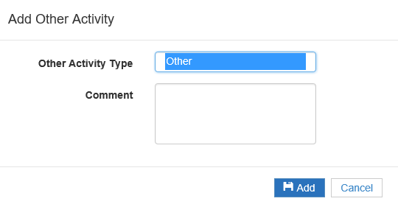
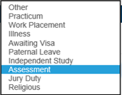
Further options for Absent Students
If a student is Absent with good reason, you can indicate this in SEAtS.
Highlight a Student in the Absent list and use the Absence Reason button to select an option.
If the reason is Illness they will remain in Absent. Others will move Student to Unscheduled attendance.

Slide 13
PeopleSoft Class Register Printing
The Attendance Tracking Office (ATO) is no longer printing any registers as at 23rd July 2018 – Semester 2 start.
All non-timetabled classes will be able to print the class register.
Timetabled class registers can be printed for now, but this is only short term and will be deactivated in the future. Only for transition period.
Non-timetabled classes can be added directly into PeopleSoft and for this reason you have the option to not print and update live.

Slide 14
Printing Class Registers in PeopleSoft
On the Unitec Attendance HomePage, fill out the Class Attendance Register Print information, use the look ups to help. Click Get Register(s)
This is currently being finalised and will appear here soon.

Slide 15
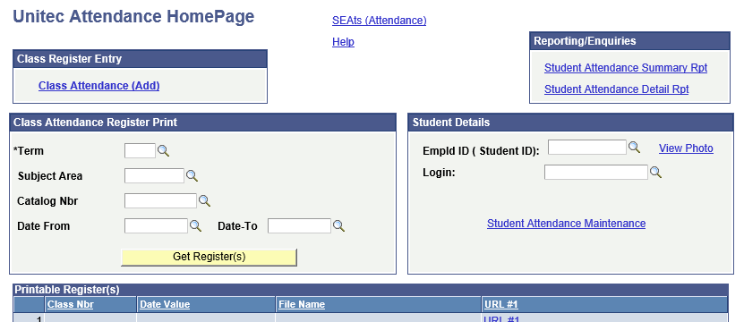
PeopleSoft Entry only for non timetabled
Login into PeopleSoft Campus Solutions, The Nest, quick links, Staff Portal, PeopleSoft CS
Navigate to SEAts (Attendance Tracking), Attendance Homepage.

Slide 16
Class Register Entry
Select Class Attendance (Add) link (opens in a new tab).
Fill in Term, Class Nbr, Class Mtg Date and Class Time
PeopleSoft will look up and display list of students. Click the headings to sort by First Name or alternative sorting.
You have 2 options:
If the majority of your class has arrived: Click Select All Present then deselect those not present.
If few students have arrived or marking as they arrive. Just tick.
If you have been notified of absence prior, then update those fields. For both options click Save button to retain.

Slide 17
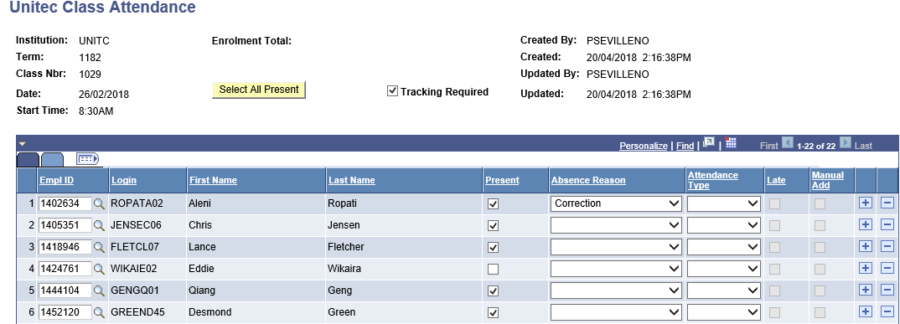
Add a New Attendance record
Fill in Term, Class Nbr, Class Mtg Date and Class Time and click Add.
Tip: Current semester is 1182 or use the look up icon.
Use the Select All Present and deselect, or tick as required.
Save.

Slide 18
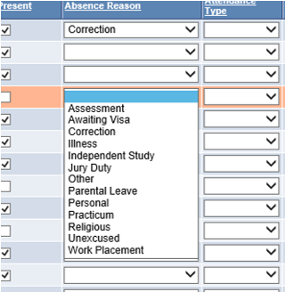
Additional Features for Attendance
Use the drop down under Absence Reason to select a reason.
Optional is selecting a Attendance Type for Field Trips or Study time.
Marking Late.
Manual Add, if student is not on the list, but did attend. Use the plus at end of the row.
Look up using their Student ID number (Empl ID in PeopleSoft).

