Slide 1
ELECTRICAL ACTS, REGULATIONS & STANDARDS Introduction

Slide 2
Acts, Regulations & Standards for Electrical Workers
Acts that are important to the work of registered electrical workers
Consumer Guarantees Act,
Building Act,
Electricity Act,
Health and Safety at Work Act,
Industry Training and Apprenticeships Act

Slide 3
Acts, Regulations & Standards for Electrical Workers
Regulations
that are important to the work of registered electrical workers
Building Act associated regulations,
Electricity (Safety) Regulations

Slide 4
Acts, Regulations & Standards for Electrical Workers
Key Standards that are important to electrical workers
AS/NZS 3000
(known as the Australian/New Zealand Wiring Rules)
Part 1. Scope, application and fundamental principles - (Section 1)
Part 2 Installation practices— (Sections 2 to 8)
PROTECTION
SELECTION AND INSTALLATION OF WIRING SYSTEMS
SELECTION AND INSTALLATION OF APPLIANCES AND ACCESSORIES
EARTHING
DAMP SITUATIONS
SPECIAL ELECTRICAL INSTALLATIONS
VERIFICATION & TESTING

Slide 5
Acts, Regulations & Standards for Electrical Workers
Key Standards that are important to electrical workers
AS/NZS 3760 - In-service safety inspection and testing of electrical equipment
SECTION 1 – SCOPE AND GENERAL
Definitions
SECTION 2 – INSPECTION AND TESTS
Frequency of inspection and tests
Documentation

Slide 6
Acts, Regulations & Standards for Electrical Workers
Key Standards that are important to electrical workers
AS/NZS 3017 Electrical Installations – Verification Guidelines
SECTION 1 SCOPE AND GENERAL
Including Definitions
SECTION 2 VISUAL INSPECTION
SECTION 3 TESTS
3.1 Earth continuity and resistance
3.2 Insulation resistance
3.7 Operation of residual current devices (RCDs)

Slide 7
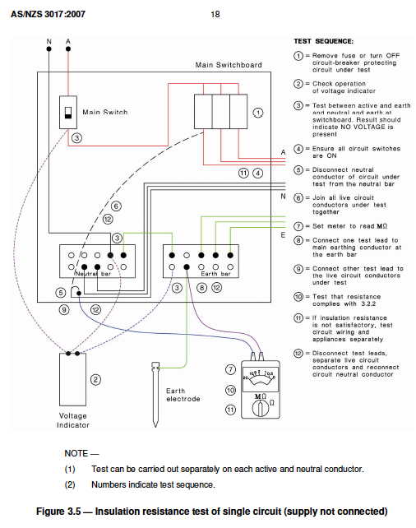

Slide 8
Acts, Regulations & Standards for Electrical Workers
Key Standards that are important to electrical workers
AS/NZS 4836 Safe working on or near low-voltage electrical installations and equipment
SECTION 1 SCOPE AND GENERAL
Including Definitions

Slide 9
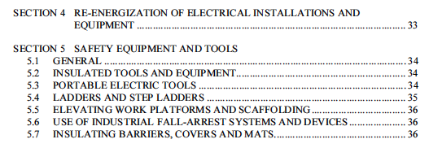
Acts, Regulations & Standards for Electrical Workers
Key Standards that are important to electrical workers
AS/NZS 4836 Safe working on or near low-voltage electrical installations and equipment

Slide 10
Acts, Regulations & Standards for Electrical Workers
Key Standards that are important to electrical workers
AS/NZS 4836 Safe working on or near low-voltage electrical installations and equipment

Slide 11
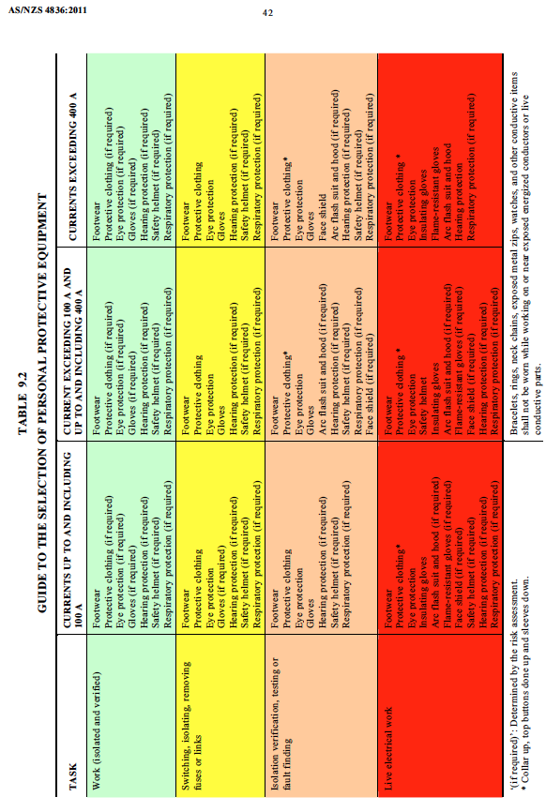
Acts, Regulations & Standards for Electrical Workers

Slide 12
Acts, Regulations & Standards for Electrical Workers
Organisations impacting on the work of registered electrical workers.
EWRB, Electrical Workers Registration Board
ERAC, Electrical Regulatory Authorities Council
Ministry of Business, Innovation and Employment,
The Skills Organisation,
Work Safe New Zealand,
Electrical supply companies (energy suppliers),
Electrical industry associations.

Slide 13
Acts, Regulations & Standards for Electrical Workers
Organisations impacting on the work of registered electrical workers.
Electrical industry associations.
Master Electricians (aka ECANZ)
The professional trade organisation for electrical contracting businesses in New Zealand.
Electricity Engineers' Association (EEA)
Provides the New Zealand electricity supply industry with expertise, advice and information on technical, engineering and safety issues affecting the electricity industry.

