Slide 1
CIBC 5022 Preliminary and General
The Code of Estimating Practice published by the Chartered Institute of Building (CIOB) describes preliminaries as'...the cost of administering a project and providing general plant, site staff, facilities, and site based services and other items not included in the rates.'

Slide 2
Preliminaries in construction
Preliminaries (or 'prelims') may appear in tender documents, providing a description of a project that allows the contractor to assess costs which, whilst they do not form a part of any of the package of works required by the contract, are required by the method and circumstances of the works.

Slide 3
Preliminaries in construction
It has become increasingly the practice in the U.K. for substantial projects to be let on a "measured contract" basis, with bills of quantities describing in detail every item of the works to be done forming part of the contract documents. 75
Bills of quantities normally devote a separate bill to each trade necessary for the erection of a building or the construction of works. For instance, there are usually separate bills for excavation work, for concreting, bricklaying, joinery, paving, tiling, ironmongery, painting, and so on. Generally, also, there is a bill for what are called preliminary items such as general foreman, site huts, insurances, special liabilities under the contract, water, and other items which are applicable to all trades. Preliminary items frequently give rise to difficulty when valuing variations.

Slide 4
Preliminaries in construction

Slide 5
Preliminaries in construction

Slide 6
Preliminaries in construction

Slide 7
Preliminaries in construction

Slide 8
Preliminaries in construction

Slide 9
Preliminaries in construction
P & G’s are defined as those expenses which are incurred before work in producing the project deliverable commences, together with those costs that are non-specific to a particular Bill or Activity list item. P&G cost therefore represents those costs which cannot be reasonably allocated to any specific identified activity on a project. In this regard the international Webster comprehensive dictionary defines the word preliminary as “antecedent or introductory to the main business” and defines the word general as “pertaining to including or affecting all of the whole; not local or particular”. The term originates from civil engineering industry where those costs which are not attributable to a specific bill of quantity item rate or cost were collected under the heading “P & G expenses.”

Slide 10
Preliminaries in construction
The use of the term is generally appropriate where a bill of quantity or an activity level contract value form part of the order or contract to be accepted or placed.
This is because changes in the scope of work, either in terms of increase or decrease, will affect the cost of the activity or bill item only, and the impact on establishment cost and the management of the project will not form part of the price adjustment.
In order therefore to address the cost of changes which are not directly related to a change in the work content of an activity or a change in the quantity of a BOQ item, the Bill or activity listing or BOQ will incorporate an item or a heading called P & G expenses.

Slide 11
Preliminaries in construction
mobilisation cost
insurance cost
finance charges
site establishment
site disestablishment
project management
site management
planning
material control
site offices
head office overhead which in turn can be broken down into: A.rental for premises
accounting
general and senior management
equipment (computers, printer, photocopiers..)
clerical and administrative personnel
quality assurance
quality control
security
payroll administration
secretarial services
data processing services
site QA
site QC
site planning
site contract administration
site quantity survey
site buildings
site equipment (other than small tools)
site craneage
site supervision

Slide 12
Preliminaries in construction
Supervision:
“Day work rates quoted include all other costs associated with such labour, including but not limited to all overhead costs, profit, the cost of tools and equipment, the cost of supervision on site for such labour, the costs for induction, accommodation, transport to site and costs of safety, Protective Gear, and consumables used in the execution of the work carried out at day-work rates”
If adequate levels of supervision are provided for by the Contractor in his quotation, the additional cost of supervision associated with minor scope changes will not affect his overall cost as he would not be bringing additional supervision onto the site to deal with the supervision of such additional work.

Slide 13
Preliminaries in construction
A general summary.
Method statements.
Pre-construction information.
A description of any planning conditions or other conditions that may affect the work to be carried out by the contractor.
A description of any outstanding statutory approvals that may fall to the contractor to satisfy.
Party wall requirements or other agreements with, or rights of, neighbours (such as rights to light).
Any emergency services obligations.
A description of the reporting information that the contractor will be required to submit (often on a monthly basis) describing construction progress (including a detailed critical path programme, key performance indicators and earned value analysis). See Construction progress reports for more information.
A description of the commissioning strategy, separating setting to work and balancing tasks from independent verification by the consultant team.
Relevant reports (such as soil reports).
An information release schedule.
Quality management procedures.
Labour relations.
Schedules of mock-ups, testing and samples required from the contractor.
The method of sub-contracting.
Requirements for insurance, performance bonds, warranties and product guarantees (for the contractor and sub-contractors).
Requirements for the operating and maintenance manual (the client's facilities management team may wish to comment on this).
Requirement for progress photos to be taken on site during construction and off-site during fabrication.
Dates for partial possession.
Collaborative practices.
Building information modelling (BIM) requirement and protocols (including requirement for BIM in sub-contracts).
Site waste management plan.
Contractor's site preliminaries, such as; staff, welfare provisions, site offices, plant, site waste clearance, water, electricity, furniture, ICT and consumables, rates, protection of work, protective clothing, site transport, setting out, building control fees, and so on.

Slide 14
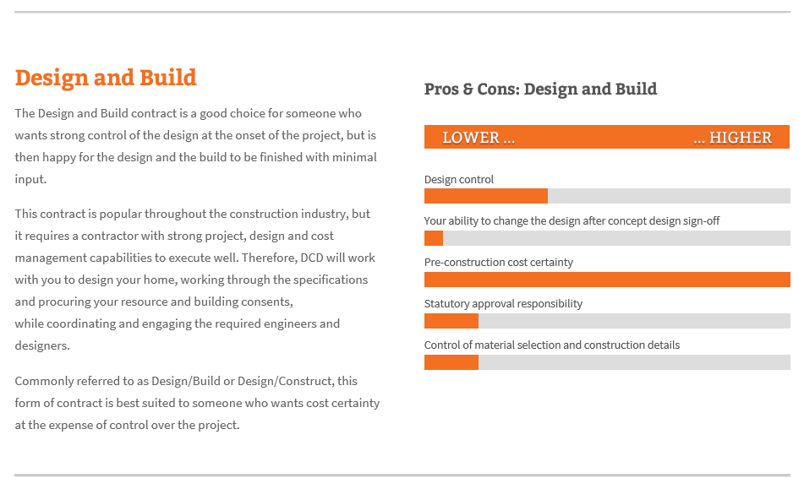
Contract types

Slide 15
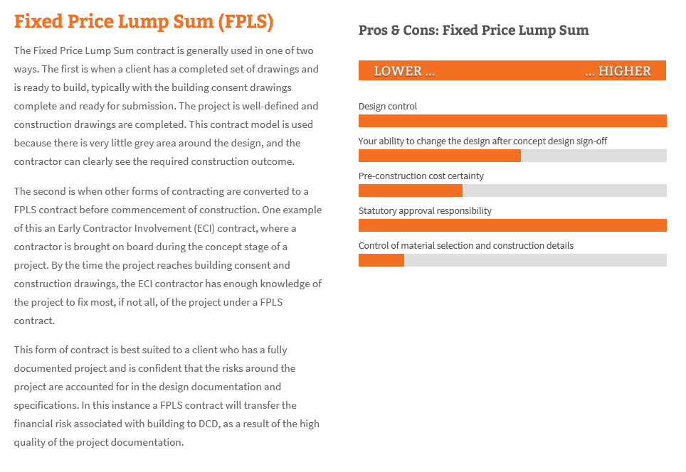
Contract types

Slide 16
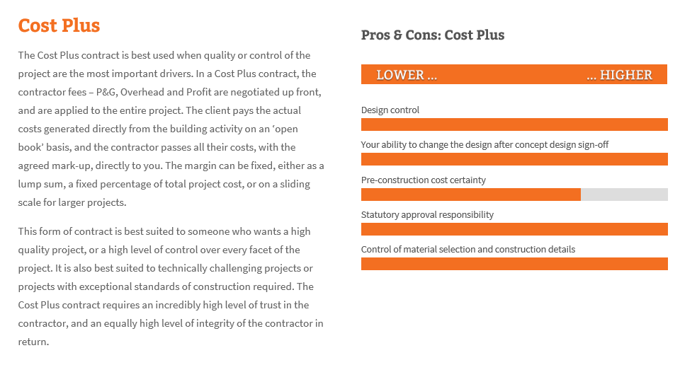
Contract types

Slide 17
Bill of Quantities
The bill of quantities (sometimes referred to as 'BoQ' or 'BQ') is a document prepared by the cost consultant (often a quantity surveyor) that provides project specific measured quantities of the items of work identified by the drawings and specifications in the tender documentation.
The quantities may be measured in number, length, area, volume, weight or time. Preparing a bill of quantities requires that the design is complete and a specification has been prepared.
The bill of quantities is issued to tenderers for them to prepare a price for carrying out the works. The bill of quantities assists tenderers in the calculation of construction costs for their tender, and, as it means all tendering contractors will be pricing the same quantities (rather than taking off quantities from the drawings and specifications themselves), it also provides a fair and accurate system for tendering.
The contractor tenders against the bill of quantities, stating their price for each item. This priced bill of quantities constitutes the tenderer's offer. As the offer is built up of prescribed items, it is possible to compare both the overall price and individual items directly with other tenderers' offers, allowing a detailed assessment of which aspects of a tender may offer good or poor value. This information can assist with tender negotiations.

