Slide 1
ENCE 3006 protection,plans and circuits
Electrical Drawings

Slide 2
Power circuit diagrams
A power circuit diagram shows the power flow sequence of the main power components and conductor connections with the control circuitry omitted. .
As with control circuit diagrams, power circuits may be drawn with horizontal or vertical orientation.

Slide 3
power circuit diagram
The diagram shows a three-phase direct on-line motor starter power circuit in vertical orientation.
Power circuit diagrams show components and conductors in their electrical relationship — not how they are physically laid out as in wiring diagrams.

Slide 4
Wiring diagrams
Wiring diagrams, also known as ‘connection diagrams’ are point-to-point” diagrams showing details of the complete wiring layout. .
The components are shown, as best as possible, in their relative physical positions along with cable connections. Cable sizes, colours, terminating particulars and other details may also be included.
The idea of wiring diagrams is that you can look at it, and even if you don’t necessarily understand how the circuit works, you could wire the equipment successfully by following the diagram.

Slide 5
Wiring diagrams
The diagrams , shows a simple single cooker element wiring diagram.

Slide 6
Single-line diagrams
Single-line (or power system) diagrams use single lines to represent cables and circuits to make the overall layout of complicated installations simple and easy to read..
Single line diagrams are used extensively in the electrical supply industry and switchboard manufacturing industry..
They are useful for gaining an understanding of the overall layout of an installation without the complication of too many details.
They are great for estimating loading, fault finding and other activities that do not need more specific installation details.

Slide 7
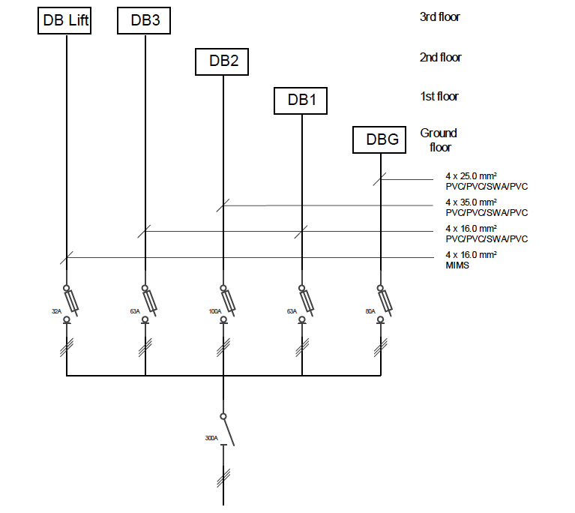
A typical single-line diagram of a three-story building is shown. As you can see, the final sub circuits for each floor are omitted for clarity. If you need more details for the final sub circuits, you would look on the location diagram.

Slide 8
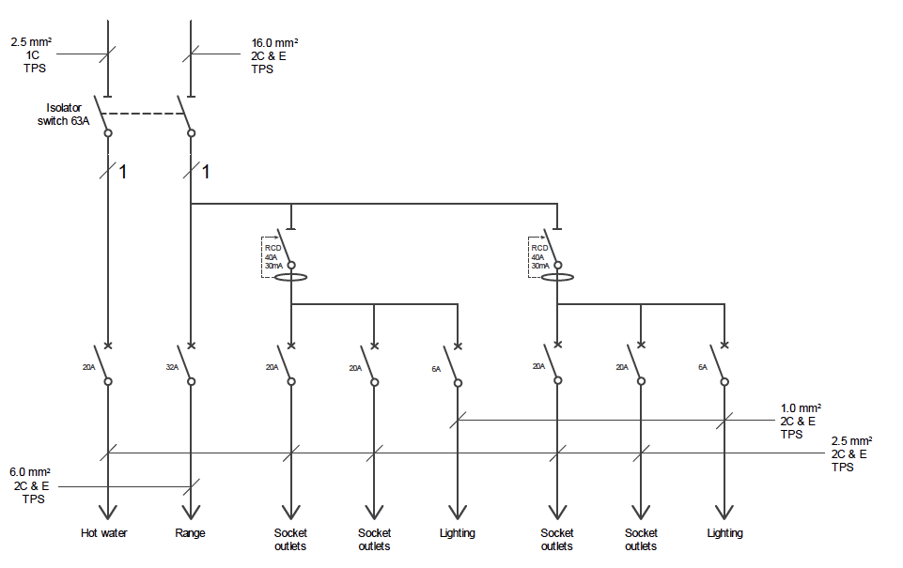
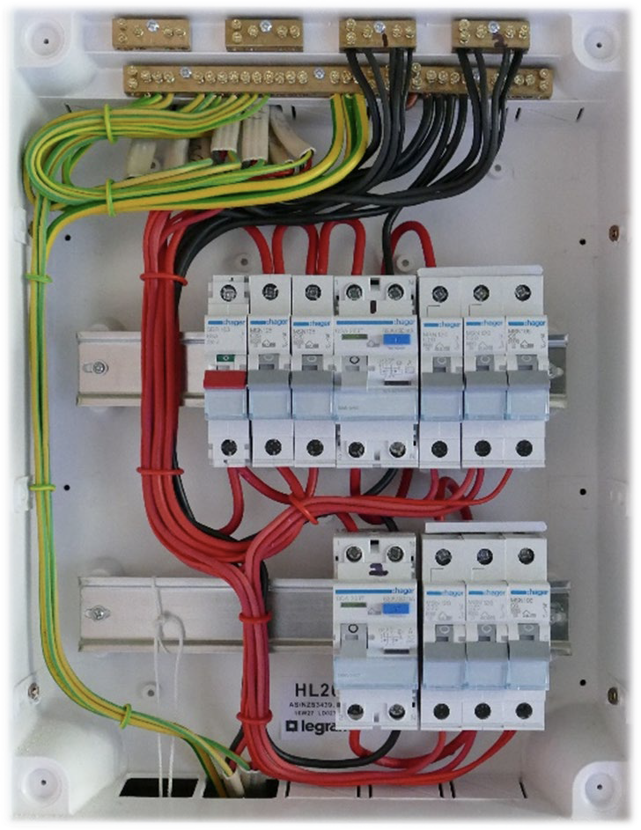
single line drawing
A single line drawing of a domestic distribution board is shown below. It contains enough detail to see the lay out of the distribution board and information about the cable and equipment sizes.

Slide 9
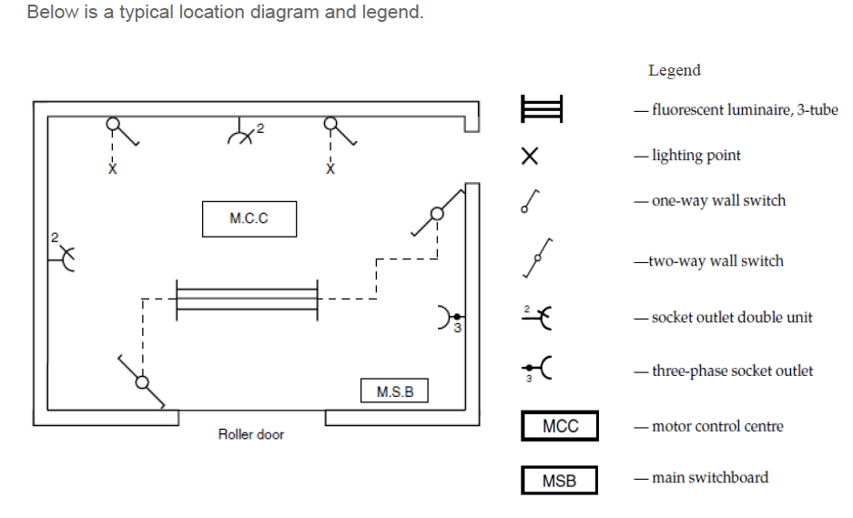
Location diagrams
A location diagram shows the position of electrical equipment such as motors, switchboards, power outlets, telemetry points and lighting, on an architectural plan of a building.
Each item of equipment is briefly described on the plan or on the legend
Most location diagrams include indications of where cables run to or how they are to be run.
These are usually shown as dotted lines that interconnect location symbols

Slide 11
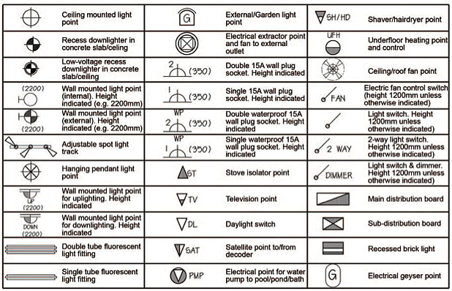
Legend
Without proper drawings and specifications, it becomes extremely difficult to undertake an electrical installation, if not impossible.
In commercial and industrial projects where the electrical installation can be complex, drawings are in most cases provided by the architect or engineer

Slide 12
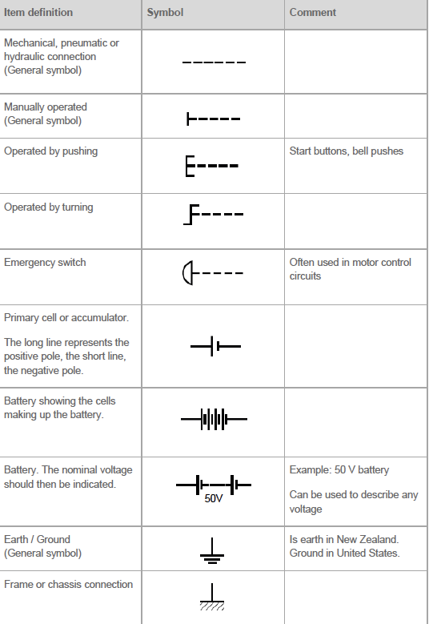
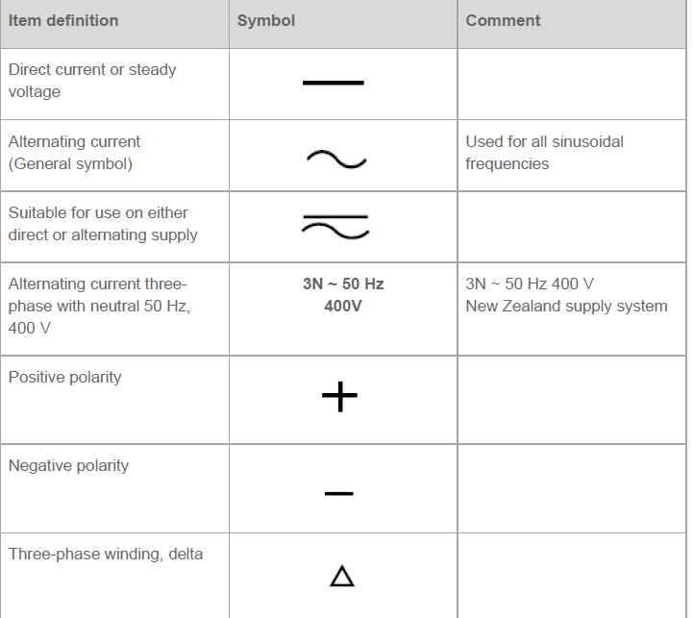

Slide 13
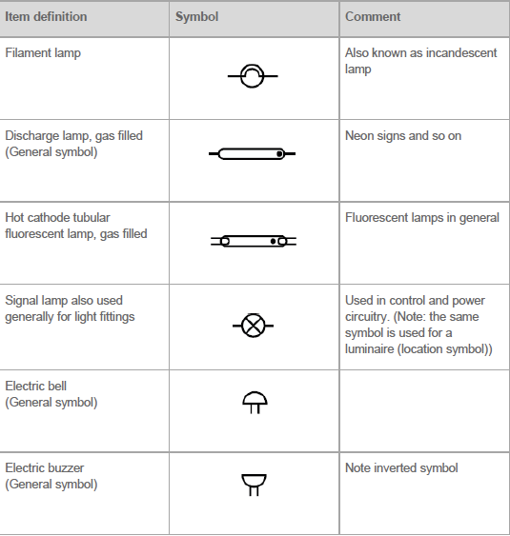
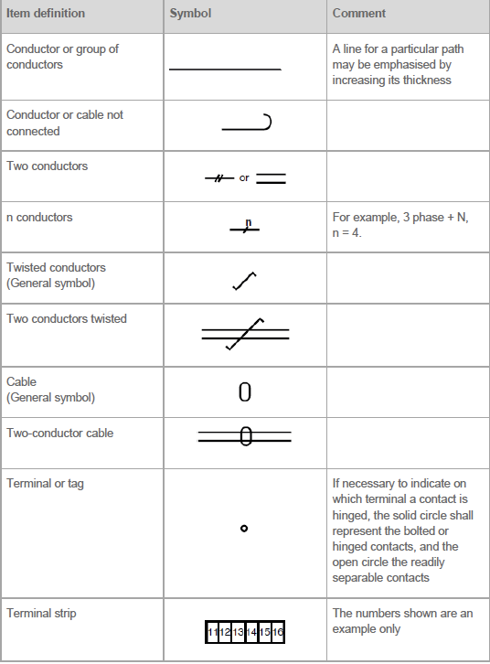

Slide 14
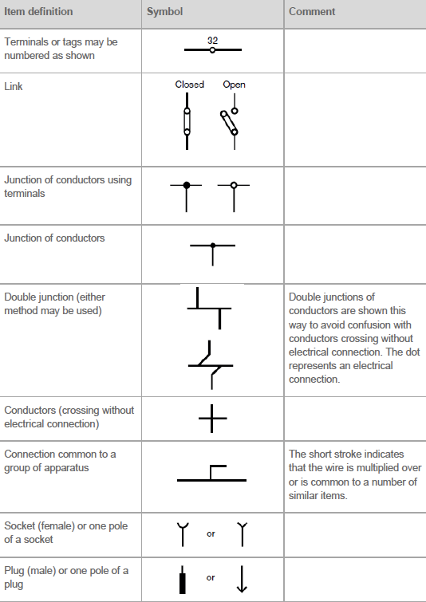
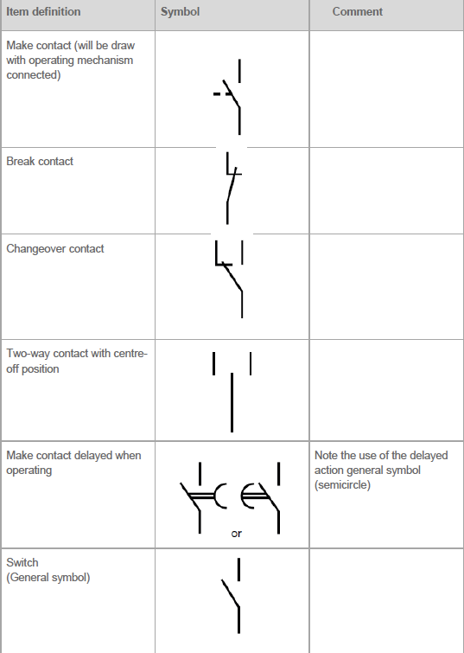

Slide 15
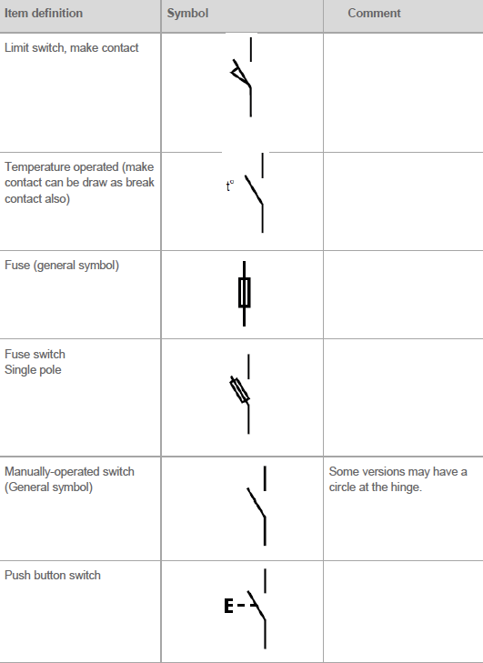
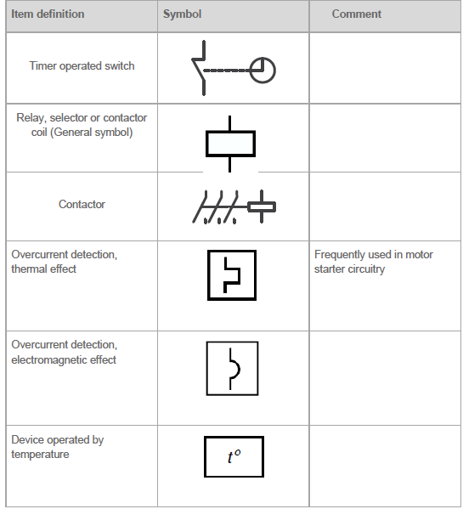

Slide 16
