Slide 1
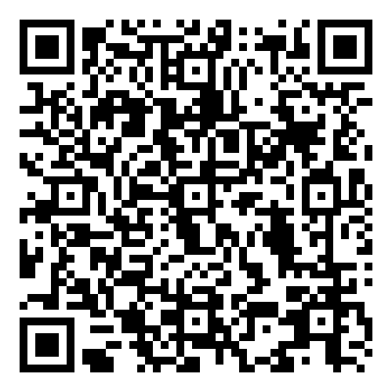
We’re looking for Student Class Reps
Nominate yourself today and get:
An important and recognised addition to your resume / Improve your leadership skillset / Ability
To make significant changes to your education / End of year function.
The deadline to register your details is Friday 8th March. Class reps must attend training – 13th March.
Responsibilities
Elicit feedback from your classmates / Attend meetings /
help resolve issues that may arise in your class
Register Now!

