Slide 1
Gender and equality
A sociopolitical and human rights focus

Slide 2
International frameworks for gender equality

Slide 3
Human rights: Universal or not?
Academic debate on whether human rights are a product of Western civilization or whether these values were present in other cultures before codification in the 1948 Universal Declaration of Human Rights is often intense.
This controversy is especially important when considering how human rights operate in local contexts. Some argue that locally-based human rights notions are more valuable to communities and states than universal ideals (Cobbah 1987;Ake 1987;Woods2003), an idea critiqued by other scholars (Oyowe 2014).
In determining the universality of human rights, conflicting theories exist, with some arguing that each human being is entitled to human rights and others presenting the community as the ultimate litmus test.
The notion of cultural relativism further challenges the understanding that all human beings have the same rights, by arguing, often in the context of women’s human rights that some deviation from accepted standards is acceptable to account for cultural differences among nations(Donnelly 2007).
Ultimately, the true test of human rights as a socio-political movement capable of creating change lies in the understanding of ordinary people of what human rights are and how they could benefit their daily lives (Odinkalu 2000;Farmer 2008).
(References cited in Pavlish, Ateva & Ho, 2017).

Slide 4
UN Sustainable Development Goals

Slide 5
UN Sustainable Development Goals
Gender equality is a key and inalienable aspect of sustainable human development and the achievement of human rights.

Slide 6
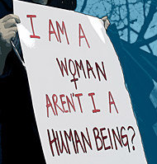
Gender equality as human right
Attaining equality between women and men and eliminating all forms of discrimination against women are fundamental human rights and United Nations values.
Women around the world nevertheless regularly suffer violations of their human rights throughout their lives, and realizing women’s human rights has not always been a priority.
Achieving equality between women and men requires a comprehensive understanding of the ways in which women experience discrimination and are denied equality so as to develop appropriate strategies to eliminate such discrimination.

Slide 7
The development of international rights: United Nations and Human Rights
Since the founding of the United Nations (1945), equality between men and women has been among the most fundamental guarantees of human rights.
In 1948, the Universal Declaration of Human Rights was adopted. It, too, proclaimed the equal entitlements of women and men to the rights contained in it, “without distinction of any kind, such as ... sex, ….” In drafting the Declaration, there was considerable discussion about the use of the term “all men” rather than a gender-neutral term.
The Declaration was eventually adopted using the terms “all human beings” and “everyone” in order to leave no doubt that the Universal Declaration was intended for everyone, men and women alike.

Slide 8
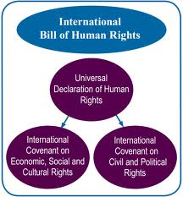
International Bill of Human Rights
After the adoption of the Universal Declaration, the Commission on Human Rights began drafting two human rights treaties,
the International Covenant on Civil and Political Rights and
the International Covenant on Economic, Social and Cultural Rights.
Together with the Universal Declaration, these make up the International Bill of Human Rights.

Slide 9
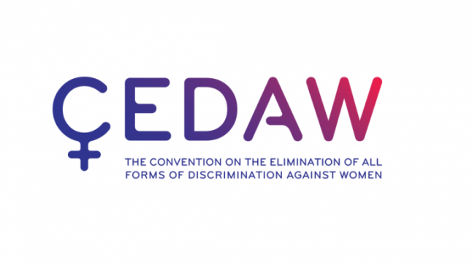
Convention on the Elimination of All Forms of Discrimination against Women
In 1967, United Nations Member States adopted the Declaration on the Elimination of Discrimination against Women,
which states that discrimination against women is an offence against human dignity and calls on States to “abolish existing laws, customs, regulations and practices which are discriminatory against women, and to establish adequate legal protection for equal rights of men and women”.
Less than a year later a proposal for a legally binding treaty on women’s rights was made. The Convention on the Elimination of All Forms of Discrimination against Women was adopted by the General Assembly in 1979. Its preamble explains that, despite the existence of other instruments, women still do not enjoy equal rights with men.

Slide 10
Convention on the Elimination of All Forms of Discrimination against Women
The Convention articulates the nature and meaning of sex-based discrimination, and lays out State obligations to eliminate discrimination and achieve substantive equality. As with all human rights treaties, only States incur obligations through ratification. However, the Convention articulates State obligations to address not only discriminatory laws, but also practices and customs, and discrimination against women by private actors.
With these general principles as an overarching framework, the specific obligations of States to eliminate discrimination against women in political, social, economic and cultural fields are laid out in 16 substantive articles.

Slide 11
Convention on the Elimination of All Forms of Discrimination against Women
The Convention covers both civil and political rights (rights to vote, to participate in public life, to acquire, change or retain one’s nationality, equality before the law and freedom of movement) and economic, social and cultural rights (rights to education, work, health and financial credit).
The Convention also pays specific attention to particular phenomena such as trafficking, to certain groups of women, for instance rural women, and to specific matters where there are special risks to women’s full enjoyment of their human rights, for example marriage and the family.

Slide 12
Convention on the Elimination of All Forms of Discrimination against Women: discrimination
The Convention defines discrimination in its article 1 as “… any distinction, exclusion or restriction made on the basis of sex which has the effect or purpose of impairing or nullifying the recognition, enjoyment or exercise by women, irrespective of their marital status, on a basis of equality of men and women, of human rights and fundamental freedoms in the political, economic, social, cultural, civil or any other field.”
Such discrimination encompasses any difference in treatment on the grounds of sex which:
Intentionally or unintentionally disadvantages women;
Prevents society as a whole from recognizing women’s rights in both the private and the public spheres;
Prevents women from exercising the human rights and fundamental freedoms to which they are entitled.

Slide 13
Convention on the Elimination of All Forms of Discrimination against Women: toward equity
The Convention also specifies the different ways in which State parties are to eliminate discrimination, such as through appropriate legislation prohibiting discrimination, ensuring the legal protection of women’s rights, refraining from discriminatory actions, protecting women against discrimination by any person, organization or enterprise, and modifying or abolishing discriminatory legislation, regulations and penal provisions.

Slide 14
Convention on the Elimination of All Forms of Discrimination against Women: toward equity
The Convention foresees that achieving equality may require positive action on the part of the State to improve the status of women. To accelerate women’s actual equality in all spheres of life, States are permitted to use temporary special measures for as long as inequalities continue to exist.
The Convention thus reaches beyond the narrow concept of formal equality and aims for equality of opportunity and equality of outcome. Temporary special measures are both lawful and necessary to achieve these goals. In principle, these measures should be removed once equal status has been achieved.

Slide 15
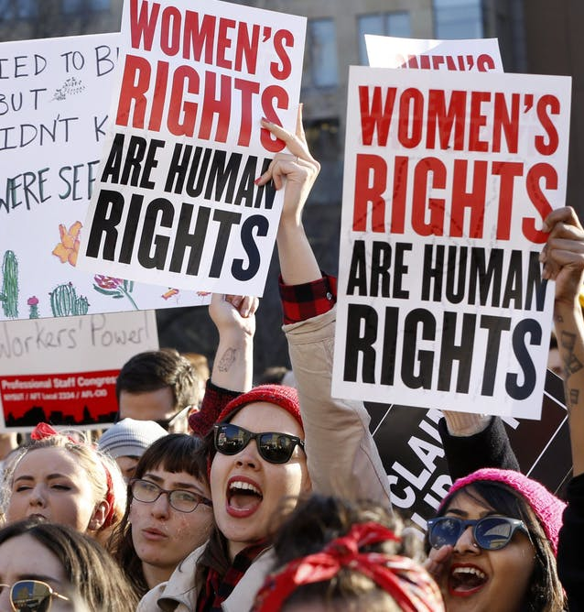
A closer look: United Nations, 2014. Women’s Rights are Human Rights, United Nations Publication
The focus here is on: public and political life, sexual and reproductive health and rights, the right to an adequate standard of living, violence against women, migration, conflict and crisis, and access to justice.
Across all of these, education and the family context are particularly pertinent and are addressed throughout. (United Nations, 2014)

Slide 16
Women’s Rights are Human Rights: education
The right to education is recognized in the International Covenant on Economic, Social and Cultural Rights (art. 13), the Convention on the Rights of the Child (art. 28), the Convention on the Elimination of All Forms of Discrimination against Women (art. 10) and the Convention on the Rights of Persons with Disabilities (art. 24).

Slide 17
Women’s Rights are Human Rights: education
Besides calling for non-discrimination in the enjoyment of the right to education and free universal primary education, human rights law also requires States to address the particular obstacles that girls and women face in accessing education,
such as early marriages,
pregnancies,
child labour
and violence.
The needs of girls suffering from multiple forms of discrimination—e.g., with disabilities, from poor or rural areas and belonging to minority communities—should also be considered.
Ensuring equality in education requires financial resources as well as continued awareness-raising about the importance of girls’ education.

Slide 18
Women’s Rights are Human Rights: marriage and family life
The right to equality between men and women in marriage and family life is also recognized in various human rights instruments, including the Universal Declaration of Human Rights, the International Covenant on Civil and Political Rights, the Convention on the Elimination of All Forms of Discrimination against Women, the Convention on the Nationality of Married Women, and the Convention on Consent to Marriage, Minimum Age for Marriage and Registration of Marriages.

Slide 19
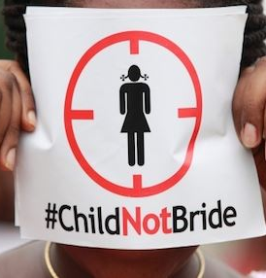
Women’s Rights are Human Rights: marriage and family life
Women nevertheless lag behind men in the enjoyment of rights related to the private sphere.
In many countries, women are forced to enter marriage,
they do not enjoy the same rights with regard to guardianship and adoption, they are not allowed to transfer their nationality to their children and husbands, and they do not have equal legal capacity.

Slide 20
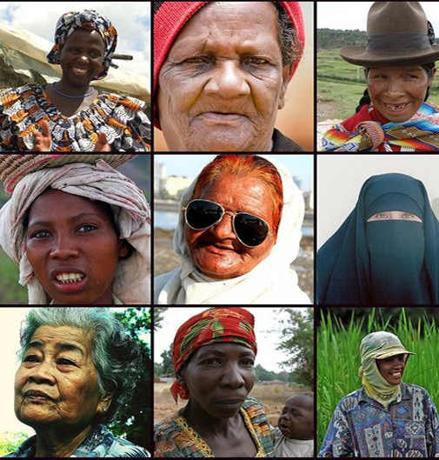
Women’s Rights are Human Rights: marriage and family life
The Convention on the Elimination of All Forms of Discrimination against Women requires State parties to take “all appropriate measures to eliminate discrimination against women in all matters relating to marriage and family relations” (art. 16).
In its general recommendation No. 21 (1994) on equality in marriage and family relations, the Committee on the Elimination of Discrimination against Women called on States to resolutely discourage any notions of inequality of women and men in the private sphere which are affirmed by law, religion or custom.

Slide 21
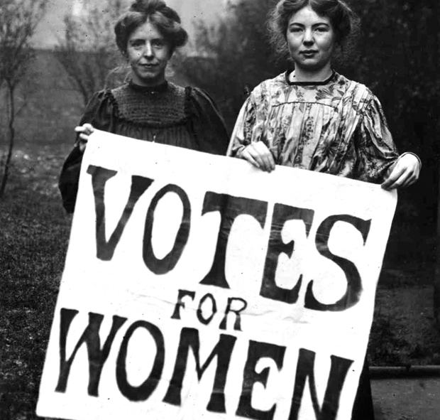
Women’s Rights are Human Rights: Women’s rights in public and political life
Historically, women have been excluded from political life and decision-making processes. Women’s campaigns for participation in the public and political arena date back to the nineteenth and twentieth centuries and continue today.
At the time of the First World War, few parliamentary democracies recognized women’s right to vote. In 1945, when the United Nations was established, more than half of the 51 nations that ratified the Charter still did not allow women to vote or gave them only restricted voting rights.

Slide 22
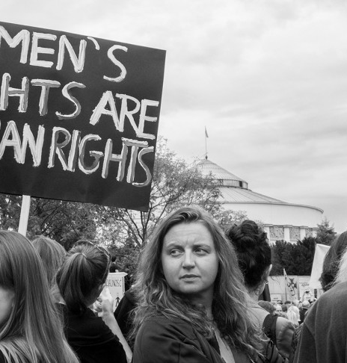
Women’s Rights are Human Rights: Women’s rights in public and political life
Although women’s right to vote has been secured in nearly every country of the world, in practice, the right to vote can sometimes be meaningless when other conditions make it virtually impossible or very difficult for both men and women to vote, such as the absence of free and fair elections, violations of freedom of expression, or lack of security, which tends to affect women disproportionally.
In some countries, women cannot register to vote because they are missing a birth certificate or identity papers that are issued only to men. Other obstacles such as stereotyping and traditional perceptions of men’s and women’s roles in society, as well as lack of access to relevant information and resources, also inhibit women’s possibilities or willingness to exercise their right to vote fully.

Slide 23
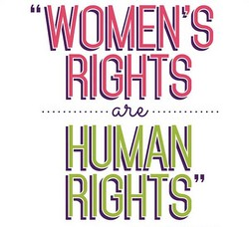
Women’s Rights are Human Rights: Women’s rights in public and political life
Traditional working patterns of many political parties and government structures continue to be barriers to women’s participation in public life, and women may be discouraged from seeking political office because of their double burden of work and the high cost of seeking and holding public office, in addition to discriminatory attitudes and practices.
Among the countries that have ratified the Convention on the Elimination of All Forms of Discrimination against Women few have a legal bar to the eligibility of women, yet women remain seriously underrepresented at all levels of government.

Slide 24
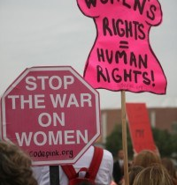
Women’s Rights are Human Rights: Women’s rights in public and political life
Participation in public life is, however, much broader than elections or being elected to public office.
According to the Committee, the political and public life of a country is a broad concept, and can refer to the exercise of political power, in particular legislative, judicial, executive and administrative powers, all aspects of public administration and the formulation and implementation of policy at the international, national, regional and local levels.
Women’s right to participation also includes participating in civil society, public boards, local councils and the activities of political parties, trade unions, professional or industry associations, women’s organizations, community-based organizations and other organizations concerned with public and political life

Slide 25
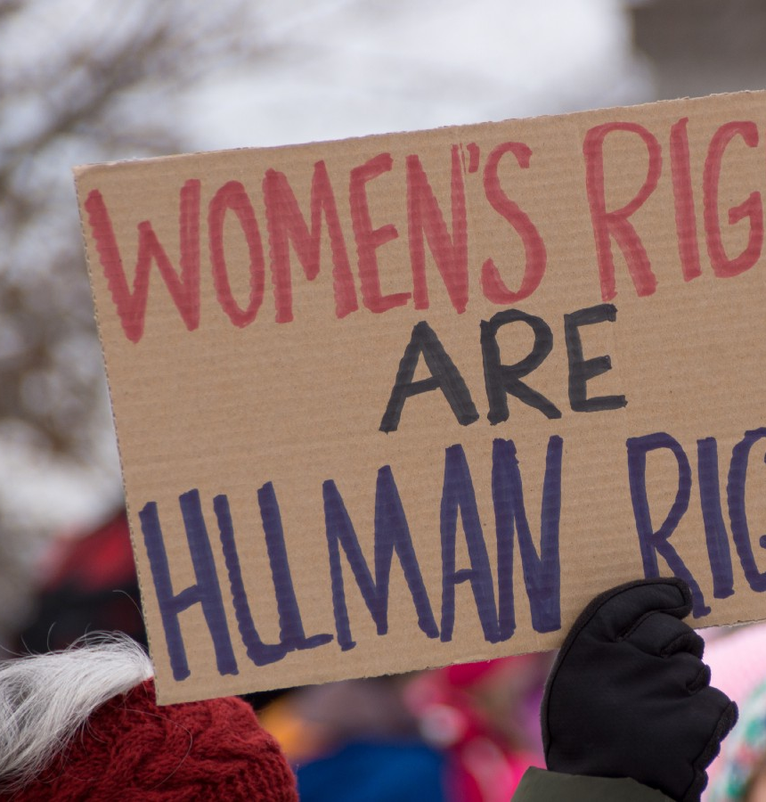
Women’s Rights are Human Rights: Violence against women
Since the beginning of the 1990s, violence against women has gained much attention in the human rights discourse.
However, it took a long and persistent struggle by the women’s rights movement to persuade the international community to discuss violence against women as a human rights concern and recognize that gender-based violence is a serious violation of human rights of global importance which poses a threat to human development as well as international peace and security.

Slide 26
Women’s Rights are Human Rights: Violence against women
The agenda for the 1993 World Conference on Human Rights held in Vienna did not originally mention women or any gender aspects of human rights.
It was the women’s rights movement that brought attention to the issue of violence against women during the Conference, leading inter alia to the recognition, in the Vienna Declaration, of the elimination of violence against women in public and private life as a human rights obligation.
Subsequently, the General Assembly adopted the Declaration on the Elimination of Violence against Women in December 1993. This was the first international instrument to specifically address this issue. It recognizes that violence against women constitutes a violation of the rights and fundamental freedoms of women and a manifestation of historically unequal power relations between men and women.

Slide 27
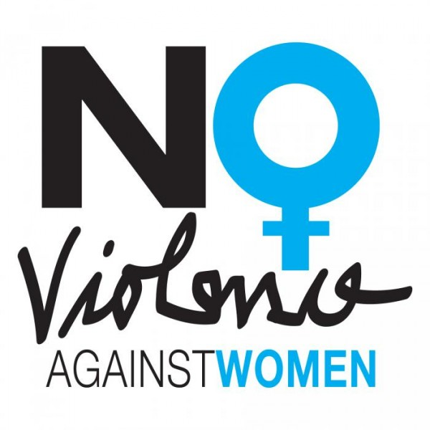
Women’s Rights are Human Rights: Violence against women
The Declaration on the Elimination of Violence against Women defines “violence against women” as “any act of gender-based violence that results in, or is likely to result in, physical, sexual or psychological harm or suffering to women, including threats of such acts, coercion or arbitrary deprivation of liberty, whether occurring in public or in private life.”

Slide 28
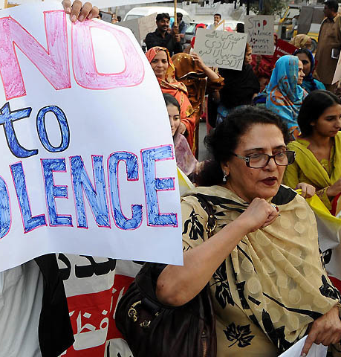
Women’s Rights are Human Rights: Violence against women
Women in all countries, irrespective of status, class, age, caste or religion, experience violence in virtually all spheres of life, whether in the home, at work, on the street, in government institutions, or in times of conflict or crisis. Violence is also present throughout the lifetime of a woman, affecting girls and older women too.
Specific groups of women suffering from various forms of discrimination, such as women with disabilities or migrant women, lesbian, bisexual and transgender women, are particularly vulnerable to violence.
Understanding that violence against women is a manifestation of historically unequal power relations between men and women, a human rights analysis posits that the specific causes of such violence and the factors that increase the risk of its occurrence are grounded in the broader context of systemic gender-based discrimination against women and other forms of subordination.
Vulnerability to violence is understood as a condition created by the absence or denial of rights.

Slide 29
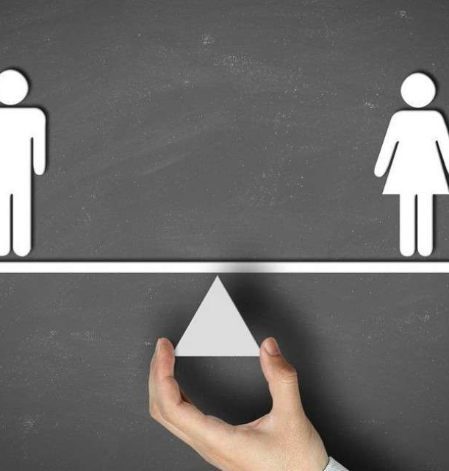
Gender Equality: Basic principles
Rights: people of all genders should have the same rights, and be equal before the law. These are articulated in international law (Convention to Eliminate All Forms of Discrimination Against Women; Bill of Rights)
Opportunities: address issues that hinder all genders from having equal opportunities. Same opportunities to access employment, resources, knowledge, information and services.
Value: contribution of all genders should be valued. These contributions include (paid and unpaid) of non-monetized or immaterial resources such as time, care, skills, and knowledge.
Situation and outcome: Until real choices are available to the majority of the population, differences in outcome and situation between men and women need to be interpreted as a signal of unequal opportunities, rights, and value.
Agency: we also need to stress that gender equality is something that men and women can claim through their actions and voice.

Slide 30
Gender equality does not mean ‘same-ness’: is sometimes misleading to think it means that people of all genders are “identical.”
Just as differences in age, culture, religion, race, and experience contribute to the diversity of our societies and communities, differences between genders are a vital contribution to this diversity.
Intersectionality: most of these differences concern the social and cultural positions and values we assign to each gender in our society.
We need to analyze the causes and effects of these differences to see whether they are related to any inequalities in rights, opportunities, value, or outcome.
Gender inequality works like a spiral whereby inequality in one place gives momentum to inequalities in other places. These instances of inequality overlap and reinforce each other, creating a tangled web that is difficult to unravel.
Existing inequalities, if unchecked, lead to further inequalities. This is why addressing gender inequality is very challenging, and why it requires a multi-pronged approach.

Slide 31
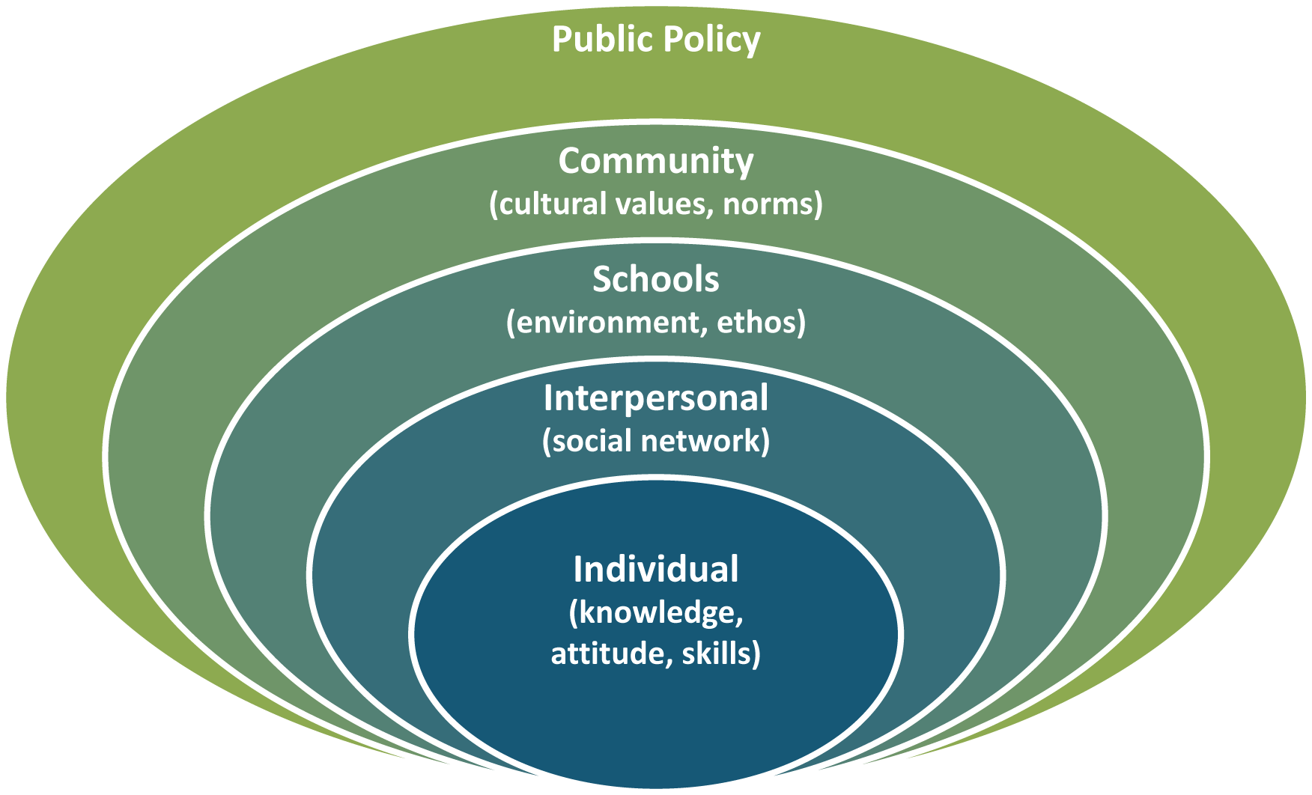
Protective Factors
Risk Factors
Norms, values and attitudes, laws and policies, and our institutional practices all reinforce one another in a manner that creates and sustains gender inequality. Because this results in a gender-based power structure, gender inequality continues to flourish even if we, as individuals,
oppose it in theory.
Notes:
List some risk and protective factors

Slide 32
Some gender related issues
‘Double burden’ – earning household income in addition to caring for children and other family members
Lack of access to higher levels of government
Unequal pay and employment opportunities
Social exclusion and marginalisation
Unequal access to education and health care
Gender-based violence
Economic status
Race and ethnicity
Physical and mental disability
Environmental degradation
“Gender equality” is not a one-dimensional phenomenon. It is rather a complex constellation of rights, opportunities, value, situation, and agency. Each of these aspects is intimately connected to the others.

Slide 33
Attitudes on gender in Aotearoa NZ
Gender Equal NZ, led by the National Council of Women, ran a Gender Attitudes Survey with Research NZ in late 2017.
The survey tested attitudes around gender roles – in the household, at school, at work and in the community and has given us a snapshot of where we’re at in New Zealand on gender.
The good news is most New Zealanders recognise gender equality is a fundamental right for all of us. But we are seeing a pocket of New Zealanders that hold outdated and old-fashioned views when it comes to gender stereotypes and roles.
The results show there are some strong ideas about what girls and women can do and be, and even more about what boys and men “should” be like – and what makes a “real man”.
https://genderequal.nz/ga-survey/

Slide 34
Gender in Aotearoa: Mind the gap.
In Aotearoa New Zealand the gender pay gap is 12 percent (2016).
A gender pay gap means women's hourly rates remain behind that of men’s.
Women in New Zealand are doing far more unpaid work than men. About 63 percent of women's work is unpaid and 35 percent of men's work is unpaid.
http://women.govt.nz/about/new-zealand-women

Slide 35
Gender and violence
76% of family violence incidents are NOT reported to Police.
Police investigated 118,910 incidents of family violence in 2016 or about one every 5 minutes. This was an increase of more than 8,000 on 2015. There were more than 101,955 investigations in 2014 and 95,101 in 2013. It is not clear whether the increase is due to an increase in violence or an increase in people reporting family violence incidents.
In the four years from 2009 to 2012, an average of 13 women, 10 men, and 9 children were killed each year as a result of family violence.
24% of women and 6% of men report having experienced sexual assault in their lifetime.
Disabled women are about twice as likely to be victims of violence or abuse compared to other women.

Slide 36
Gender and violence
Partner abuse
50% of Intimate Partner Violence (IPV) deaths occurred at the time of actual or intended separation.
1 in 3 women experience physical and/or sexual violence from a partner in their lifetime.
76% of recorded assaults against females are committed by an offender that is identified as family.
In the four years from 2009 to 2012, 76% of intimate partner violence-related deaths were perpetrated by men, 24% were perpetrated by women.
As many as one in 10 people over 65 years in New Zealand will experience some kind of elder abuse in a year.
Economic cost
Family violence is estimated to cost the country between $4.1 and $7 billion each year.
http://areyouok.org.nz/family-violence/statistics/

Slide 37
Pavlish, C., Ateva, E., & Ho, A. (2017). Women’s Health and Human Rights: Converging Avenues for Action in East Africa. Journal of Human Rights Practice, 9(1), 119–135. https://doi-org.libproxy.unitec.ac.nz/10.1093/jhuman/huw025

