Slide 1
JS Debugging
Week 6 Session2

Slide 2
Contents of This session
Js Debugging
Syntax error
Runtime error
Debugging tool (Mozilla firefox)

Slide 3
JavaScript Errors
In most programming and scripting language, there are two types of errors:
Syntax error
A programmer use incorrect syntaxes
A program cannot be compiled
Runtime error/Logic error
A Programmer implements wrong logics
A program can run but unexpected result may occur
A program crashes

Slide 4
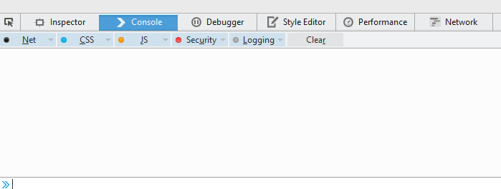
JavaScript Debugging tool
All modern web browsers have a built-in debugging tool
Normally, if you hit F12 button, the console should appear
Debugging tool in Mozilla firefox

Slide 5
JavaScript Debugging tool
Console tab
Displays error messages regarding html, css, JavaScript
You can manually display your own messages to a console
Debugger tab
Allows a web developer to evaluate JavaScript code and debug the code if required
Breakpoints are set to perform a step by step debugging

Slide 6
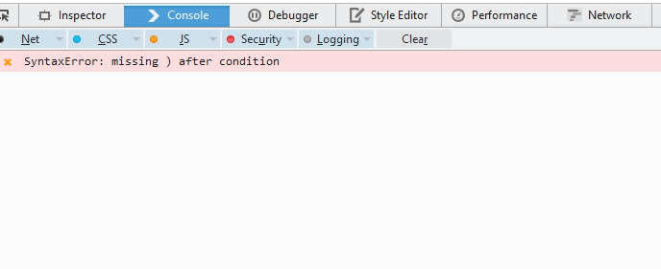
Debugging Syntax error
Syntax error is the most easiest error to be identified and fixed
A console tab always display message for this type of errors as well as its location in your code
Error message in a console tab

Slide 7
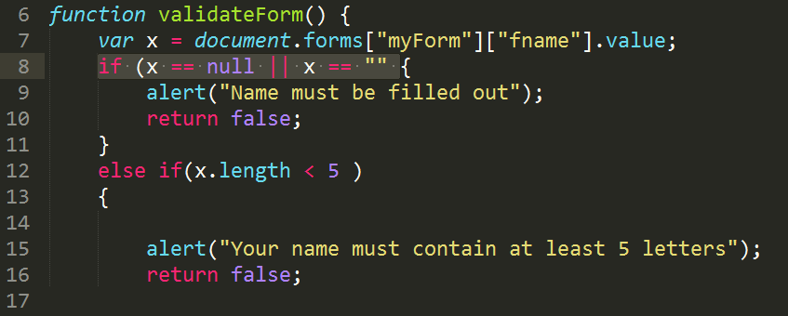
Debugging Syntax error
Once you know a location of a syntax error, you can open any text editor or authoring tool to fix your code
Fixing syntax error in a text editor

Slide 8
Debugging Runtime error/Logic error
Runtime error is much harder to be identified and fixed than syntax error
A console tab can not display this kind of errors
To solve this error, you will need:
Console.log() : a programming statement to display data, e.g. variable, on a console tab
Debugger tab : allows to set breakpoints and step by step debugging

Slide 9
Debugging Runtime error/Logic error
Normally, most developers use console.log() to help debugging
Example:
var x = 1;
console.log(x);
A console tab displays a value stored in x variable after console.log get executed

Slide 10
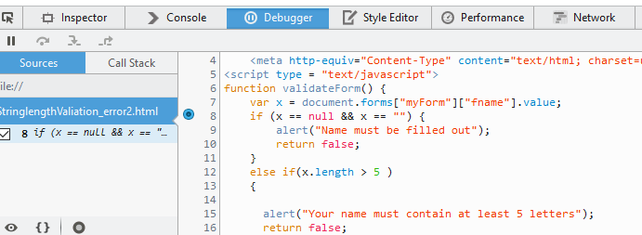
Debugging Runtime error/Logic error
When using debugger tab, double clicking on a line number to place a breakpoint
A breakpoint placed in a breakpoint

Slide 11
Debugging Runtime error/Logic error
Then, reload the page (and click the button). The JavaScript interpreter will stop at the indicated line.
Now, you can use step in, step over button to evaluate your code
A script stopped at the indicated line

Slide 12
Exercise
JS Debugging Exercise

Slide 13
End of The Session 2
Week 6

