Slide 1
design process
Sketches + sketch modelling
concept and design development
Design Studio One ARCH5112: School of Architecture: 2023

Slide 2
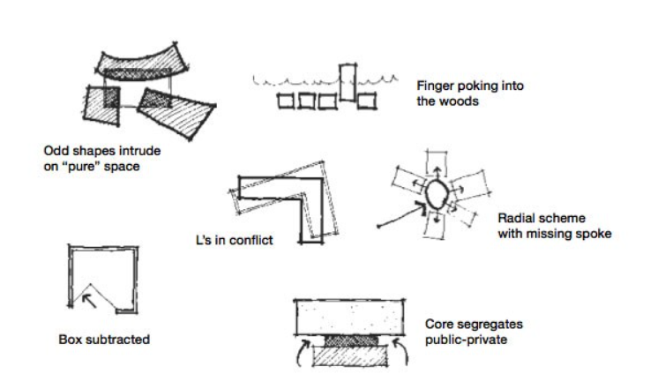
15/ PARTI
“A parti is the central idea or concept of a building”
101 Things I Learned in Architecture School - Matthew Frederick, The MIT Press @2007

Slide 3
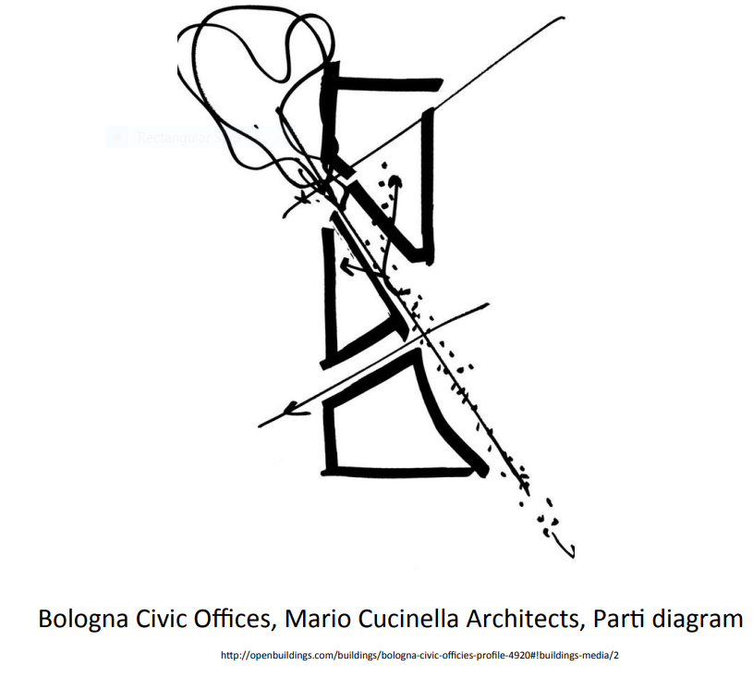

Slide 4
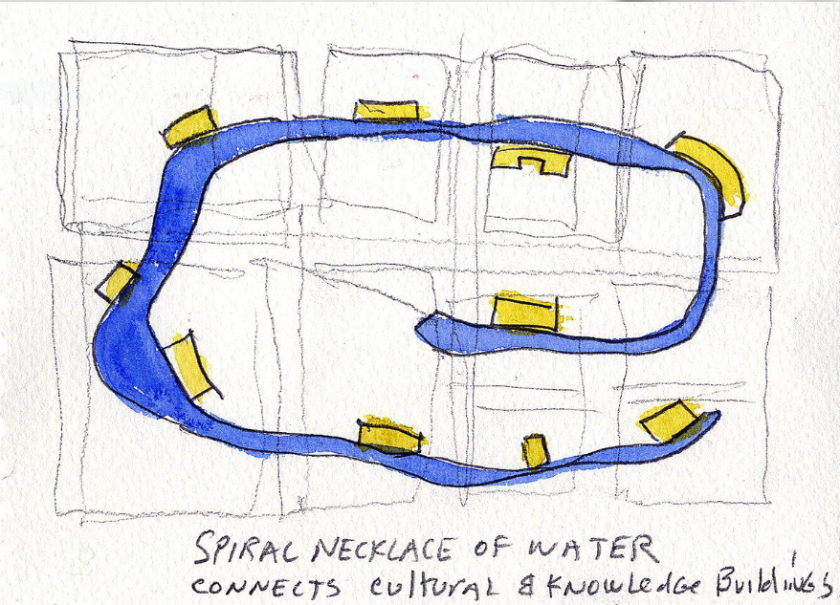
https://www.stevenholl.com/project/knowledge-lake-wuhan/

Slide 5
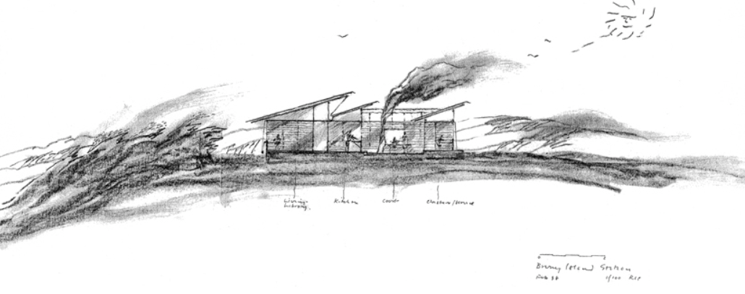
Cloudy Bay Retreat, Richard Leplastrier
https://panfilo.co/2013/12/07/richard-leplastrier/

Slide 6
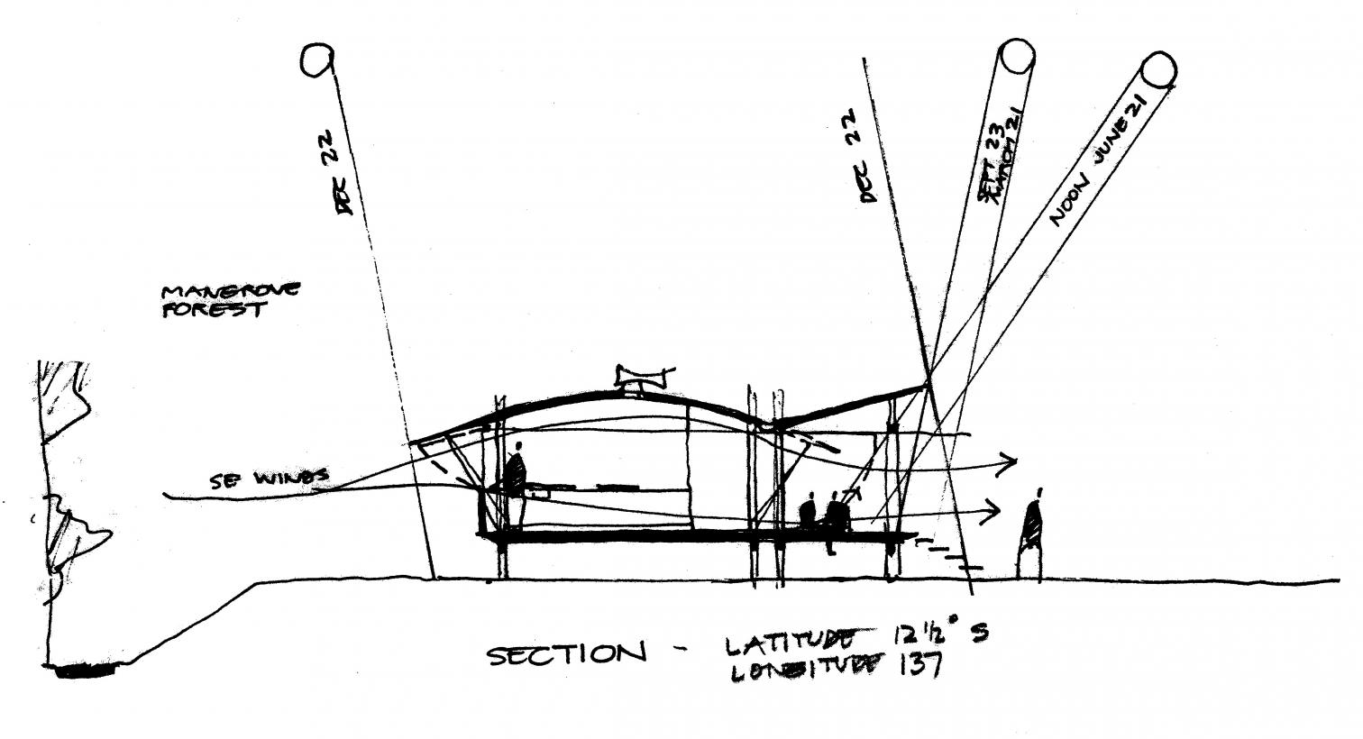
Sections sum up Glenn Murcutt’s climatic interests and construction methods: in the sketch, the Marika-Alderton house
https://arquitecturaviva.com/articles/llamame-glenn-3

Slide 7
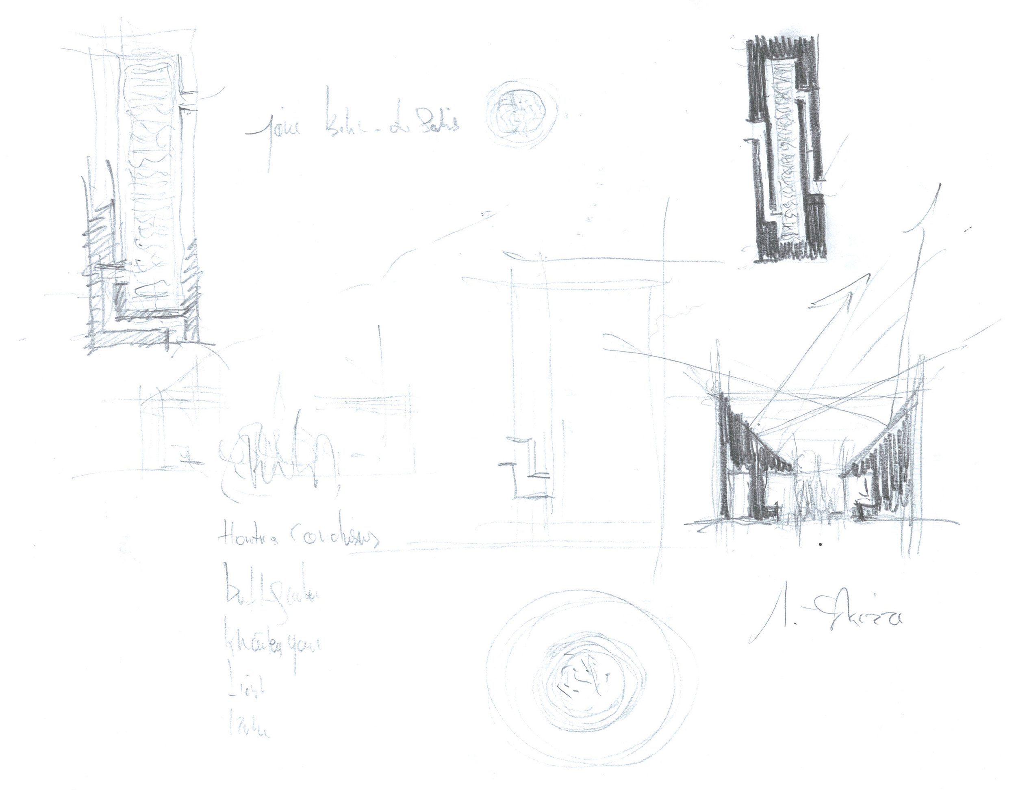
First sketch, Archive Peter Zumthor Büro Serpentine Summer Pavilion, Peter Zumthor, 2011
https://www.susana-ventura.com/material-experimentation

Slide 8
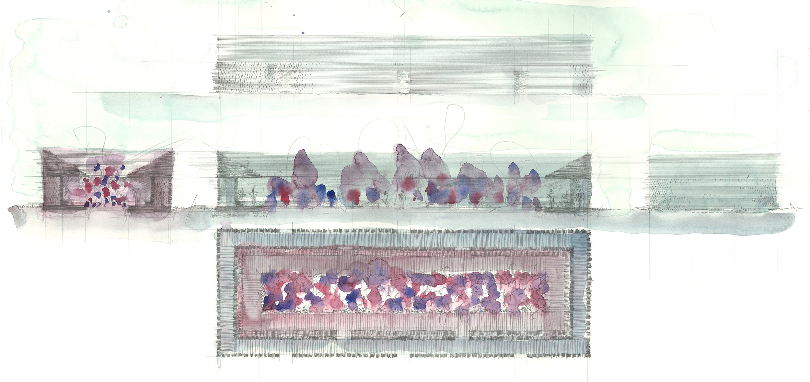
„The experimentation never ends in the watercolour, but it crystallises, undoubtedly, determinate properties of the work, which are immutable. There is, almost always, in his watercolours, an implicit defined work and, in that moment, the initial image, which Zumthor seeks in each work, does not now have vague and unformed contours, but a body.”
Archive Peter Zumthor Büro Serpentine Summer Pavilion, Peter Zumthor, 2011
https://www.susana-ventura.com/material-experimentation

Slide 9
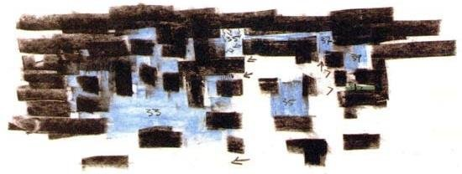
Drawing and atmosphere - Peter Zumthor’s Sketches for Vals Therme https://www.researchgate.net/publication/318985526_Architectural_notation_and_design_process

Slide 10
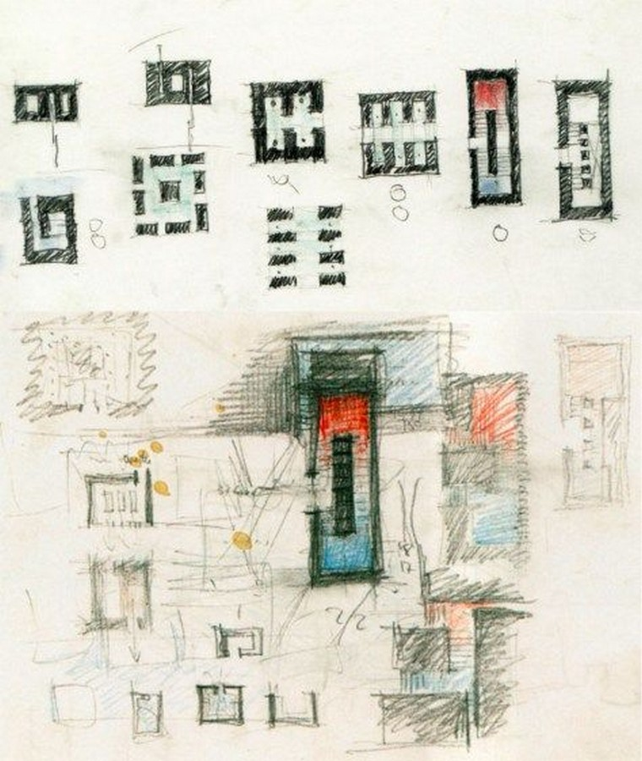
“Peter’s Zumthor’s masterpiece is a complex design composed of monolithic horizontal and vertical slabs; this composition creates a puzzling construction where its joins conserve eight centimeters of separation in between the slabs. This technique allows natural light to play with the roof rectangular blocks’ apertures, and it creates a mystic architectural momentum in the interior spaces. It is described as the moment when light and shade combine, and it generates a sublime atmosphere where the rhythm of silence is prevalent.”
Peter Zumthor’s Sketches for Vals Therme Spa; Source: ©Architecturalogy.
https://www.re-thinkingthefuture.com/case-studies/a2530-therme-vals-spa-in-switzerland-by-peter-zumthor/

Slide 11
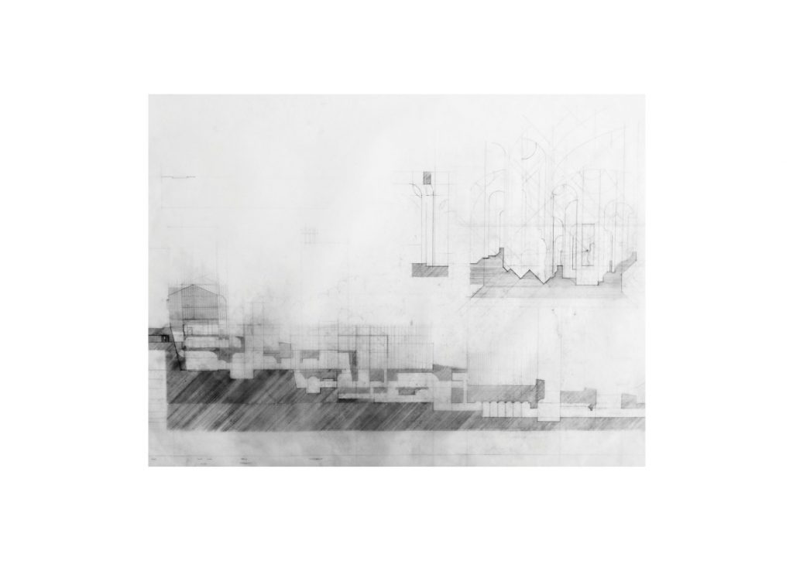
Studying sectional development and circulation in relation to ground – The Highgate Wake House – KooZA/rch
https://www.koozarch.com/interviews/the-highgate-wake-house/

Slide 12
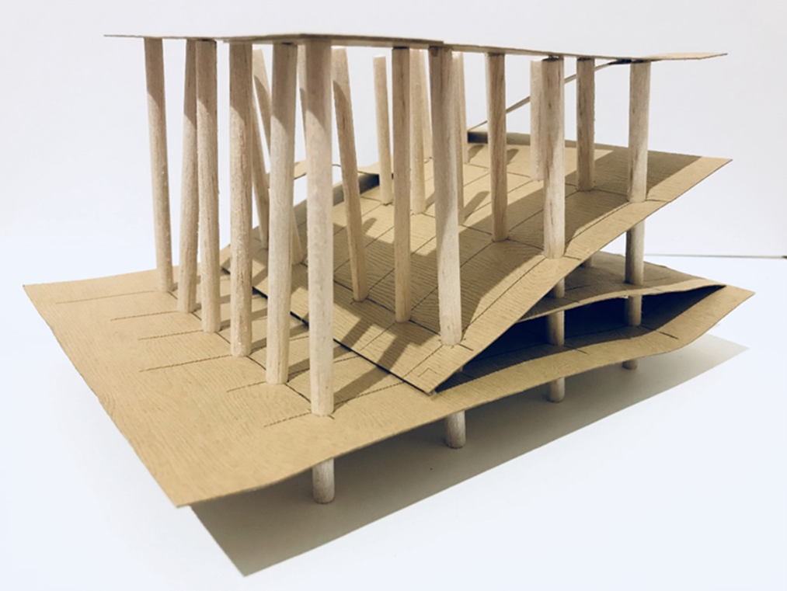
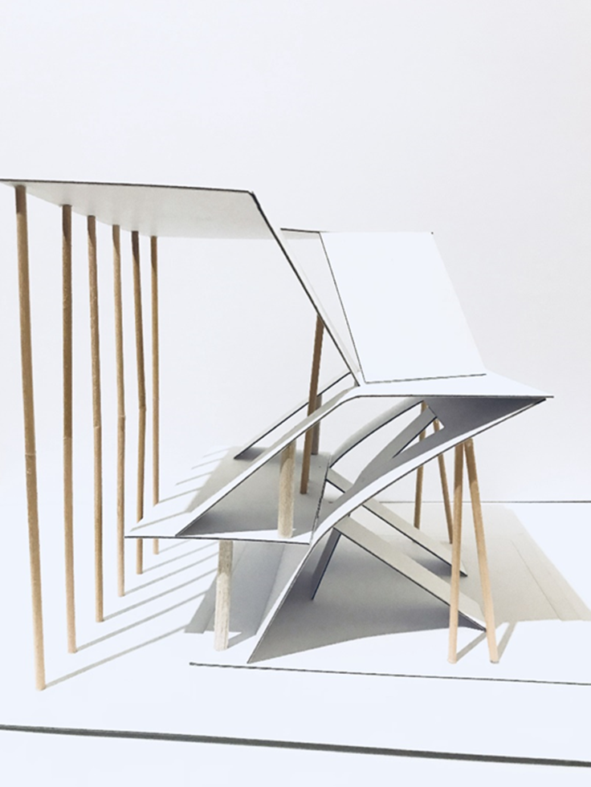
“In my fifth iteration, I used a different type of paper that has wood texture on it, and balsa wood rods. so for this iteration, I have started to get an idea of what my final model is going to look like, however, after finish this iteration I wanted to play with the idea of columns and slabs, so that is how the final iteration comes in.”
Final model made by Phebe Lin
https://medium.com/@Lin_3193620/architectural-history-and-theory-orientations-bb428dde57a6

Slide 13
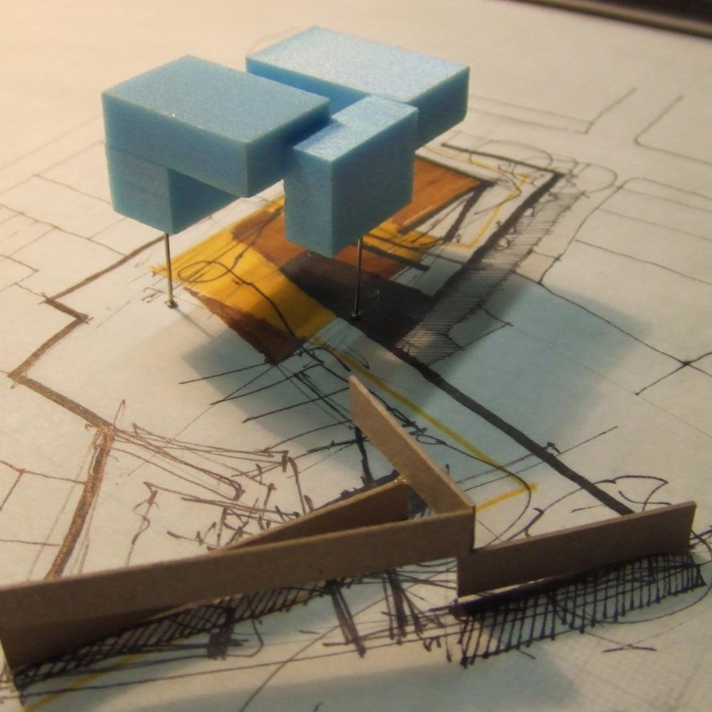
Runner-up High Commendation
(Re)making_City
Part 2 Project 2009 Paul Durcan University College Dublin | Ireland
FOLD
http://www.presidentsmedals.com/Entry-24881
http://www.presidentsmedals.com/showcase/2009/l/2488_08104003709.jpg

Slide 14
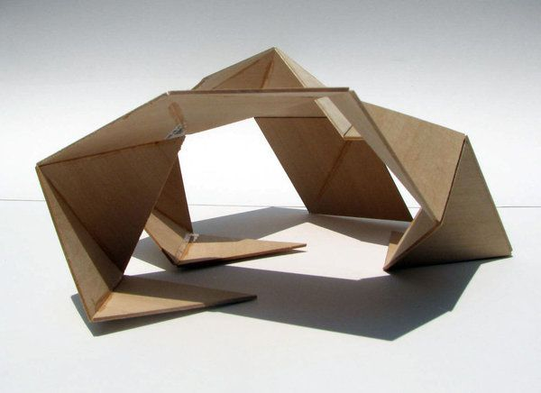
Working model
Working models go a step further in developing design ideas and solutions. The working model will have higher quality materials that reflect specification in design They help us understand and communicate scale, form and materials.
https://www.firstinarchitecture.co.uk/architectural-model-making-the-guide/
https://www.firstinarchitecture.co.uk/wp-content/uploads/2018/09/Image-03.jpg

Slide 15
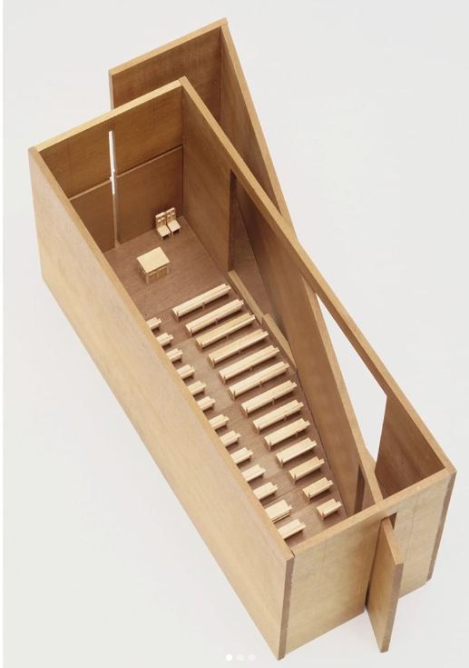
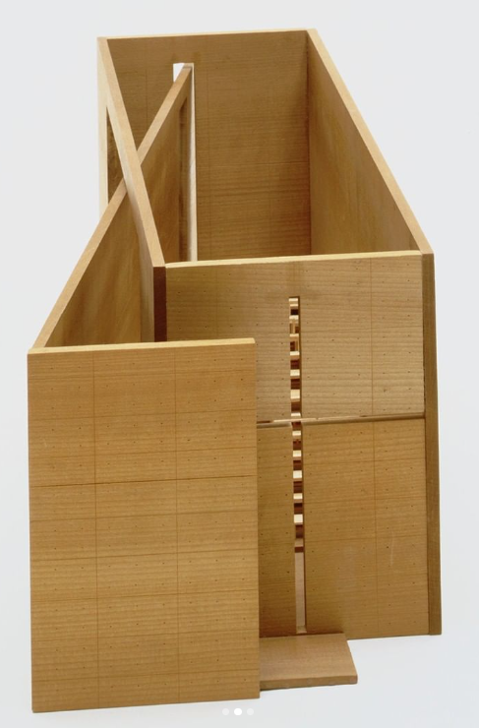
models_architecture
Tadao Ando Church of the Light, Ibaraki, Osaka, Japan, 1984-89 Model: Tadao Ando Architect & Associates Model material: Wood Dimensions: 18.1 x 45.1 x 17.8 cm

Slide 16
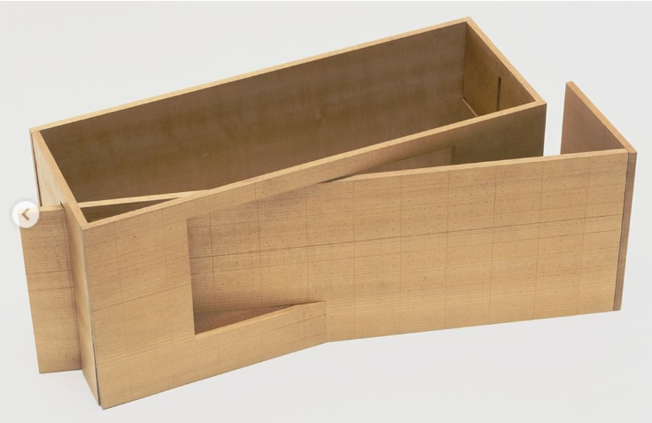
models_architecture
Tadao Ando Church of the Light, Ibaraki, Osaka, Japan, 1984-89 Model: Tadao Ando Architect & Associates Model material: Wood Dimensions: 18.1 x 45.1 x 17.8 cm

