Slide 1

Creative Social Practice
Week one: Introduction
with craig

Slide 2

Karakia | MANAWA MAI
Manawa mai te mauri nuku
Manawa mai te mauri rangi
Ko te mauri kai au
He mauri tipua
Ka pakaru mai te po
Tau mai te mauri
Haumi e, hui e, taiki e
Embrace the life force of the earth, embrace the life force of the sky
The life force I have fathered is powerful, and shatters all darkness
Come great life force,
Join it, gather it, it is done

Slide 3
Karakia | He hōnore
He hōnore, he korōria
Maungārongo ki te whenua
Whakaaro pai e
Kingā tangata katoa
Ake ake, ake ake
Āmine
Te Atua, te piringa,
Toku orange
https://www.youtube.com/watch?time_continue=4&v=EIw73tvLrUI

Slide 4
Tasks for today
Overview of the developing (in the act of creating) course
Discuss creativity
Review learning outcomes.
Explore assessment
Your participation (what, how, why)- moodle
Create groups

Slide 5

What is this course about?
Some things we will explore….
What is creativity?
Unleashing your and client’s creativity
Culture and creativity
Is creativity contagious?
Obstacles to the creative process and creative problem solving
Humour, play, fun and their role in dealing with grave problems
Enthusiasm
Creative guest speakers
And whatever you bring to share ….

Slide 6
During our time together we will explore …..
Creative ways of working with people, groups, families and organisations
Ways of unleashing our creative potential
Ways of reaching client’s creativity
A number of resources to ignite your creativity
Various ways in which creative practitioners practice
Your favourite ways to learn and present what you’ve learnt

Slide 7
Teaching practices that inform this course
Co-creation
Ako: teaching and learning
Inquiry led.
Student generated/student led

Slide 8
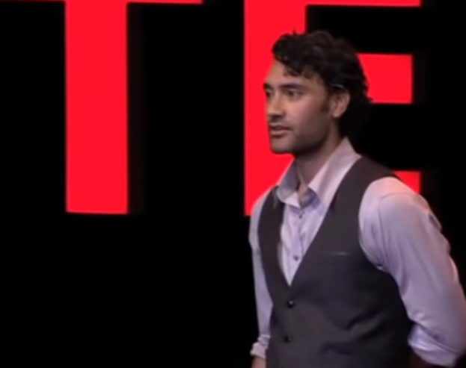
The Art of Creativity | Taika Waititi | TEDxDoha
https://youtu.be/pL71KhNmnls?t=866

Slide 9
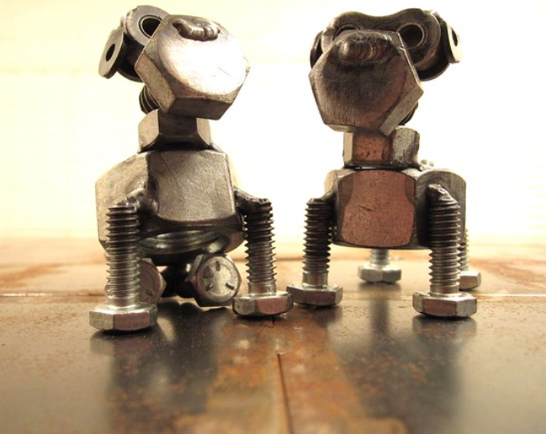

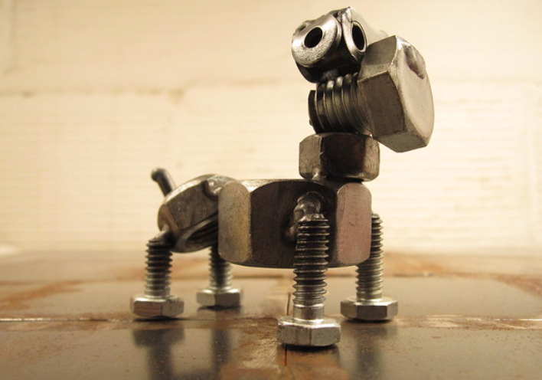
Nuts and bolts stuff

Slide 10
Teaching Team
Course Coordinator
Academic Leader
Course Coordinator & Lecturer | Craig Tunnicliffe
Office Location | 510-50??
Email | ctunnicliffe@unitec.ac.nz
Availability | Please email if you have any questions- we can set up a phone call/zoom or F2F.
Academic Leader | Aulola Lino
Office Location | 510-5009
Email | alino@unitec.ac.nz
Availability | By Appointment

Slide 11

Learning Outcomes
1
2
3
4
5
Compare and contrast the theories and research on creativity
Explore and integrate a range of modalities in social practice which utilise creative potential to improve wellbeing.
Compare and contrast the abundance of creative approaches in social practice and justify approaches utilised in a variety of contexts in social practice
Reflect on and evaluate contribution to the course.
Describe creative practice in a Māori context.

Slide 12
Assessment
1: 50% Group presentation LO 1, 2, 5
2: 50% Written individual reflection LO 3, 4, 5
  With creative artifact.

Slide 13
Assessment 1
Assessment 1 | Group Presentation (50% of the course mark) LO 1,2, & 5
Weight: | 50%
Due: | 08/05/23 or 15/05/23
Submission type: | Presentation: Prepare and present a 50 minute presentation to the class on a creative methodology to work in diverse social practice settings.

Slide 14
Assessment 1
Task: | Create, develop and maintain a collaboration of four to five students, to prepare and present a 30 minute presentation to the class on a creative methodology to work in diverse social practice settings.
Instructions: | The presentation must demonstrate an understanding of the theories and research behind a chosen creative approach to social practice, and explore ways in which it may contribute to clients and communities well-being. You need to discuss the ways this creative approach may/or may not work in different cultural contexts and specifically in working with Iwi, Hapū, and Whānau. Some practical examples of how the chosen creative tool has been/could be used in social practice settings needs to be included. Include some of the challenges that can be found when using your chosen creative tool, along with a brief description on how you would approach them.

Slide 15
Assessment 2
Assessment 2 | Individual reflection and creative artefact LO 3,4,5
Weight: | 50%
Due: | 19/06/23
Submission type: | Creation and evidence of creation of a creative artifact and a written reflection on creativity.

Slide 16
Assessment 2
Task: | 1a: Develop an individual artwork/artefact/article/image/presentation etc that reflects and captures your understanding of creativity and its links to social practice (please note: we will workshop/brainstorm ideas during class). And 1b: Write a small (1000 word) reflection on your created artifact and how your ideas of creativity have developed through the learning in this course.
Instructions | Your individual artwork/artefact/article/image/presentation can be almost anything. In some cases, “evidence” may be a recording or image of your creation. In the written reflection Consider: Based on your knowledge and what you have learned in this course, how would you define creative social practice? Which creative approaches and modalities that we focused on during the course resonated with you? What theories may help to inform your application of creativity to practice? What does creativity mean in different cultural contexts?

Slide 17
karakia whakamutunga|
closing karakia
Ka wehe atu tatou
I raro I te rangimarie,
te harikoa
Me te manawanui
Haumi e, hui e, taiaki e

Slide 18
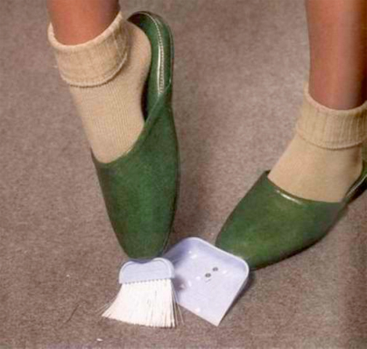
Chindogu
Literally translated, chindōgu means unusual (珍, chin) tool (道具, dōgu).
The term was coined by Kenji Kawakami, a former editor and contributor to the Japanese home-shopping magazine "Mail Order Life."
In the magazine, Kawakami used his spare pages to showcase several bizarre prototypes for products. He named these gadgets “chindōgu”; Kawakami himself said that a more appropriate translation than "unusual tool" is "weird tool".
https://youtu.be/N56Xe1CCiDM

Slide 19
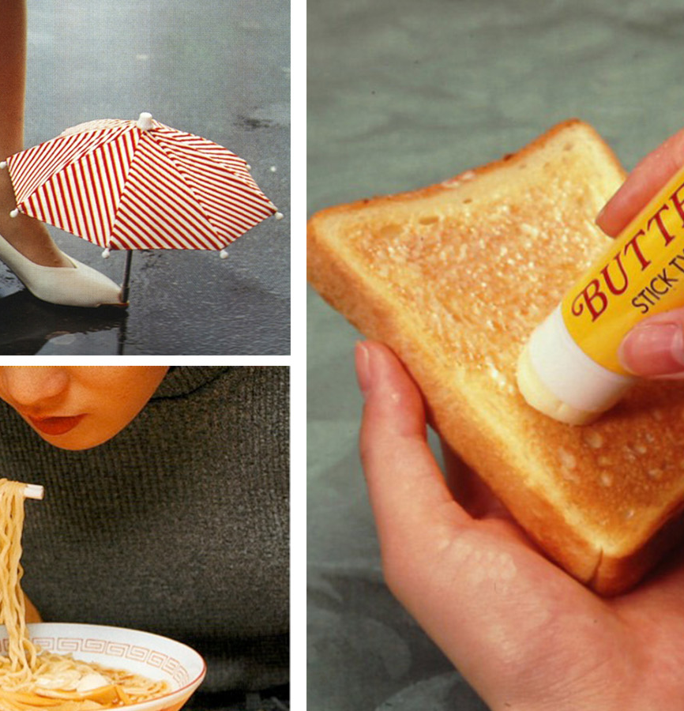
The Ten Tenets of Chindōgu
The Chindōgu Society developed ten tenets of Chindōgu explaining the principles on which chindogu products should be based, inspiring designers and users to think about the deep core of design in general. The tenets require[ that a Chindōgu
cannot be for real use,
must exist,
must have a spirit of anarchy,
is a tool for everyday life,
is not a tradeable commodity,
must have resulted only from an exercise of humor,
is not propaganda,
is not taboo,
cannot be patented, and
is without prejudice.

Slide 20

Next Week….

