Slide 1
What is creativity?
Topic 2

Slide 2
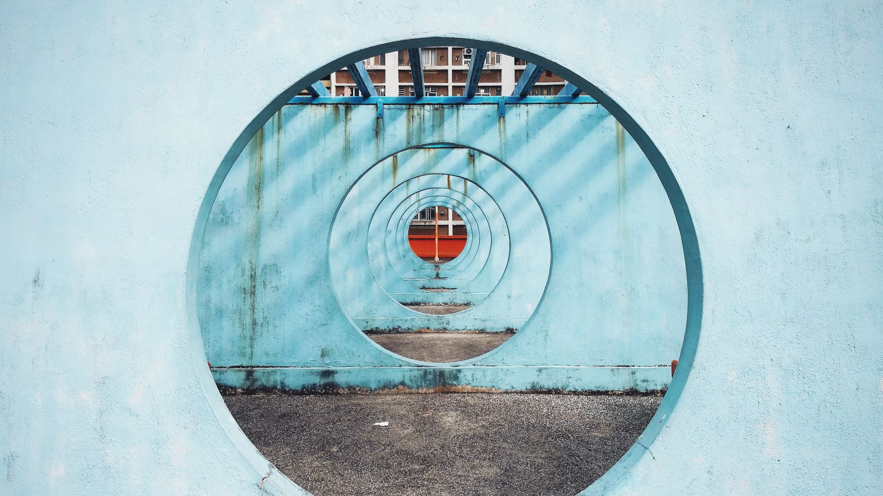
opening

Slide 3
Karakia | MANAWA MAI
Manawa mai te mauri nuku
Manawa mai te mauri rangi
Ko te mauri kai au
He mauri tipua
Ka pakaru mai te po
Tau mai te mauri
Haumi e, hui e, taiki e
Embrace the life force of the earth, embrace the life force of the sky
The life force I have fathered is powerful, and shatters all darkness
Come great life force,
Join it, gather it, it is done

Slide 4
Kotahi Aroha

Slide 5
Opening
Sharing
Thinking
Connecting
Doing

Slide 6
Reminders
Groups

Slide 7
Opening: thoughts from reading
Chaos (?) (change, flux, becoming?) defines the human condition more arcuately than order.
People are diverse (culturally, gender, backgrounds)
Creativity may feel unsafe
Creativity means your practice is not ridged
Creativity within limited resoursing
Creativity- respect for intuition (your experience?)
Non-empty vessel (rich in knowledge, of self, of traditions, of culture, of experience).

Slide 8
Negotiating the Contradictions between Competence and Creativity in Social Work

Slide 9
sharing

Slide 10
Show and tell
Creative discoveries

Slide 11
thinking

Slide 12
Thinking patterns that help create new ideas.
Explore
Practice visualization (concept mapping)
Explore other fields (new theories, ways of doing)
Keep a record of your explorations. Make notes/words/doodle
Please do this as we watch today’s video clips (this may support your later “doing”.
Learn to think of possibilities (ideas, ideas ideas)
Practice trying to look at things holistically and try to get the big picture.
Notes:
Let’s relate it to work with clients
Explore new ideas and learn to become flexible in your thinking.
Practice visualization - learn how to create concept maps, illustrative schema, and sketch ideas out.
Explore other fields looking for new theories and ideas that can be synthesized and adapted.
Keep a record of your explorations. Keep an "Idea Journal"
Learn to think of possibilities, diverge, be expansive. Generate lots of ideas, then refine them.
Practice trying to look at things holistically and try to get the big picture.

Slide 13
Thinking patterns that help create new ideas.
Learn to focus in on parts of a problem, then come back out to the big picture.
Don't get in a rut. Force yourself to try new things. Experiment with new strategies and play with ideas imaginatively.
Think of yourself as an "idea artist" or an "idea vendor."
Combine ideas. Let ideas and thoughts ferment and percolate and then revisit them.

Slide 14
Thinking patterns that help create new ideas.
Take time to imagine new ideas and possibilities. Practice daydreaming.
Look for ideas and inspiration in ordinary places. Scan books, magazines, articles, advertisements & photos for new ideas.
Ask family members, friends, co-workers and even strangers for fresh perspectives.
Brainstorm and free associate frequently.

Slide 15
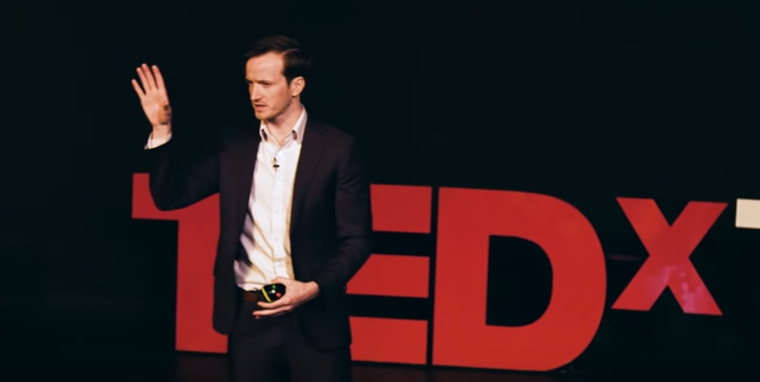
Thinking
Watch: The Skill of Humor | Andrew Tarvin | TEDxTAMU (20mins)
https://youtu.be/MdZAMSyn_As
Watch: where good ideas come from by Steven Johnson

Slide 16
Connecting

Slide 17
Connecting
Watch: 4 mins The Right To Be Me Dr Rangimarie Turuki Rose Pere
Celebration – difference – uniqueness - respect
Watch: 5mins Dr Rangimarie Turuki Rose Pere
Power - wisdom - connection - oneness

Slide 18
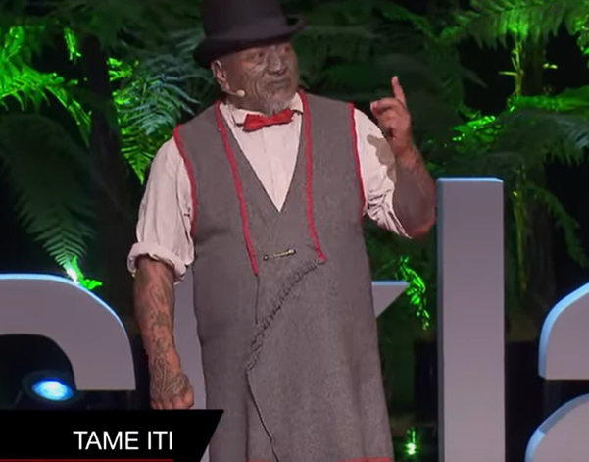
Connecting
Mana: The power in knowing who you are | Tame Iti | TEDxAuckland
https://youtu.be/qeK3SkxrZRI

Slide 19
Doing

Slide 20
Doing
After lunch
Create small working groups
Question: What could creativity be?

Slide 21
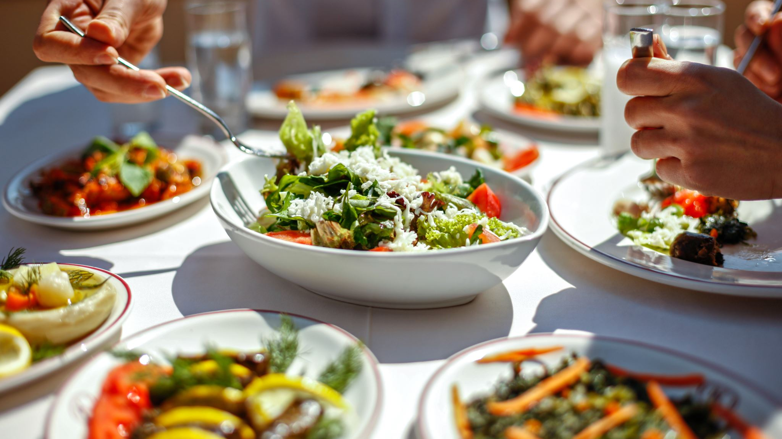
Lunch

Slide 22
Doing

Slide 23
Group work
Create small working groups
Create a presentation (in what ever form). 1hr.
What could creativity be?
Present to class
Share reflections of your experience/process

Slide 24
Nudges
What are some words (perhaps from different cultural contexts) to describe creativity.
What types of creativity do you admire?

Slide 25
Brainstorming
Watch: (3mins) Six Creative Ways To Brainstorm Ideas

Slide 26
Closing
Final thoughts
Announcements

Slide 27
Karakia whakamutunga
Ka wehe atu tato
I raro I te rangimarie
te harikoa
Me te manawanui
Haumi e,
hui e,
taiaki e

