Slide 1
Comedy
Creative social practice, 2022

Slide 2
https://youtu.be/JuwK8a2d4wk

Slide 3
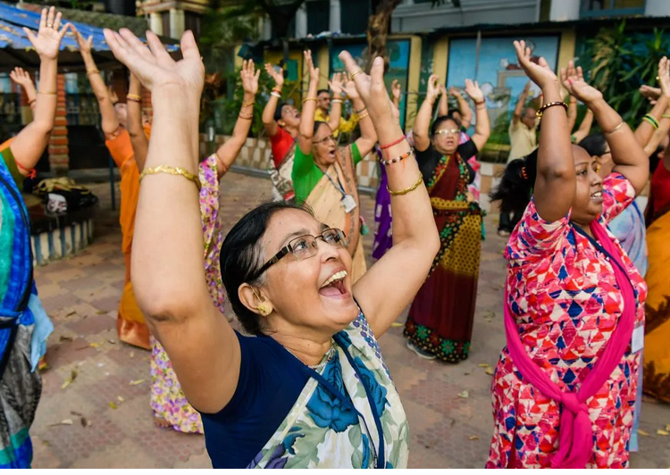
Laughter Yoga
Liliana DeLeo | TEDxMontrealWomen
https://youtu.be/4p4dZ0afivk

Slide 4
Benefits of laughing

Slide 5
Some opening thoughts
Comedy (kōmōdía) is a genre of fiction that consists of discourses or works intended to be humorous or amusing by inducing laughter, especially in theatre, film, stand-up comedy, television, radio, books, or any other entertainment medium.
A feature throughout history and cultures.
Laugh and the world laughs with you, literally.
A 2010 study suggests laughter is part of a universal language of basic emotions that all humans share.
What we find funny however is shaped by our social and cultural environment.

Slide 6
What is comedy to you?
What makes you laugh?

Slide 7
The psychological aspects of laughter
In this interview Dr. Sophie Scott, Professor of Cognitive Neuroscience at the Institute of Cognitive Neuroscience, University College London discusses the different aspects of laughter.
Watch (4mins)
https://youtu.be/mf9OhIhHdGA
TS: 00-4.38

Slide 8
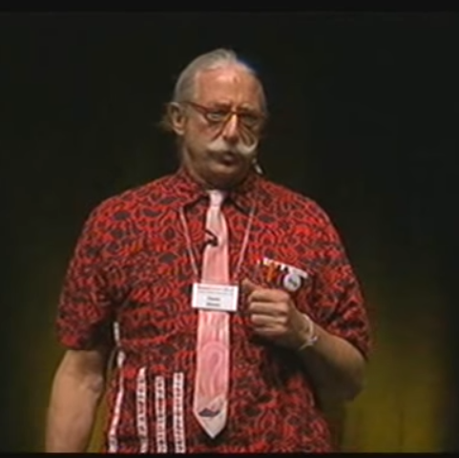
Practice comedy
Patch Adams
movie clip: Children's ward https://www.youtube.com/watch?v=byPJ22JDFjI
Patch Adams, M.D. - Transform 2010 - Mayo Clinic
https://youtu.be/CdCrPBqQALc
Meet the real Patch Adams | Today Show Australia
https://youtu.be/9T6BQdNMvRU

Slide 9
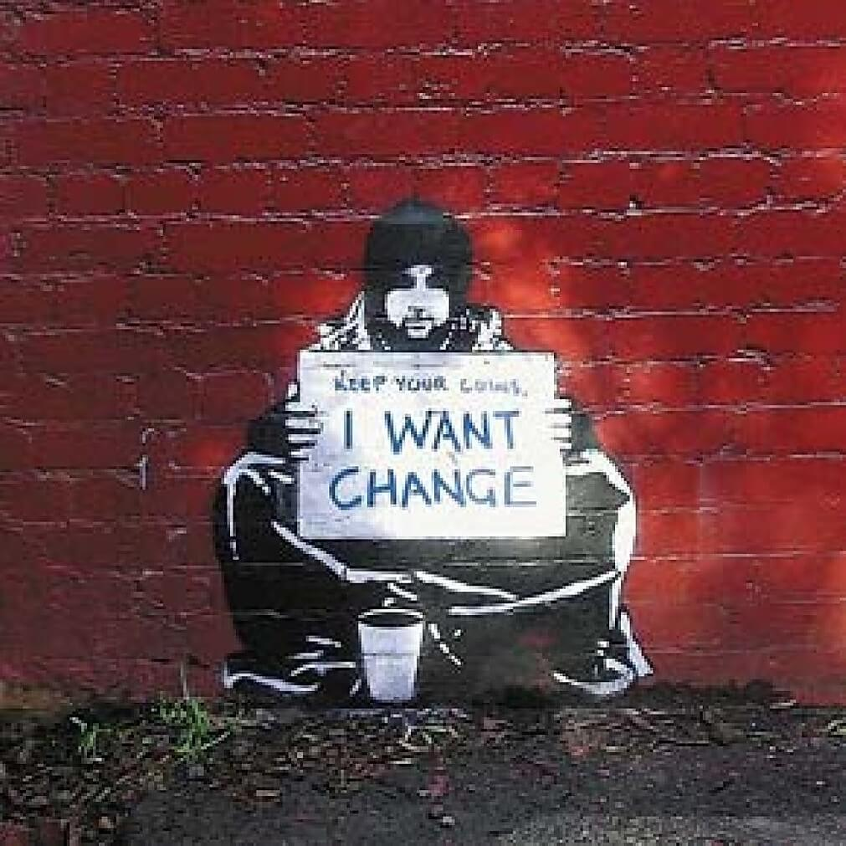
Not Just For Laughs: How Comedy Sparks Change
Laughter is a universal language.
Globally, comedy can be a powerful voice for change: speaking truth to power and shaping public opinion and social norms.
Comedy can challenge the status quo, expose hypocrisy, and change mindsets. We’ll hear from researchers, comedy writers, and activists about how they leverage humor to drive real change.
https://youtu.be/5fpacaB8epM
TS: 6.00-8.48
Why is now a “moment” that sees creativity and social justice issues merging?
TS: 17.28-20.58

Slide 10
Not Just For Laughs: How Comedy Sparks Change
Central ideas
Humour/comedy
Helps to see the stautus quo in a new way
Is a deviant and disruptive form or art and culture
Provides hope and optimism
A new way to see
Brings people together
Supports civic engagement
Provides a social critique.
Comedy as a form of persuasion
The sociology of comedy
Speaking about power
Politics (e.g. gender, race, sexuality)
Taking about taboos

Slide 11
“Because of the nature of a joke, topics that are often taboo can carve out a space that can work at creating a new understanding of a sensitive topic in its parody. It also allows the comic/audience a dynamic space to openly discuss and contemplate these sensitive issues. Humor provides a key site for reversal and resistance to the inequalities that society perpetuates, encouraging its incongruity through disturbance, thus offering a stylistic redefinition of reality”
https://www.sociologylens.net/topics/collective-behaviour-and-social-movements/the-power-of-comedy/9860

Slide 12
Hasan Minhaj on How Racism Hurts Immigrants
Hasan Minhaj talks about how racism impacts the immigrant experience in America. Hasan Minhaj: Homecoming King is streaming now on Netflix.
https://youtu.be/P3RyCtbwBDA

Slide 13
Humour in the south Pacific
A guide to Fresh Comedy - TV Comedy
It's all about the funny as we pay tribute to Fresh Comedy!
We talk to some of our favourite funny Freshies about what makes us laugh; who were the first Freshies to crack us up and who is making us lol today! Join Tofiga, The Panis, Dazz Fresh, The Cougar Boys, The Māori Sidesteps and more as we look back at some of our funniest Fresh segments!
Watch (7mins)
https://youtu.be/Tv-ehplZfQQ

Slide 14
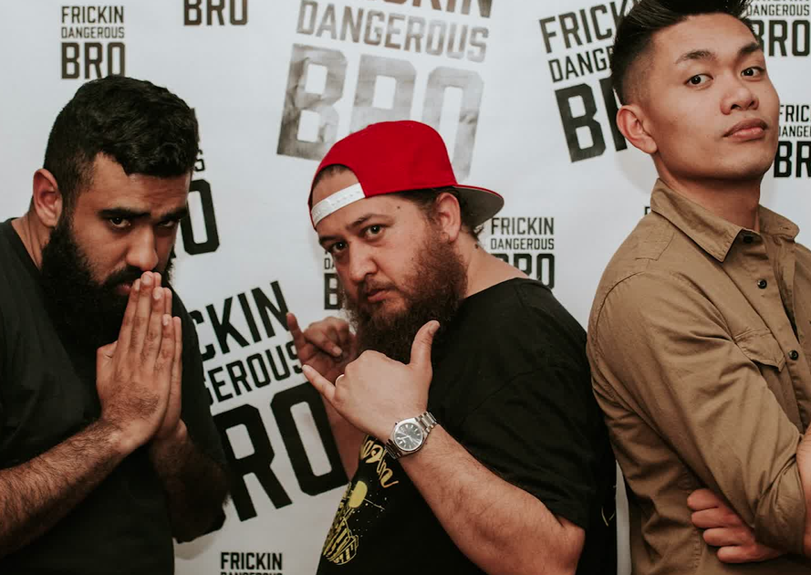
Ethnicity and stereotypes
Challenging stereotypes and social discourse
Frickin Dangerous Bro - 2017 Comedy Gala
James Roque, Pax Assadi and Jamaine Ross at the NZ International Comedy Festival 2017
https://youtu.be/O52jOfEt5-g

