Slide 1

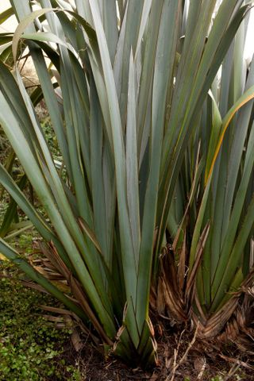
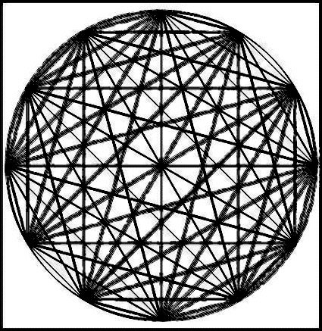
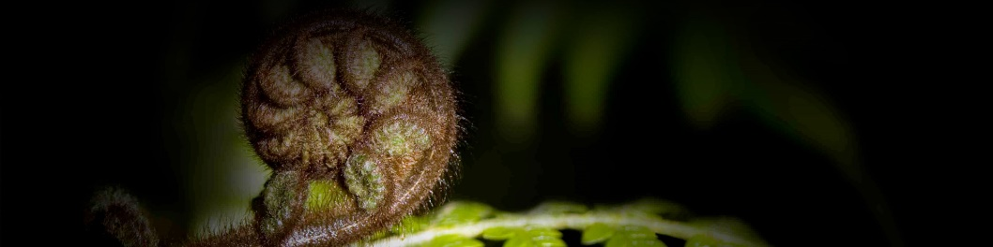
Papaora
Wānanga

Slide 2
Outline :
Karakia timatanga
Whanaungatanga
Intentions for the session
Papaora
Te whare tapa wha – a way of life
Reflection round
karakia whakakapi

Slide 3
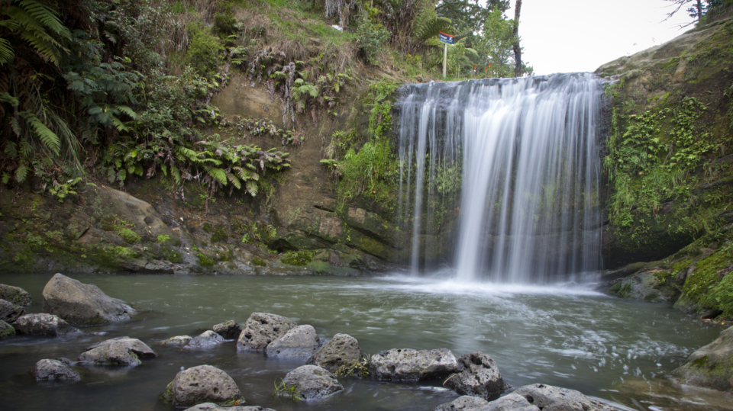




Karakia Timatanga
Manawa Mai te mauri nuku
Manawa mai te mauri rangi
Ko te mauri kei au
He mauri tipua
Ka pakaru mai te pō
Tau mai te mauri
Haumi e
Hui E
Taiki E!

Slide 4
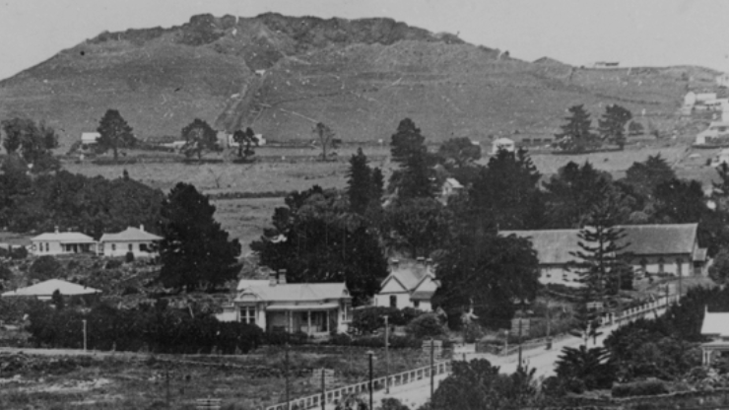
Whanaungatanga
Ko wai koe
No hea koe?
One thing I hope to get out of today is?

Slide 5
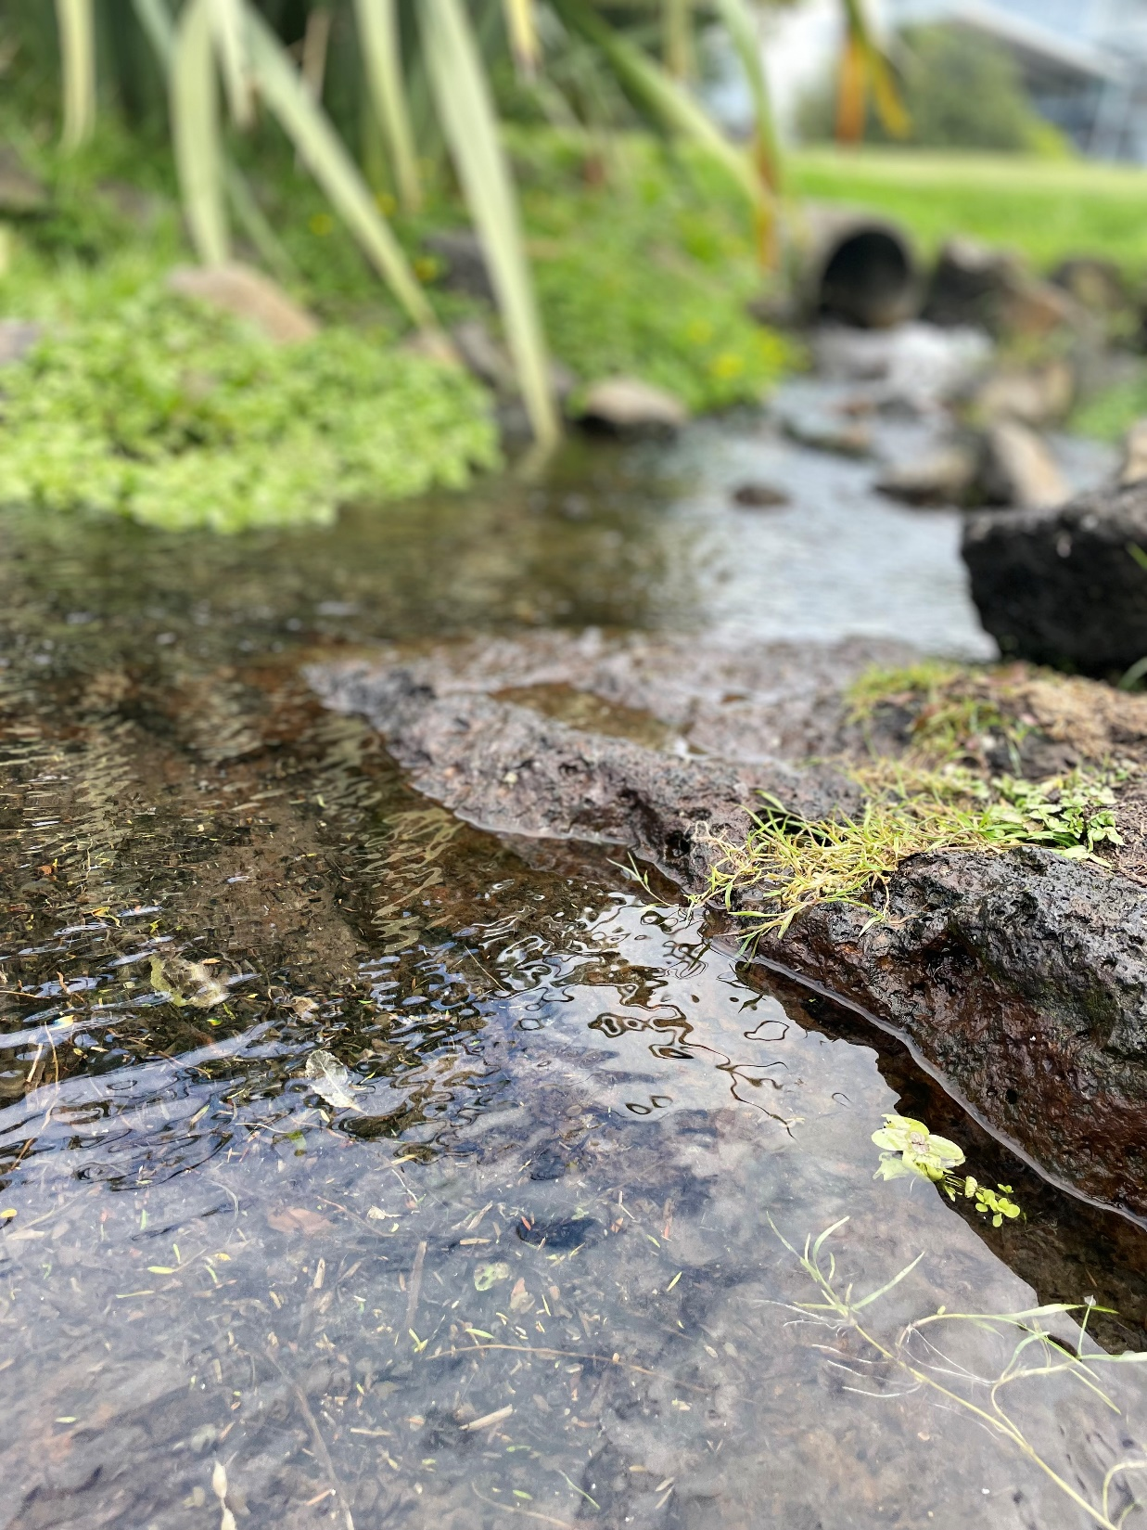
Hauora intentions:
Develop awareness of the interconnected relationship with Te taiao and your wellbeing
Mana tangata, Mana whenua - Enhance relationships and connections within your pā
Develop a personalised hauora plan to build resilience and resources
Weave your own 'papaora’

Slide 6

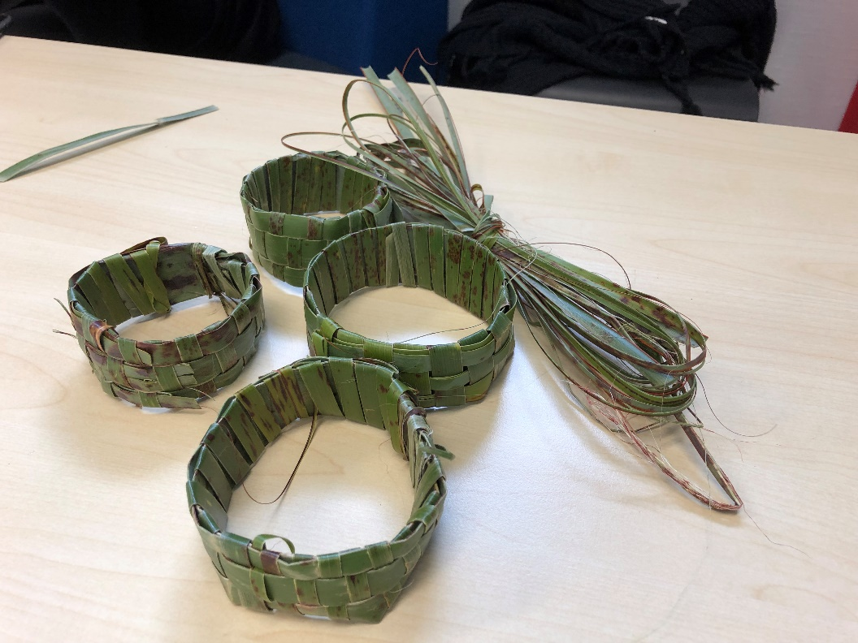
Papaora
Papa = Acknowledgement to papatūānuku, to the whenua, that nurtures and sustains all life.
Ora = to be well, alive, acknowledges the element of good health
The combination of the 2 kupu/words gives expression to the overarching principle of Kaitiakitanga and the interwoven connection between the natural environment, to the people and wellbeing.

Slide 7
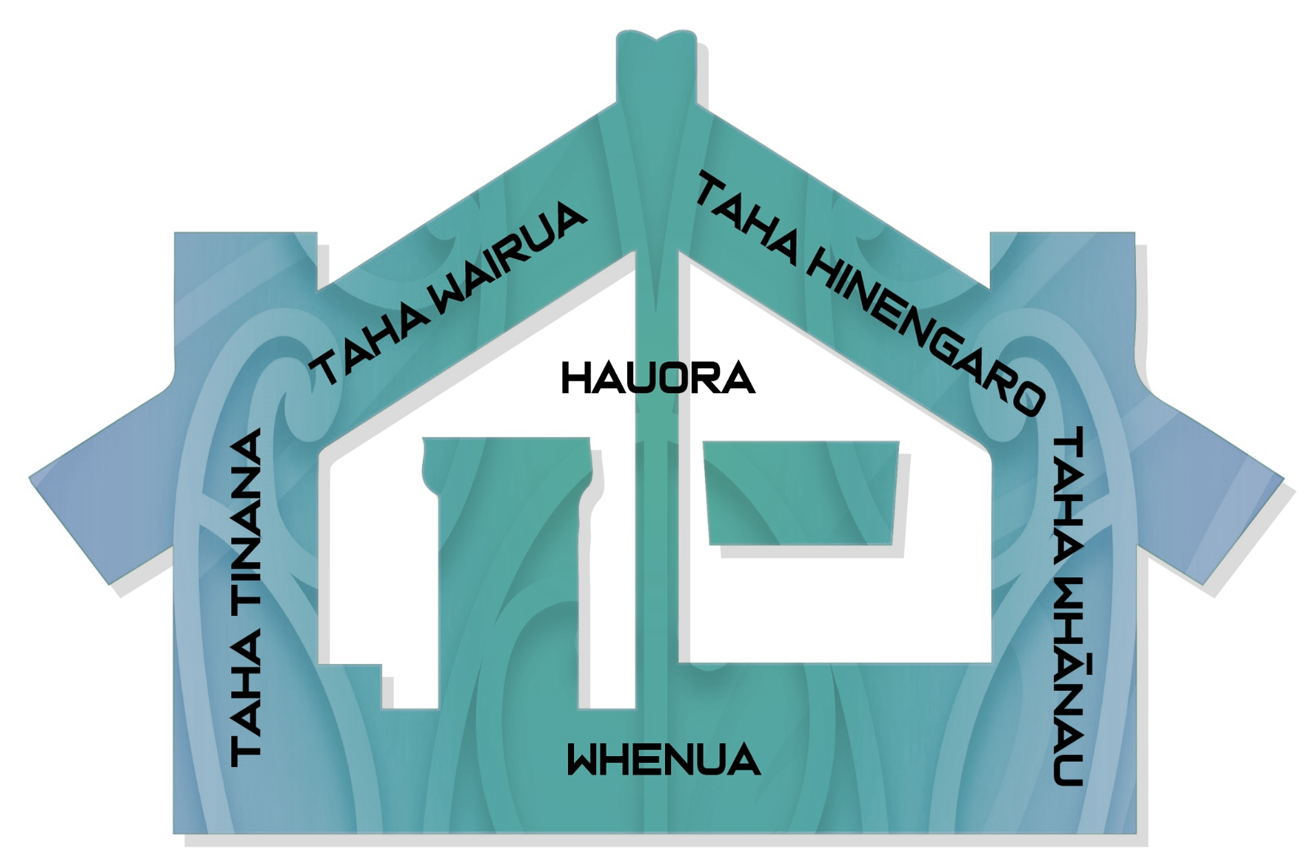

Te Whare Tapa Wha overview
Taha Wairua
Taha hinengaro
Taha tinana
Taha whānau
Taha Whenua
Mā te taiao, kia whakapakari tōu oranga.
Building connections with nature and the whenua can enhance our mental health and wellbeing

Slide 8
Reflections
Share one word/thought/learning from today

Slide 9
Karakia whakamutunga
Ka pa ki tua
Ka pa ki waho
Ka pa ki te whare, ka pa ki te rua
Ka pa ki te pou e tu nei
Kia ma te ariki, kia ma te tauira
Nohau e ruatau, e tane te waiora e
Whano, whana
Haramai te toki
Haumi E, hui e
Taiki E!

Slide 10
Feedback:
Your feedback is valuable and will help us to shape future wānanga.
We would appreciate your time to complete the following form:https://forms.office.com/r/t81ktnqn2D

