Slide 1
Our experiment with photo voice

Slide 2
Photovoice
Creative social practice 2023

Slide 3
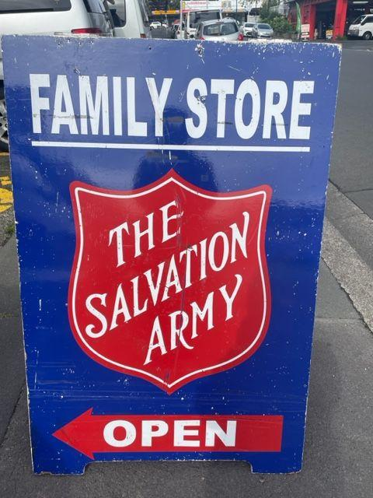
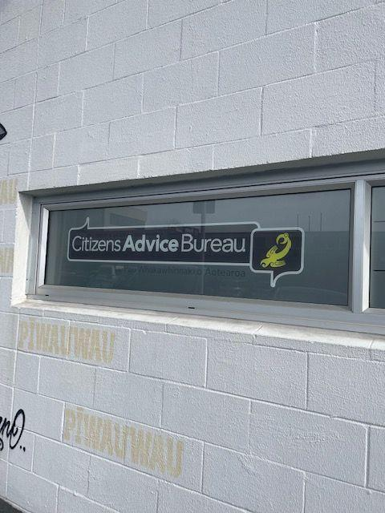
Playing up
The prices in an op shop are now too expensive for the
Families who are in need. Wasn’t it started as a way for
Low income individuals or families to buy things they needed?
Now the people who need it no longer use it
On top of essentials being too expensive to afford the stupid Mayor wants to cut funding that help those in need.

Slide 4
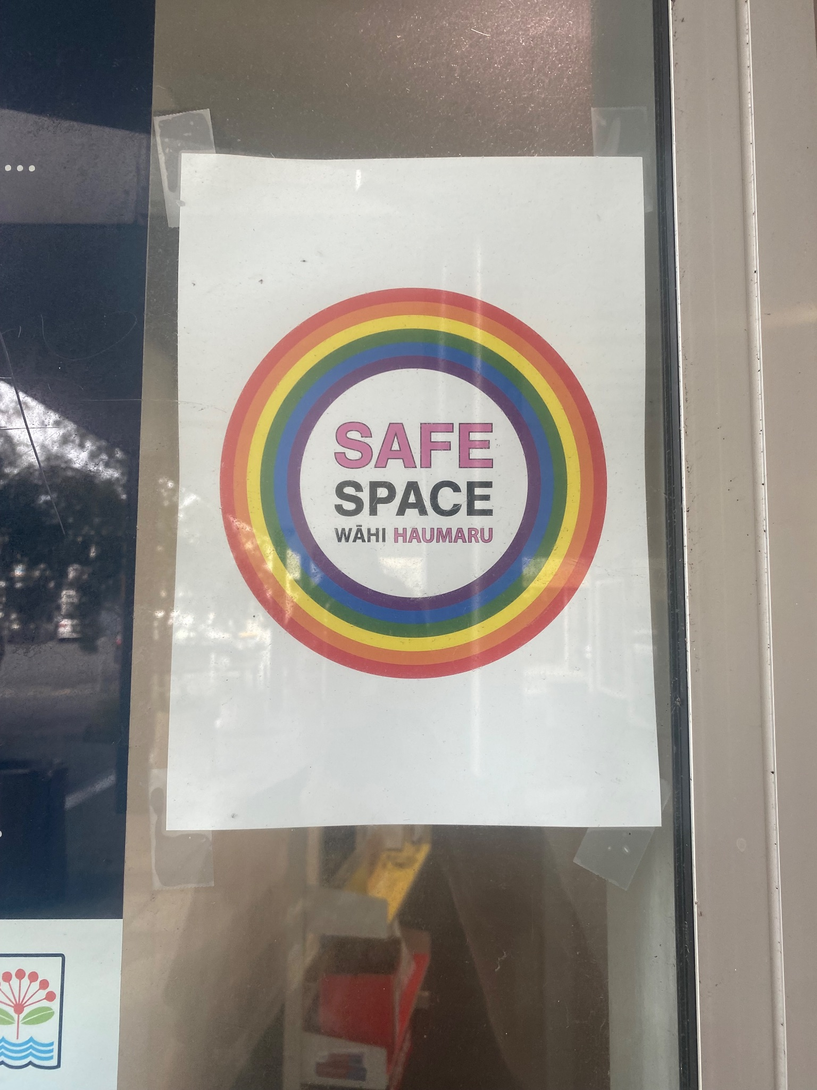
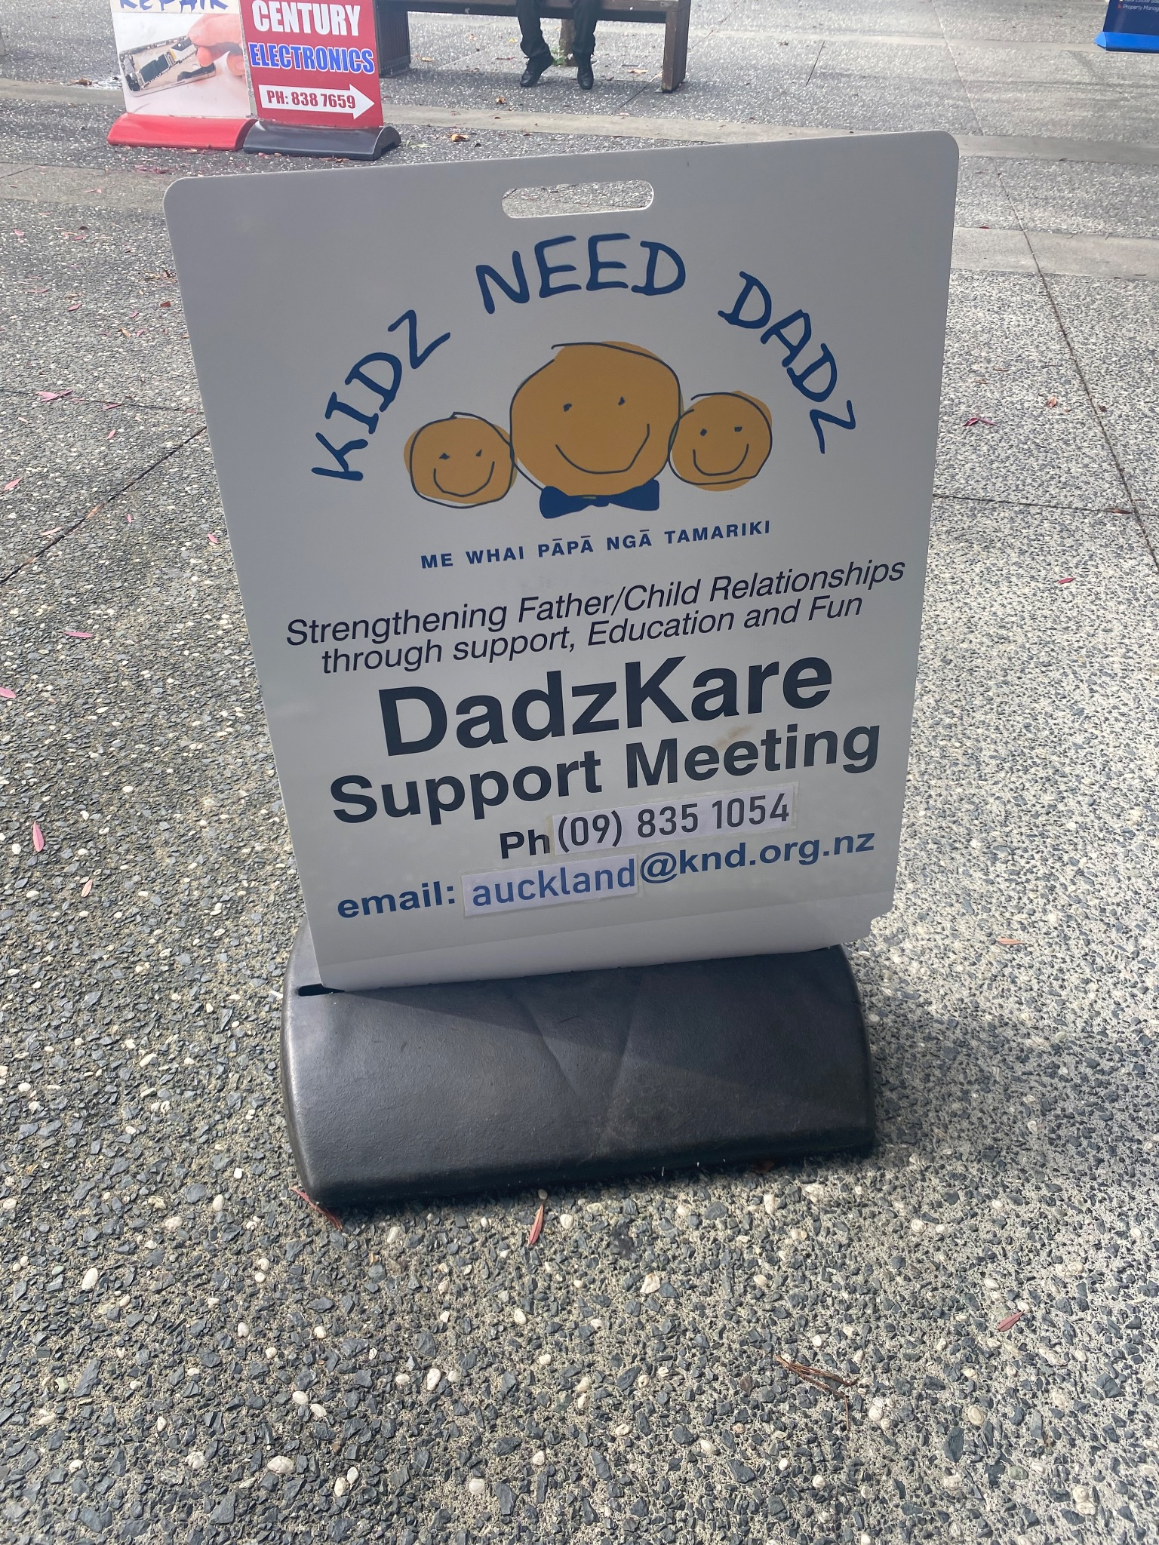
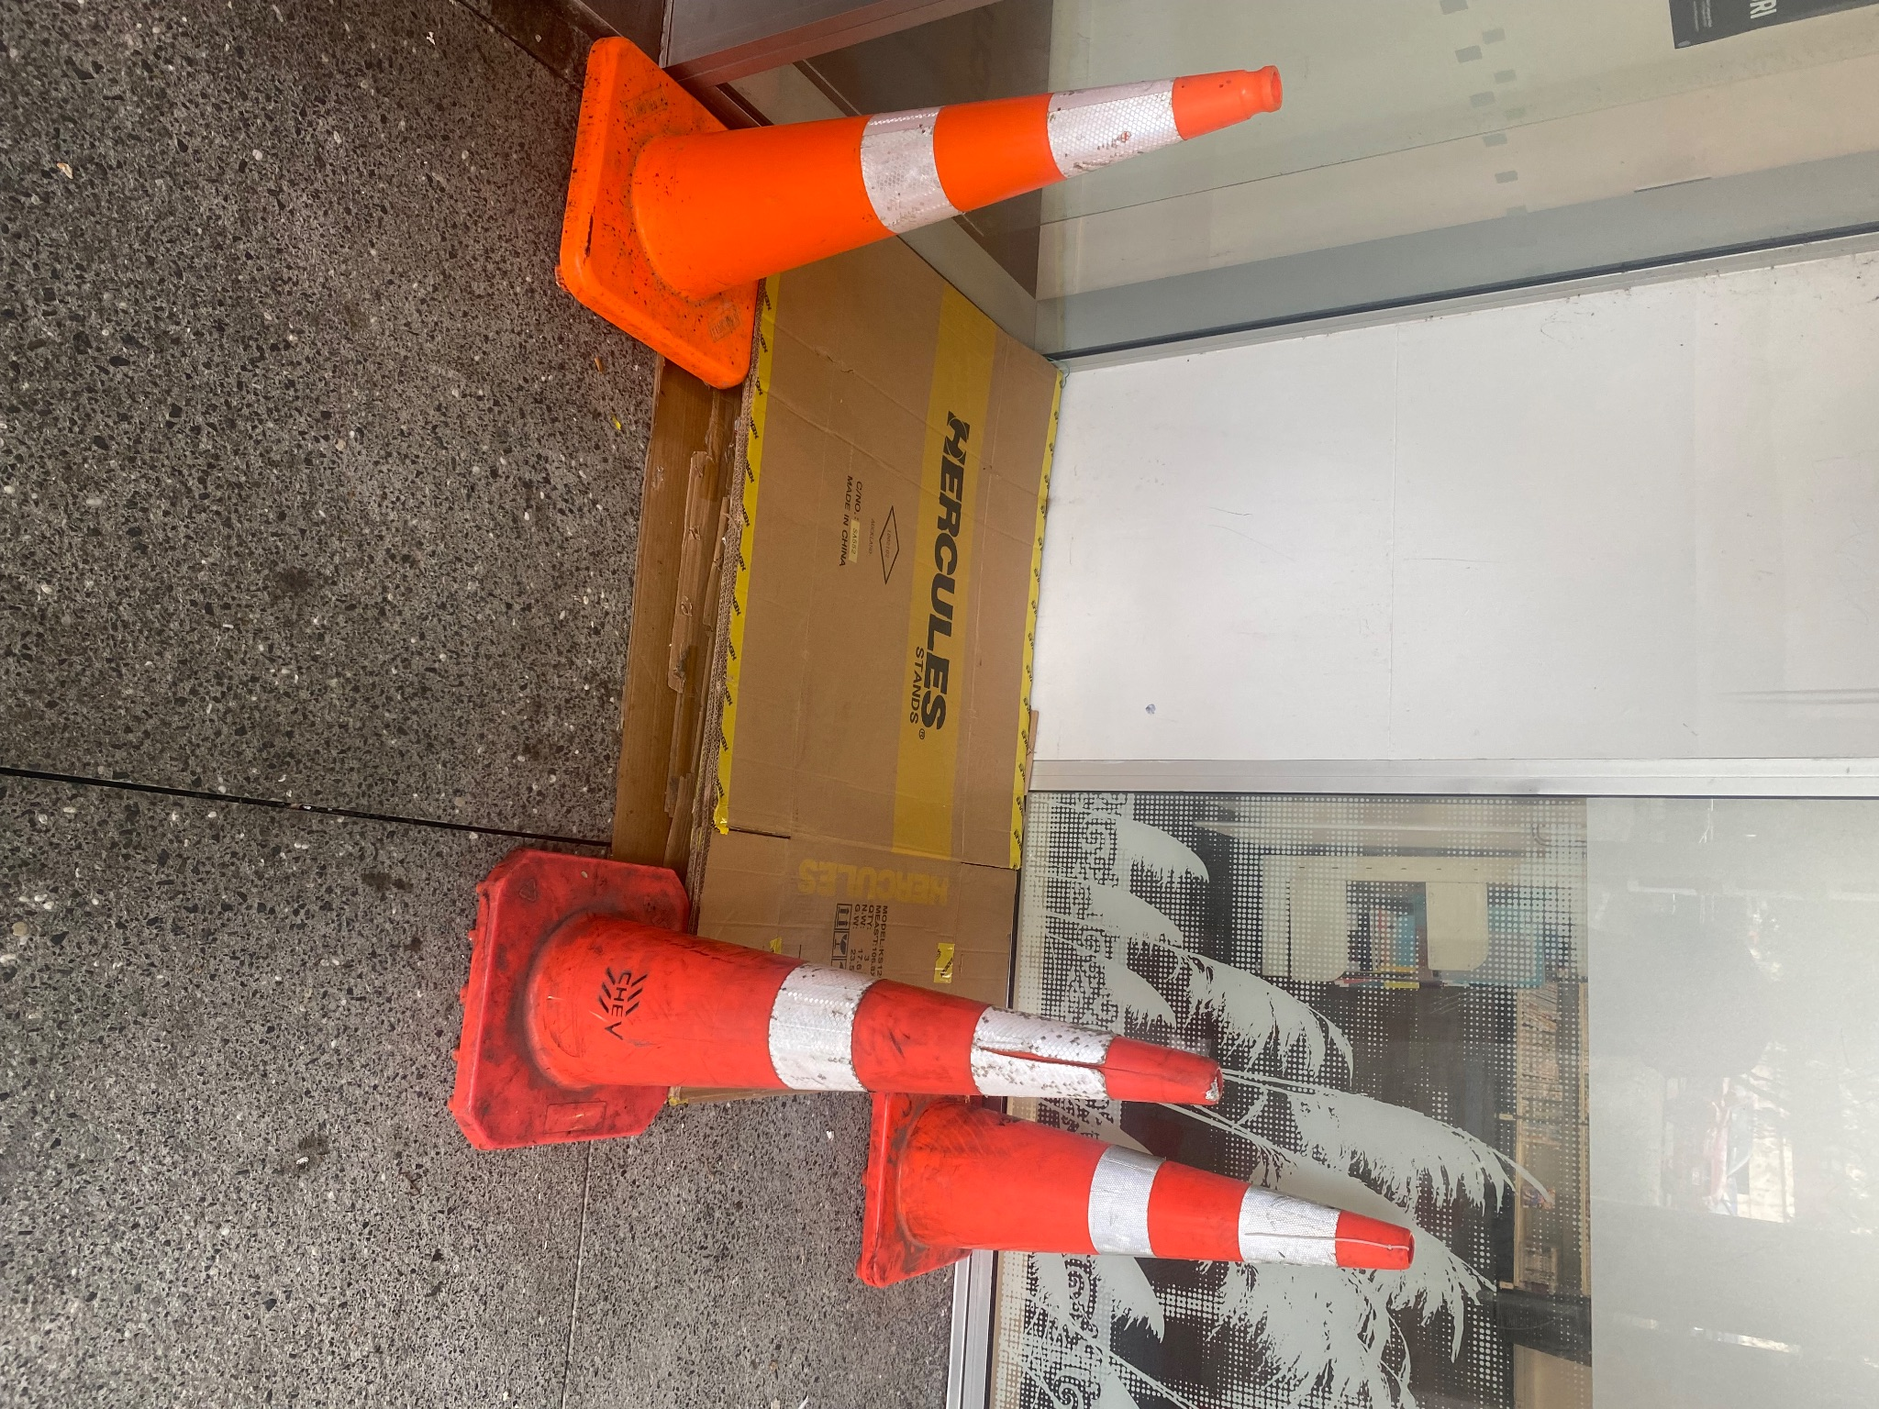
“Safe Spaces”
Waitakere Library welcome the LGBTTQIA+ community
Marking out hazards to

Slide 5
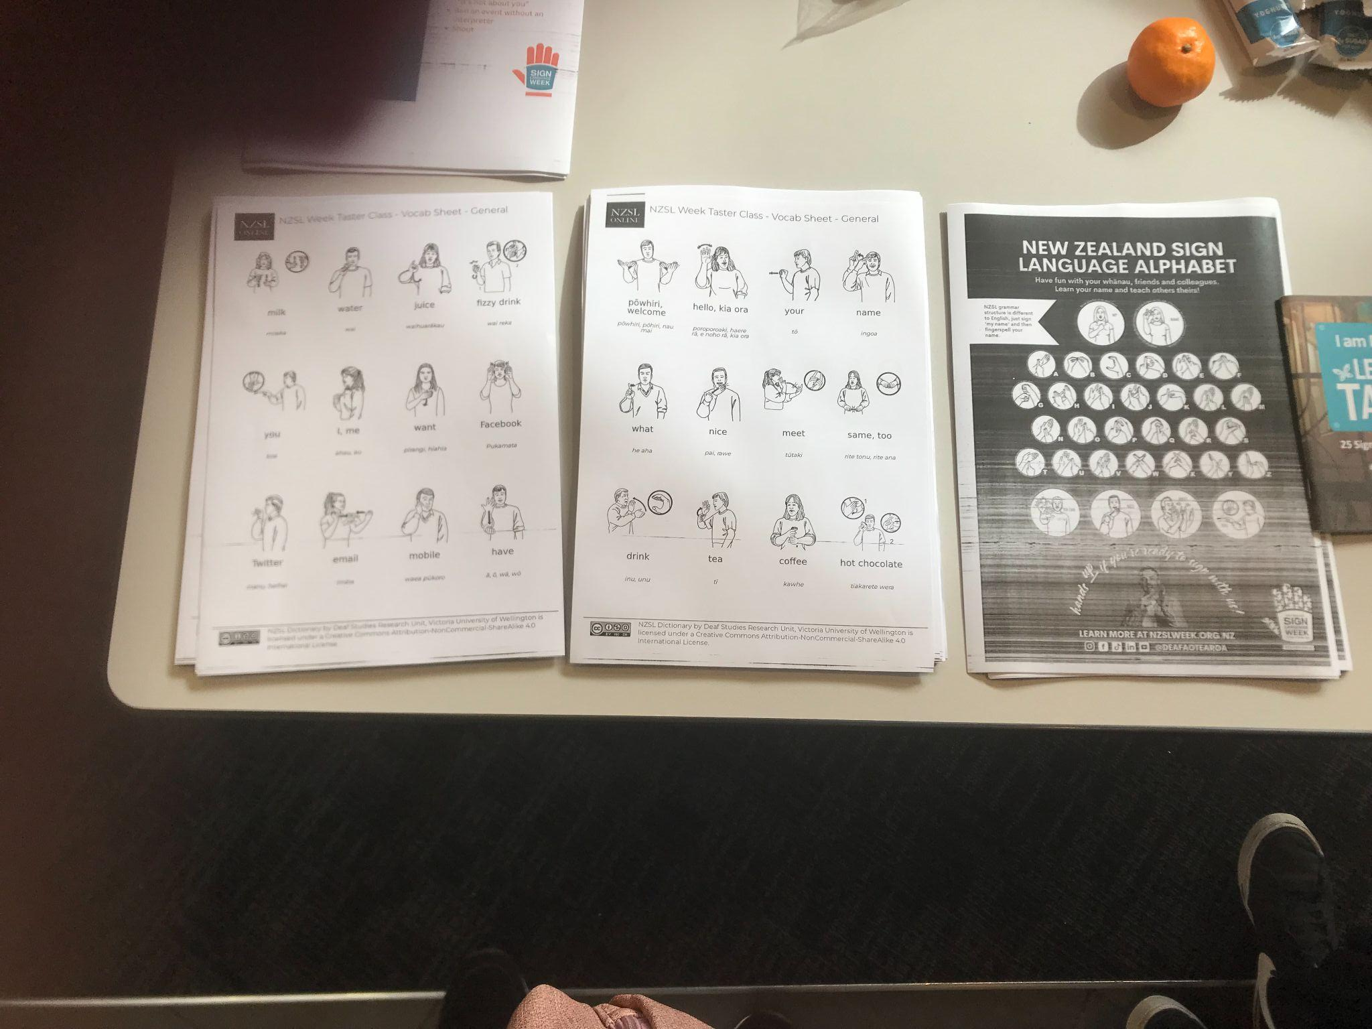
Third official language of Aotearoa
Inclusion people with disabilities
Promotes equality for those that do not yet have the ability to communicate verbally.
Acceptance and Normalizing the third language

Slide 6
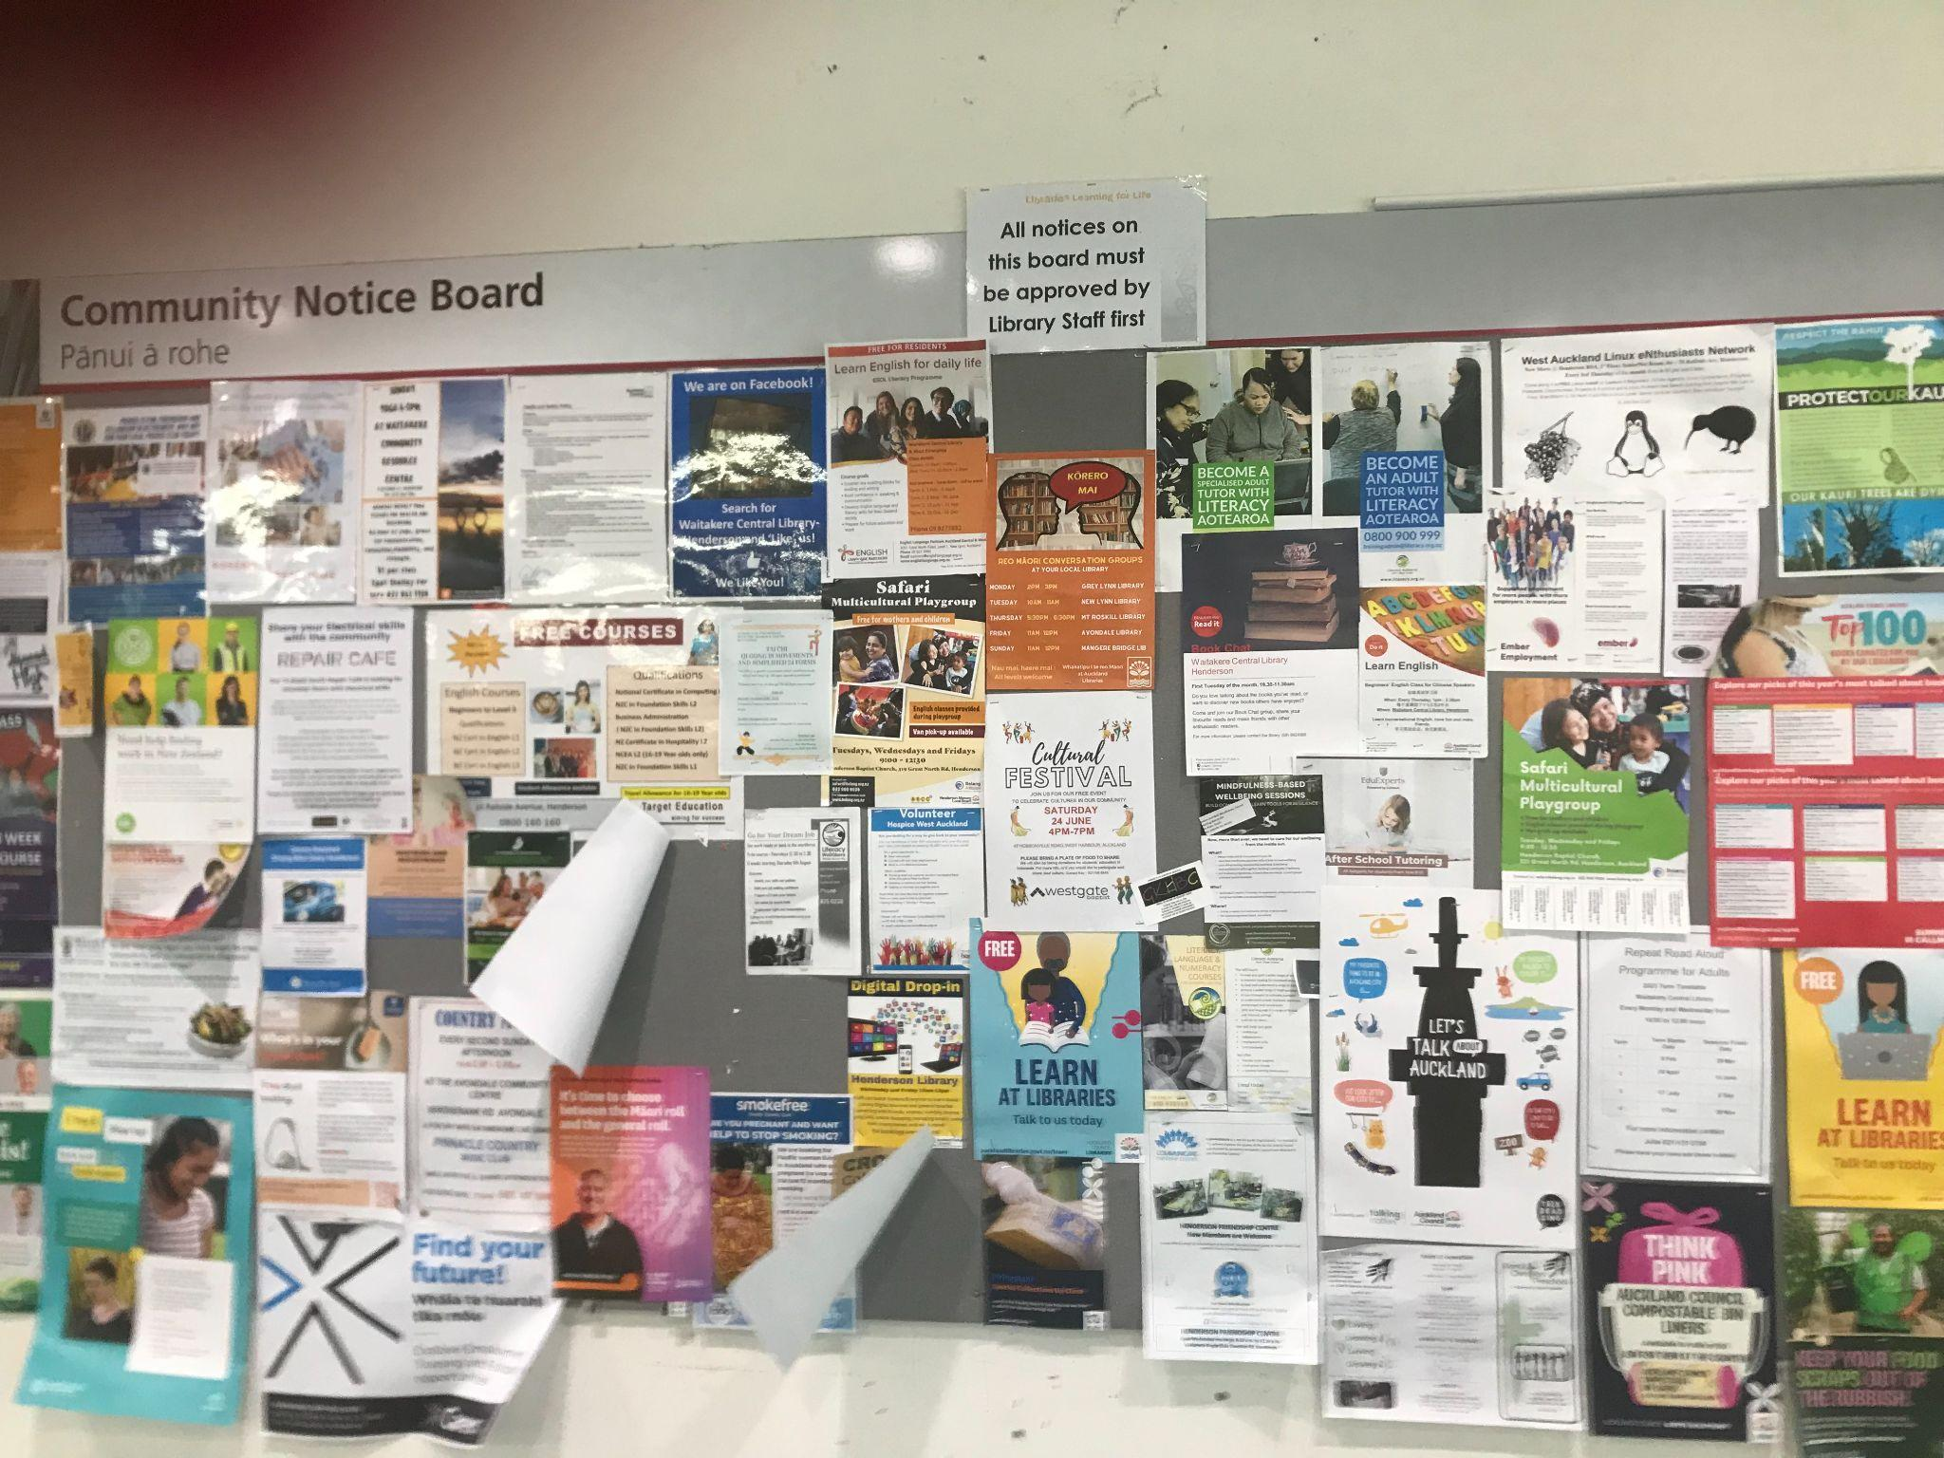
Community Notices Boars outside the Waitakere library.
-Accessible to the public with information such as, advertisement (jobs, accommodation, local events, company ads).
-Free to view for the public.
- Beneficial to any kind of organization as a means of effective advertisement
- Displays important contact information
- Showcases community recent achievements.

Slide 7
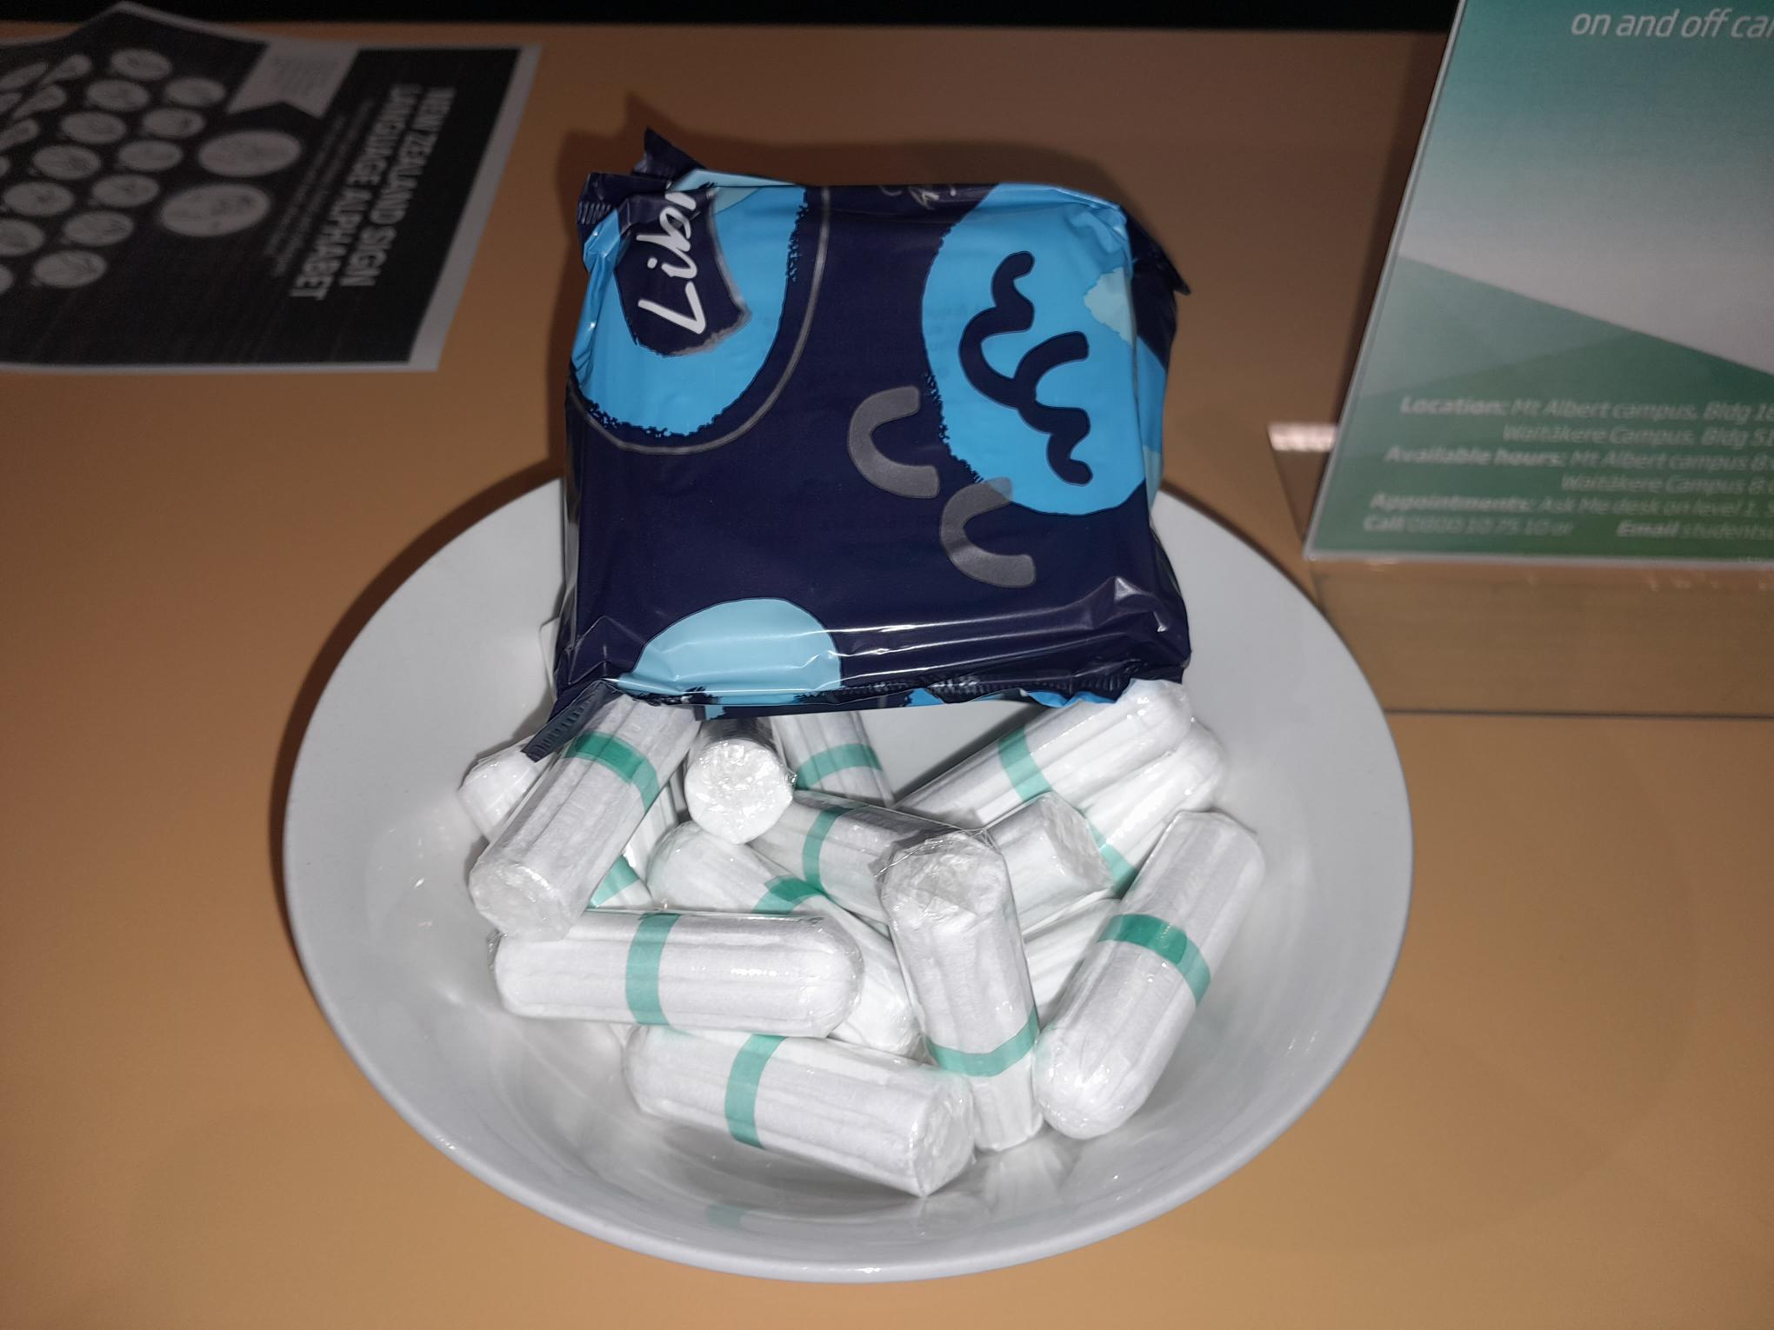
Help yourself
Unitec providing sanitary products.
For me this speaks to supporting access to education. It is a commitment to addressing gender inequalities.

