Slide 1
HAWKINS SESSION
Tender Bid Submission
Including Tender Evaluation techniques
NOVEMBER 2023

Slide 2
Review of estimators workings
Bid submission details
Decision on what mark up to apply
Submit your Tender

Slide 3
Submitting a Tender
Remember, you have been invited by the client to make an offer.
The client will have set out the requirements they would like you to follow.
A client does not normally accept an offer that does not meet their requirements.

Slide 4
Procedures as set in tender documents must be followed meticulously to avoid the tender being disqualified:
  Form of tender to be signed by an authorised person
  Bond details
Confirmation of confidential clause- a signed confidentiality agreement that there has been no collusion between themselves and other bidders, and that there has been no improper contacts or discussions with any of the customer’s staff
  Basic requirements to be met when submitting alternative proposals
Notes:
The bid must also include a signed confidentiality agreement that there has been no
collusion between themselves and other bidders (a bidding ring), and that there h
as been no improper contacts or discussions with any of the customer’s staff

Slide 5
Tender must be submitted on or before the time and date stipulated in the invitation to tender.
Public sector does not accept late tenders under any circumstances.

Slide 6
What would you expect to be included in your cover letter [MC submitting tender to Client]?
Take 10 minutes and identify the information that you would expect to be included in the tender cover letter.

Slide 7
Starting Point
Always date your letter.
Always address it to the client.

Slide 8
Thank the client for the invitation
We thank you for the opportunity to tender for the proposed................ ................................ We have pleasure in submitting our quotation for your consideration.

Slide 9
Tell them what it is your are offering.
  We hereby offer to carry out the work described below for the sum of $1,350,468.00 (One million, three hundred & fifty thousand, four hundred & sixty eight dollars.)

Slide 10
The scope
This submission has been completed in accordance with the invitation to tender, dated .............. . Specification reference No .......... and drawing No’s ............... as received in the enquiry received from your Consulting Engineer.

Slide 11
Clarify included/specified sums
The offer is inclusive of the specified sums (all provisional and contingency sums) of $ .......... as included in your specification, but exclusive of GST.

Slide 12
Limit liability
Apply the rules specific to the type of offer
  Firm/fixed price or open to Fluctuation?
  If Fluctuation
    This tender is firm/fixed and not subject to adjustment until 30 November 2018, or
    This tender is submitted on the basis of Fluctuation in accordance with the current formula……. (or other applicable).

Slide 13
As such, this offer is of a fixed price for 12 months from the date of this tender and will remain open for acceptance for a period of not exceeding twenty-eight days.

Slide 14
Are you prepared to negotiate this offer?
  E.g. We would be prepared to negotiate a firm price.
Limit your legal liability.
  ‘Reasonable’ period vs. stated time period.
    E.g. This tender remains open for acceptance for 14 (fourteen) days after this date.

Slide 15
Conditions
Our offer has been compiled on the basis, that the contract will be awarded as a whole. Should any item in our itemised summary of this tender, (other than the provisional or contingency sums), be deducted before acceptance of the offer, the remaining prices may need to be adjusted. Such price changes being subject to negotiation.

Slide 16
Special conditions:
  The installation shall be carried out in accordance with the latest edition of ……, all relevant Codes of Practice, and those working practices set by ….
  Should any changes be made to this agreement we reserve the right to submit a cost variation for any resultant expenses we incur as a result of these changes.

Slide 17
Special conditions:
  This tender is based on a 38 hour, 5 day (Monday to Friday) working week.
  We have not allowed for any scheduled overtime and should this be required, we reserve the right to submit a variation for the costs so incurred.

Slide 18
Completion time
  The contract time will be 200 working days after issue of the building permit or access to the site, whichever is the later.
  Clearly state any special days that you will or will not work
    E.g. this tender period does not allow for any ………….. days, which would have to be added to our construction period etc.

Slide 19
Detail what you are including or excluding from your tender.
  Inclusion - Our tender is submitted in accordance with Specification number A745/93 and Drawing numbers A745/93 sheets 1 to 73 inclusive, revised drawing….
  Exclusion - site fencing is assumed to be existing and is not included

Slide 20
Time to start the project
  We have submitted this tender on the condition that the work will commence on site by 30th November 2013.
  Should work not commence for any reason beyond our control, we will charge $1000 per week until work commences.

Slide 21
Economic Factors
  Where the contract may include a large value of imported equipment.
    E.g. This tender is based on the NZ Dollar at a minimum exchange rate of 1NZD=0.85USD
    Should the Dollar fall below this level, then any additional costs incurred by the import of such equipment will result in a cost variation.

Slide 22
Feedback
Early notification of your decision would be helpful for our future workload planning. If this electrical installation work is to be placed elsewhere, an indication of the accepted value of the contract would be most appreciated.

Slide 23
Where to from here…?
Receipt and Opening of Tenders
  By the Client / Agent

Slide 24
Tender opening
The Tender Board-
It might consist of a board member as chairman, the purchasing director, probably a technical expert, and a non-aligned person to act as secretary.
Contractor’s representative
All bids are date and time stamped and recorded.
The tender price/offer is read out and noted.

Slide 25
Late tender
How is it handled?

Slide 26
Where to from here…?
Tender Evaluation and Recommendations Report
  By the Client / Agent

Slide 27
Congratulations - You Won!!
Before you sign the contract document – you must:
  Check contract documents & establish:
    Are the drawings the same as those you tendered on?
    Conditions relating to dates, penalties etc. have not changed from original tender information.

Slide 28
Sorry, Try again…..
Compare your tender price to accepted tender.
Assess your performance!
Inform SC.

Slide 29
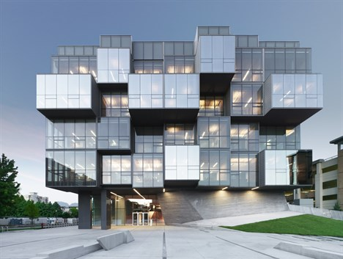
Tender Evaluation
[Plan and Process]
Notes:
Birds nest - China
Five sessions in total

Slide 30
The purpose of a tender evaluation is
to identify which bid offers the most economically advantageous proposal based on
the criteria specified in the invitation to tender.

Slide 31
Initial planning of a tendering process is essential to achieving the desired outcome.
This should consider how process fairness & probity will be ensured
  And whether there is a need for a probity plan and/or probity auditor.

Slide 32
The Q’s you ask should help identify …..
The factors that will guide which evaluation methods to use,
How you weigh the categories in which you are seeking information, and ultimately,
What questions you should ask to get the information you want.

Slide 33
Which evaluation model to use?
Lowest Price Conforming
Price Quality
Simple or small projects which are relatively straightforward to deliver
Projects which are more complex & need more information to decide which bidder has the best capabilities in relation to the project’s challenges.
Tender Evaluation Process

Slide 34
Weighted Attribute method
Brook’s Law method
Lowest Price conforming
Price – Quality trade off method
Tender Evaluation Techniques

Slide 35
Lowest price vs lowest price conforming
The usual….. But flawed

Slide 36
Lowest Price Conforming Tender (LPCT)
The lowest-price conforming model is the most basic model, and has the strongest emphasis on price. With this model, the lowest-priced tender or proposal is selected once a prerequisite level of quality is met.
Notes:
http://www.oag.govt.nz/2008/procurement-guide/part7.htm

Slide 37
It is applicable where additional quality over and above a minimum threshold is not important (that is, it does not offer greater value for money).
There should be no procedure which awards purely on the basis of price with no regard to quality
  Only on extensive repeat business

Slide 38
The attitude of LPCT to quality is that of a minimum standard
  So long as minimum standards of capability, experience and track record are met, the contract is awarded to the lowest priced tender.

Slide 39
A clear, ‘pass/ fail’, objective definition of what constitutes a ‘fail’ or non-conformance, included in the RFT.
Two envelopes [price and non-price], so that the evaluation of price information is obviously distinct from evaluation of attributes.

Slide 40
Best practice requires opening of the price envelopes first, then ranking of the prices from lowest to highest.
Due diligence on the lowest price bidder to check there are no tags that would have a financial effect, and no pricing errors.

Slide 41
Only the attributes of the lowest price bidder are checked for conformance to the pass/ fail standards defined in the RFT.
If those attributes conform, the process is complete and the attributes of the other bidders do not need to be checked.

Slide 42
The contract is awarded to the lowest price bidder provided it conforms. The attributes of the other bidders are discarded or returned

Slide 43
Activity (10 min)
What are the benefits and limitations of LPCT?

Slide 44
LPCT – what could be hidden?
The fact that the pass level is relatively low and that the lowest price is being favoured often means the Contractor may be only marginally qualified to the do the job and may also have under-priced.

Slide 45
Therefore, at the very least, there should be additional contract management costs to
  Ensure quality workmanship,
  Overcome poor management or
  Prevent attempts to cut corners
There is also an increased risk of ‘claims’ as the under priced Contractor attempts to make up margins on claims for extras.

Slide 46
LPCT Dangers
The reality is often that the lowest price is submitted by the one who has
  Misunderstood the documents
  Failed to appreciate the difficulty of the work
  Has deliberately priced low with the intention of making up on claims.

Slide 47
Weighted attributes
The PARADIGM SHIFT…..

Slide 48
The weighted attributes (WA) process seeks to balance between price and quality in a manner that is transparent….
“justice must not only be done,
it must be seen to be done”
R v Sussex Justices, Ex parte McCarthy (1924)

Slide 49
WA
The two-envelope system, where the evaluation of non-price attributes is undertaken without knowledge of the prices, contributes to the transparency of this method.

Slide 50
Purpose of criteria
In order to assess tenders, a system of criteria intended to encapsulate the competence of the tendering organisations ability to undertake a particular project is used to rate tenderers’ bids.
Notes:
http://transportblog.co.nz/wp-content/uploads/2011/09/Att-10.pdf

Slide 51
Ideal criteria
The criteria must be:
  Relevant to the project;
  They must be able to be evaluated in a meaningful way; and
  They must be able to be used to allocate a score to the tender submissions.

Slide 52
The criteria are usually selected from the following:
Relevant experience
Appreciation of the task
Past performance
Management and technical skills
Resources
Management systems
Methodology
There may be others
Price

Slide 53
Relevant Experience
Previous experience needs to be assessed in relation to the fields of expertise required to achieve the intended outcomes of the project.
Recent experience is more valuable than historic experience.

Slide 54
The tenderer’s previous experience in:
  technical areas comparable to the tendered project;
  the scale of past projects; and
  the role undertaken within those projects should be considered.

Slide 55
Information required should include a list of relevant projects undertaken and for each project you would provide:
  Description and relevance to the tendered project;
  Role of the tenderer;
  Project cost; and
  Duration of project.

Slide 56
Past Performance
You are assessing the tendering organisation’s performance in completing past projects to;
  the quality standards required,
  time performance,
  within budget,
  claims history,
  project management, and
  product value.

Slide 57
Extension to the contact completion date and claims for variations also give an indication of performance capability.
Satisfaction of previous client regarding the management of the project and project outcome provide useful subjective information on the performance of the tenderer.

Slide 58
The information required should include the following information on each project:
  Project name;
  Client’s project manager (+ contact details);
  Quality standards, target performance levels;
  Tender price, variations and final cost;
  Completion date and extension of time granted; and
  Details of OHS records.

Slide 59
Technical Skills
The competence of key management, professional and technical personnel that the tenderer proposes to employ on the project needs to be assessed with particular emphasis on the skills and experience in technical areas comparable to the project.

Slide 60
The information required should include the following details of the proposed project team:
  Names
  Function
  Technical expertise
  CV’s to be provided

Slide 61
Management Skills & systems
The availability within the tenderer’s organisation of personnel with appropriate management skills together with effective management systems and methods appropriate to the successful management of the project.

Slide 62
The information required should include the following:
  Quality systems
  Project management tools
  Programme software
  Environmental management systems
  OHS management systems

Slide 63
Resources
The equipment, including facilities and intellectual property, which the tenderer proposes to use on the project need to be assessed.
Competency vs capacity
  Know how vs can do!
  I know how to build a road, but all I have is a shovel!

Slide 64
Methodology
The procedures or innovative methods the tenderer proposed to use to achieve the specified end results, or the special processes detailed in tender documents.
The tenderer should be able to demonstrate capability to bring the contract to a satisfactory conclusion by describing the methodology of approach to accomplish the project’s required outcomes

Slide 65
The information required should include the following:
  Program of works
  Key performance indicators
  Division of works into subcontracts
  Innovative procedures to be used
  Reporting and recording systems
  Quality plan

Slide 66
WA calculations
The attributes and the price are all weighted
Then contractor’s attributes are evaluated and scored by the evaluation team.
Quality weighting: 60%
Price weighting: 40%

Slide 67
100 | Meets all requirements of an ideal tender.
90 | Meets most requirements of ideal tender.
80 | Meets many of the requirements of ideal tender.
70 | Meets a number of the requirements of ideal tender.
60 | Meets the minimum requirements but only just satisfactory for this criterion.
< 60 | Fails to meet the minimum requirements. May pass over this tender.

Slide 68
SCORE | DESCRIPTION
10 | Superior, beyond expectations. Offers an excellent level of performance that exceeds notional requirements. Represents industry best practice.
9
8 | Very good, negligible risk of failure. Satisfies the selection criterion in all respects. Highly competent and above average.
7
6 | Satisfies all requirements. Average, acceptable and compliant. Successful completion highly probable. No shortcomings apparent.
5
4 | Acceptable and mainly compliant, generally meets the requirements except for minor aspects and shortcomings. Successful completion likely.
3
2 | Marginally adequate, does not satisfy all requirements. Successful completion uncertain. Concerns regarding competence or capacity and ability to successfully fulfil the contract requirements.
1
0 | Non – Compliant. Fails to satisfy specified requirements.

Slide 69
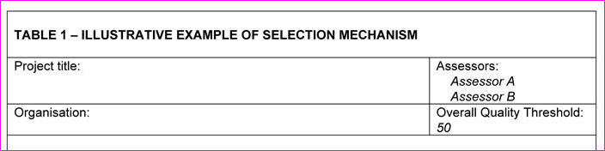
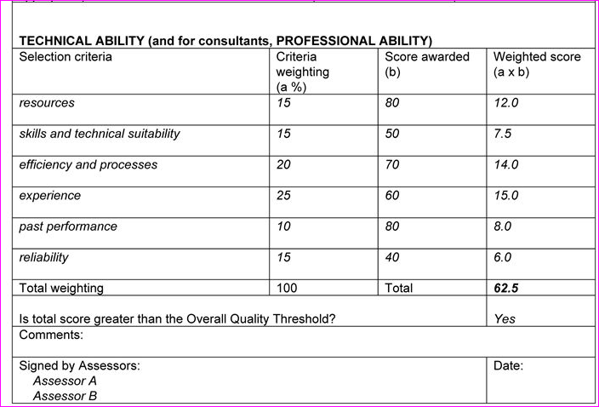

Slide 70
Price score
A price score is calculated for each of the bidders.
The lowest price tender should receive the maximum score, and those tender with higher prices should score less than that.

Slide 71
Scoring formulae:
Price Score = 50 - {100 x (Tender Price/Estimate)}
Price Score = 100 x {(Lowest Tender Price)/(Tenderer X's Price)}

Slide 72
Once all the attributes are scored, and the Price of each bidder is scored, the scores are multiplied by the weights for the respective attributes and then added together.
The highest weighted score is the winning bid

Slide 73
Activity (10min)
What are the benefits and limitations of WA?

