Slide 1
Topic 7: Identity
Complied by C Tunnicliffe 2023
With guest senior lecturer David Kenkel
Notes:
What I’m aiming for in this class is in many ways a wrap-up and reprise of ideas covered in other classes – in that gender/ race / class are intrinsic identity markers. In addition this session re-touches on identity politics as a key foci of struggle in ways that some suggest have supplanted class.
Other important things for this session is the idea of roles (and for me) – in this context – What might be speculated about the role of social worker and the extent to which living and behaving inside that role is a determinator of ‘professional identity’ – (and what does that mean??)
I’m interested in questions around ways of being the role in social practice? – who determines what the role is? – How it differs from other roles in life? And what implications this has for ideas of everyone having a self they ‘truly’ are – I.E. a real self? I generally want to ask if there is such a thing?.
What I also want to do (and this is where it departs from the text) is to somewhat politicize the late-modern ideal of the self and look at the role of the psy-discourses (everything from Doctor phil, to clinical psychologists to counsellors at schools) in reproducing / promoting a vision of the self as unitary, boundaried, singular, autonomous, independent and choice-able. Basically (in the usual fashion) I want to suggest this is a fairly western ideal of the self and when you tack on the way in which in the postmodern era identity becomes a project of continual progress and re-invention (I.E gyms and further education) then you have a self that suits a market economy. I use a guy called Cushman who is very good on the ways in which different eras and ages have different ideals of the self – determining different diseases of the self – determining different kinds of mechanics and technicians of healing (ie us social workie / counsellor types.)

Slide 2
Karakia | MANAWA MAI
Manawa mai te mauri nuku
Manawa mai te mauri rangi
Ko te mauri kai au
He mauri tipua
Ka pakaru mai te po
Tau mai te mauri
Haumi e, hui e, taiki e
Embrace the life force of the earth, embrace the life force of the sky
The life force I have fathered is powerful, and shatters all darkness
Come great life force,
Join it, gather it, it is done

Slide 3
E Tū Tāngata - Stand Together | Winner of APRA NZ Best Children's Song 2022

Slide 4
Key ideas of the week
Identity is produced in relationships with others.
The “I” we think of is shaped by ideas from others
Social ideas (ideologies) become internalised as our own beliefs
Society is therefore inside us.
Structure vs Agency
How free are we to be the “I” we wish to be?
Is there a limited set of possible Identities?
Who places these limits?
Who benefits, who is silenced?

Slide 5
What is the I in Identity
From the metaphysical to the biological.
The mystery of consciousness
(how are we an I?)
Understanding our experiences
(self Reflection v.s. unconscious processes)

Slide 6
Subject/Object
Subject
Object
Observer
Observed

Slide 7
Group discussion: To start us thinking
Identity
(my identity, your identity, our identities,)
is shaped by multiple factors.
Personal factors
Social factors
Historical factors
In groups: discuss
What has shaped your identities

Slide 8
Social Influences on identity
Employment
Family
Media
Education
religion
class
sexuality
age
ability
identity
gender
ethnicity

Slide 9
Group exercise
Who am I
Ko wai au?
Describe yourself to another.
What parts of YOU are important to you.
Make a name card. With “I am statements”.

Slide 10
I am……
My name is……

Slide 11
Developing a Sociology of the Self
The sociology of self explores the ways in which individuals locate themselves in the world through a sense of personal identity
..it seeks to demonstrate how this “self” that we perceive as uniquely our own …
is also a social construct.
Notes:
(e.g. I can’t believe I said that, or I’m sounding like my mother/father)

Slide 12
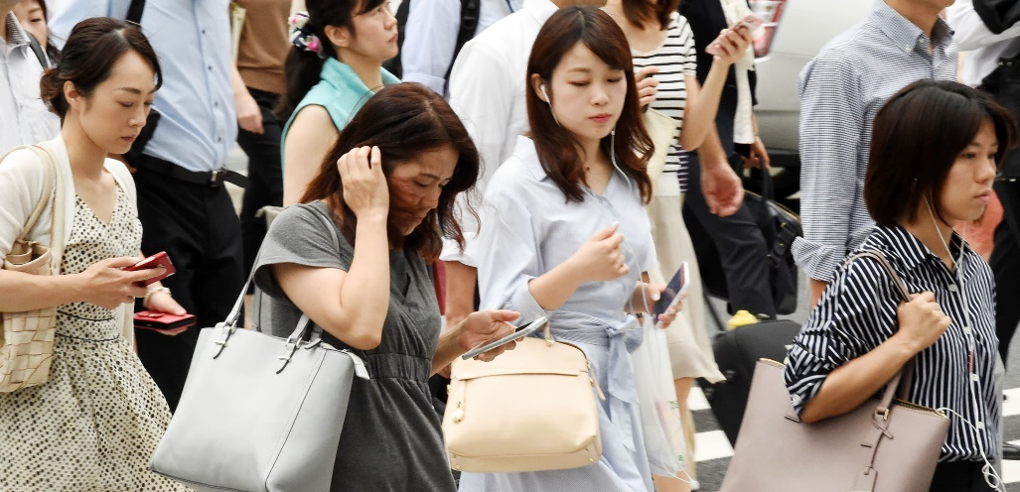
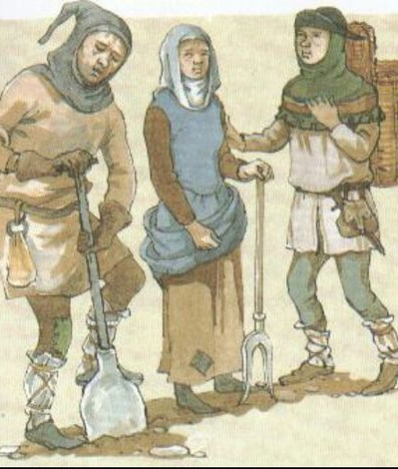
Different ways of seeing the self
The idea of possessing an individual identity is socially, culturally, and historically specific
(but we often act as if our most recent ideas of what the self is were a-historical a-cultural a-political and universally applicable (i.e. have always been this way).

Slide 13
Key historical transformations of selves
A self within a group – e.g. hunting and gathering
A producing self – home as a site of production – a rural self
A labouring self – a worker – an urban self- industrialisation
A consumer self – a consumer more than a producer- home as a site of consumption rather than production.

Slide 14
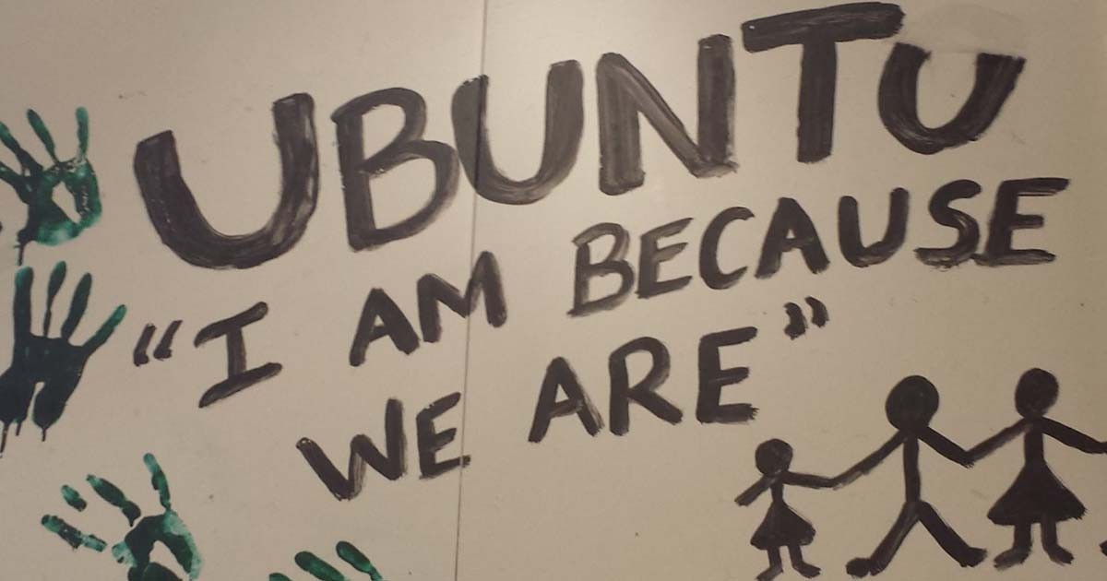
Different ways of seeing the self
The ways induvial identities are understood can vary from culture to culture
Identities have been challenged through historical processes
Indigenous identities are marginalised through colonisation
Differences in world views.
The I verses the We.

Slide 15
Break?

Slide 16
Sociological ideas of self

Slide 17
The modernist self
The modernist self is unitary (forming a single or uniform entity.)
Self contained
Autonomous
But…..
It is also social…
“One is self only among other selves. A self can never be described without reference to those who surround it” (Taylor, cited in West-Newman & Sullivan, 2013).

Slide 18
The modernist self
Language is a precondition for a sense of self
We acquire language through socialisation (our connections with family, communities, education).
Through this same process we also develop the vocabulary for a sense of self
Key thinkers Cooley 1864 –1929, Mead 1863 – 1931, Goffman 1922 - 1982)

Slide 19
Looking Glass Self (Cooley)
The looking-glass self has three elements:
We imagine how we appear to another person.
We imagine how he/she/they judges us
We have a feeling about our self that is the result of that (perceived) judgment.
We feel pride if we think others see us favourably and
shame/humiliation if we think we have been seen in a negative way.
The self is modified based on these interactions
Watch: https://youtu.be/bU0BQUa11ek (3.15)

Slide 20
Mind, Self and Society (Mead)
We can see ourselves as both subject and object
The self is made up of two aspects: the ‘I’ (subject) and the ‘me’ (object).
The ‘I’ is the independent creative part that operates before we become aware that there is a world outside of our own self.
The I responds to other peoples reactions to the me (self as object)
The I doesn’t respond to all reactions to the Me in the same way.
“I don’t think they understand me”
Watch: https://youtu.be/tl_VZzhjdQQ (5mins)

Slide 21
Roles and Identities (Goffman)
Social life can be seen as a drama in which we all play roles.
Roles are defined as context specific multiple, and to be played according to scripts and scenarios that are socially determined
The roles are part of the person, some brief and maybe insignificant, some are life long an deeply significant
Some roles we may freely choose
But some may be deeply resented, to the point we must manage, avoid, deny or reject them.
We all carry many roles which give shape to our identity
What roles do you have? Parent? Employee? Student?
Notes:
I want to strongly link this professional identity and the ‘role’ of ‘being’ a social practitioner. This might be a good one to tease out a bit in the breakouts?
I basically have a series of questions and no answers.
Is there a real self? – that sits underneath the roles we play?
What is a role? Is it being fake or something else?
Does a role have independence of who we are? (particularly a role like Swer which is partly determined by what society and others believe and want.)
Is a professional identity different to any other sort of identity? How?

Slide 22
Roles and Identities (Goffman)
Goffman distinguished between front stages and back stages. During our everyday life, we spend most of our lives on the front stage, where we get to deliver our lines and perform.
Sometimes we are allowed to retreat to the back stages of life. In these private areas, we don’t have to act. We can be our real selves. We can also practice and prepare for our return to the front stage.
Notes:
I want to strongly link this professional identity and the ‘role’ of ‘being’ a social practitioner. This might be a good one to tease out a bit in the breakouts?
I basically have a series of questions and no answers.
Is there a real self? – that sits underneath the roles we play?
What is a role? Is it being fake or something else?
Does a role have independence of who we are? (particularly a role like Swer which is partly determined by what society and others believe and want.)
Is a professional identity different to any other sort of identity? How?

Slide 23
Post-Structural/postmodern self:
Grand ideas of a unvisal self no longer hold true (ideas such as “mankind”, “human nature” have become seen as simply another set of ideas, often from a western point of view.
For the postmodern self, identity is seen as constructed within a particular social, cultural, historical period (e.g. the self within late stage capitalism)
Hyper reality and the domination of signs.
Identity is constantly shifting, it is fluid, it can change any time.
No longer an I behind the identity.

Slide 24
Post-Structural/postmodern self:
The self is seen as a reflexive project which the individual “works on” in everyday life.
Optimistic= a world of possibilities
Pessimistic = others are there for our gratification. The body becomes a “project” onto which we ascribe markers of identity.
Foucault’s idea’s on knowledge/power, discipline, the gaze.

Slide 25
The flexible self – Flexible for who?
Life long learning
For the market?
commodification of self/ commodification of labor/ commodification of your information
The consumer self?

Slide 26
Final notes: Individuality vs. Individualism to point out that these are not the same thing
 | Individuality (the recognition of difference) | Individualism (the ideology of the individual)
Includes | Difference | The “Individual” is central
 | Autonomy | Individual freedoms
 | Agency | Individual rights
 | Commonality of interest | Self interest
Is seen in contrast to | sameness?/conformity | collectivism

Slide 27
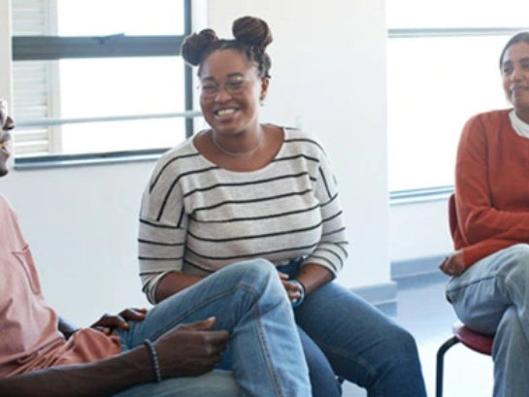
Links to practice. Other selves
How does knowing ones own self help you work with others?
(in ways that do not “other”)

Slide 28
references
West-Newman, C. L. & Sullivan, M. (2013). Becoming: Identity. In S. Matthewman, C. L. West-Newman & B. Curtis (Eds.). Being sociological. (pp.101-119).New York: Palgrave Macmillan.
McLennan, G., Ryan, A., & Spoonley,, P. (2000). Exploring Society: Sociology for New Zealand students. Auckland: Pearson Education.

