Slide 1
Building Services
Roger Birchmore MPM, BTech (hons), C.Eng (UK), MCIBSE, MNZIOB

Slide 2
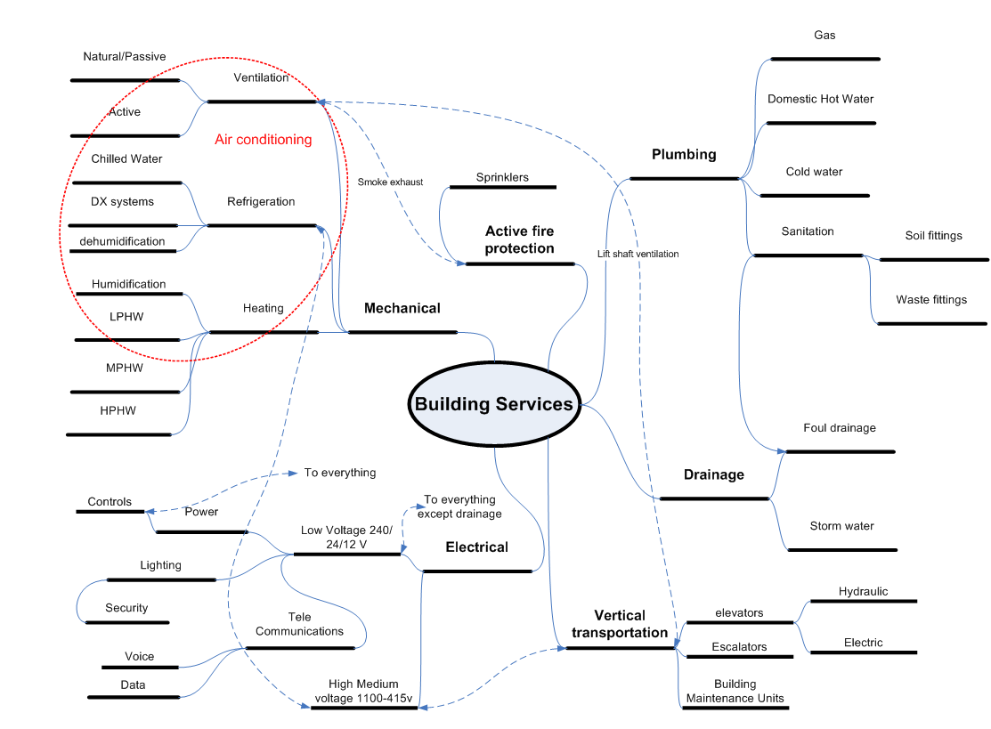
Fire
Hydraulics
Electrical

Slide 3
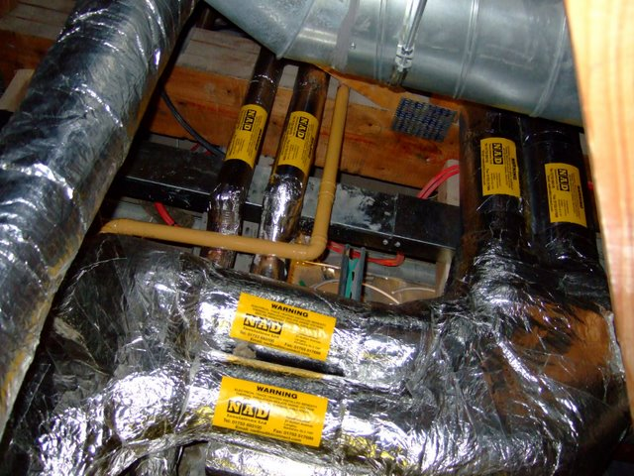
Who goes in first?

Slide 4
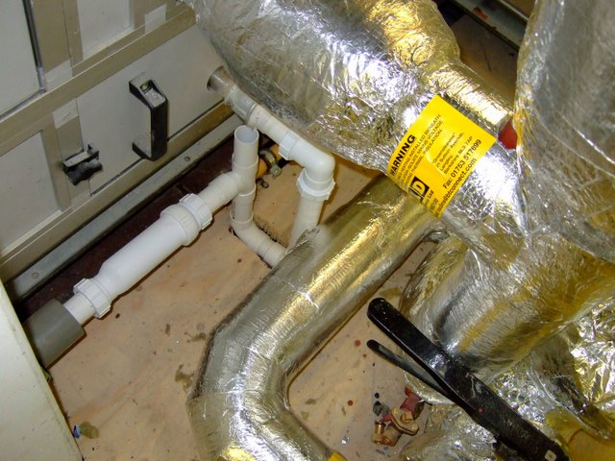
OOPS!
PHEW!

Slide 5
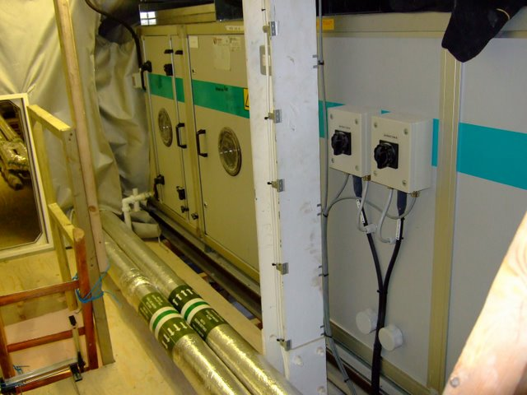
Bugger!
Will it or won’t it?

Slide 6
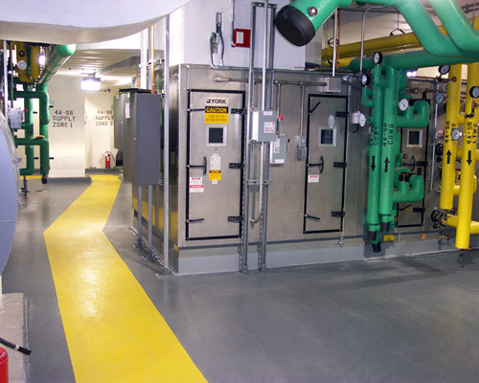
Nice!

Slide 7
Cost - Services Can Be Expensive
High Rise Office Building
Service | Space % | Cost %
Mechanical | 10 | 10
Hydraulic | 1 | 2
Fire Protection | 1 | 2
Vertical Transport | 3 | 8
Electric Power | 1 | 4
Management | - | 1
Ceiling Voids | 10 | incl above
Total | 26 | 27
Parlour,R.P. (2000) Building Services A guide to integrated design, 3rd ed., Integral Publishing, Australia

Slide 8
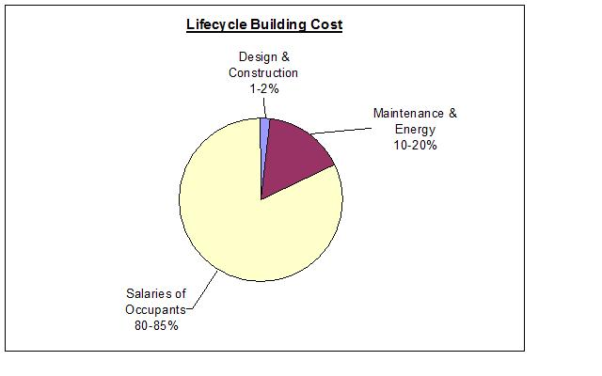
Not just to Buy but also to run!
Services = 0.25-1%
Services =
7-15%
Heavily Influenced by Services = 92.75 – 84%
ttp://commons.wikimedia.org/wiki/File:Lifecycle_building_cost_pie_chart.jpg

Slide 9
Why are Services a problem?-Procurement
High
Cost to influence
Ability to influence
Low
Services
Services
Services
Concept
Design
Implementation
Handover

Slide 10
Specific challenges
  Complexity
  Co-ordination of design
  Co-ordination of Installation
  Commissioning

Slide 11
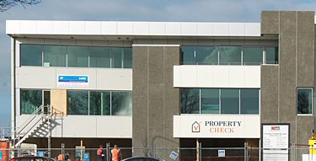
Systems Approach
External
Internal
Centralised equipment , using or processing a Resource
Resource or Utility, e.g.
Electricity , Gas ,Water
Distribution System
User Interface

Slide 12
Systems Approach - 4 Elements
External
Internal
Resource or Utility, e.g.
Electricity , Gas ,Water
Centralised equipment , using or processing a Resource
Distribution System
User Interface
Resource or Utility, e.g. Soil and waste system
Grease trap, petrol interceptor

Slide 13
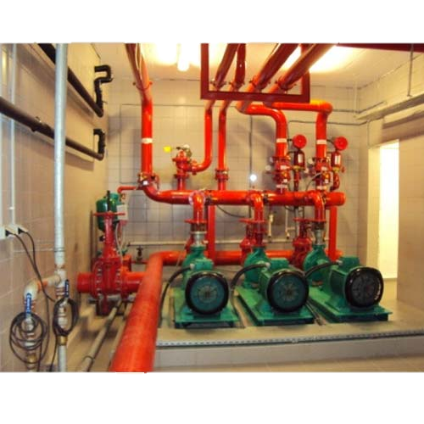
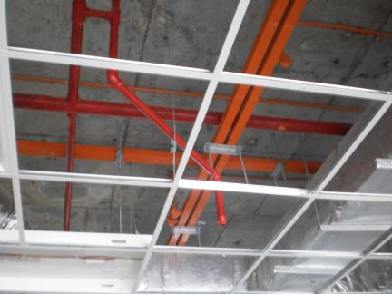
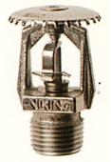
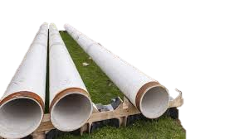

System Components
External
Internal
Resource or Utility, e.g.
Electricity , Gas ,Water
Centralised equipment , using or processing a Resource
Distribution System
User
Interface

Slide 14
Utility Characteristics
“Owned” by someone else (Local Authority, distribution company etc.)
      Require careful planning and permission to connect into
  Minimise disruption of service to others
  Protect from contamination
Often buried and difficult to access
Large scale distribution (big pipes or cables)
Dangerous (E.g. high voltage)

Slide 15
Resource- Characteristics
Usually Consumed or transformed by the central plant or system
Not owned by anybody
Free to use
Still need to protect from contamination

Slide 16
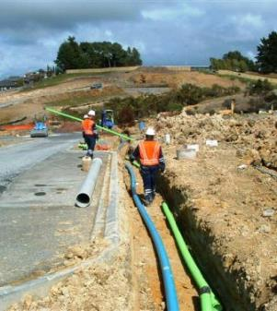
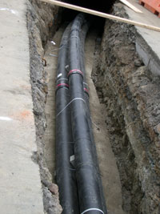
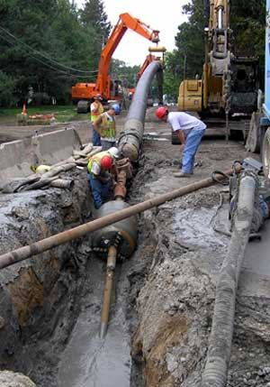

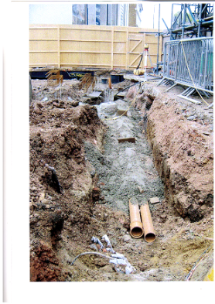
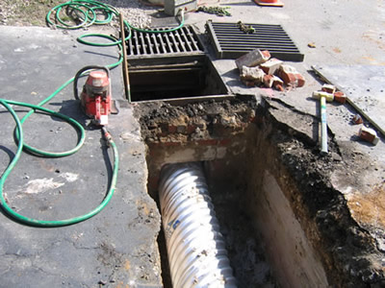
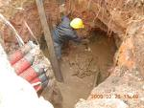

Slide 17
Centralised equipment- Characteristics
Physically large often heavy and frequently noisy
Interfaces with other services
Often needs large openings in external envelope
  Beware weatherproofing especially below ground
Requires access for maintenance repair & replacement
Often requires vehicular access
Can require access by people not connected with the building (fire service, power transmission co.)
Requires safety devices
Tends to be at bottom or top of building

Slide 18
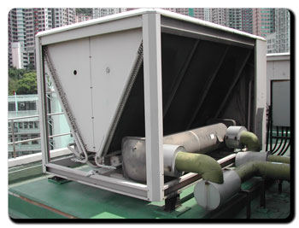
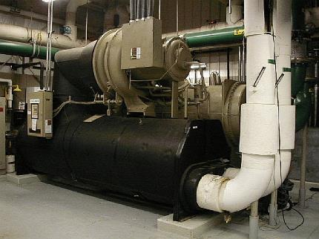

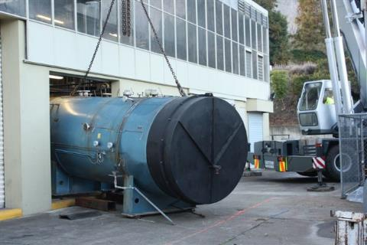
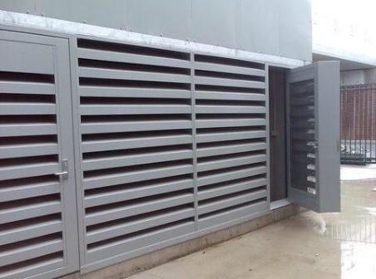
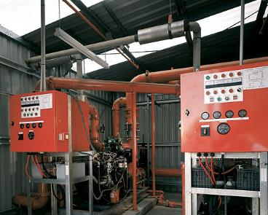
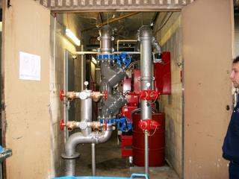
Components

Slide 19
Distribution System - Characteristics
Requires space to install
Requires support ,separation, insulation, access for commissioning, maintenance, repair and replacement
Can cut across construction zones
Tends to get smaller the further from the plantroom
Needs co-ordinating with the distribution of other services
Passes through fire barriers-maintain integrity
Contains many joints (and potential leaks)

Slide 20
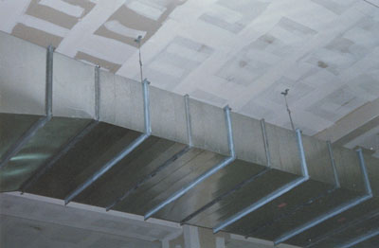
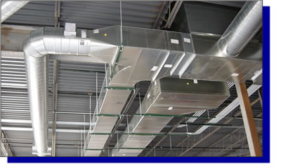
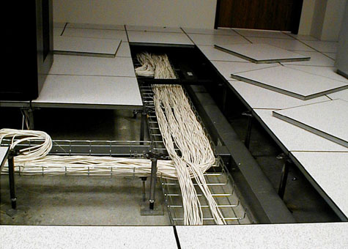
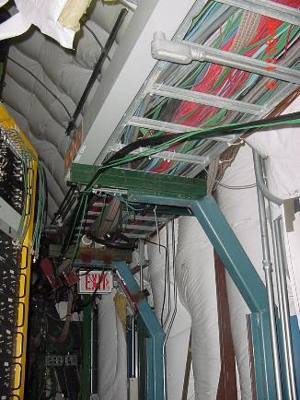
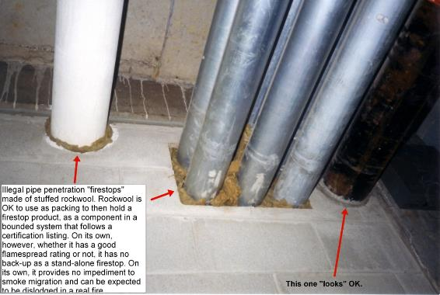
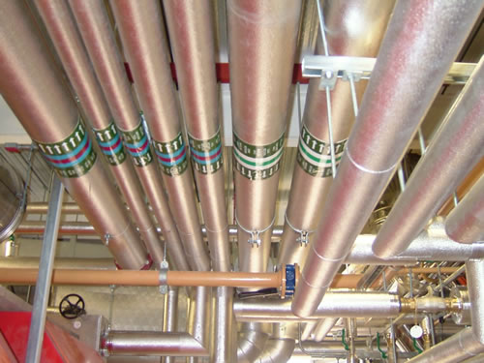
Distribution Systems- Components

Slide 21
User interface - Characteristics
Often all an occupant knows or sees of a system
Impacts most significantly and directly on their comfort
Impacts most significantly and directly on use of the space

Slide 22
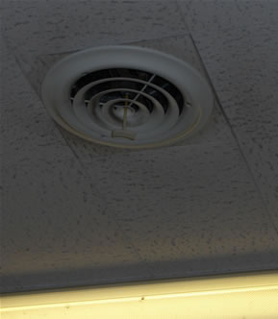
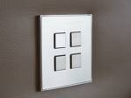
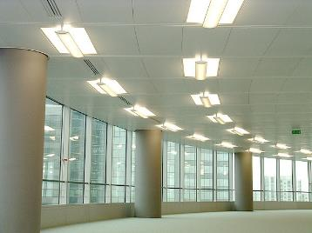


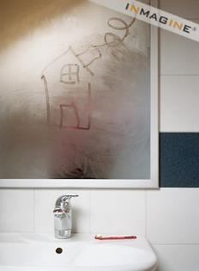
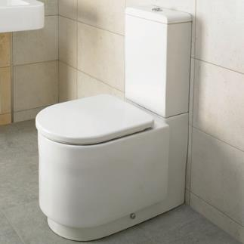
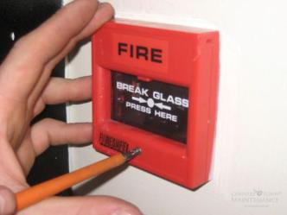


Slide 23
Activity
In your groups look at the drawings of your given service on the Moodle page.
Identify examples of the four elements on the drawings. Check against three of the elements characteristics (slides 16 -24)
Look for signs of design co-ordination (noted in slides 25-27)
Prepare for the presentation at the end of the day.

Slide 24
Co-ordination of Design- evidence it has been done
  E.g plantrooms and service risers are big enough
  Plant and components can be replaced and maintained throughout their life
  Distribution routes are available and large enough
  Interfaces between different services are designed
          Varying electrical voltages are made compatible
          Services penetrations do not leak water, air, sound or fire
          Protection of potable (drinking) water supplies from contamination
          Positions of services in shared spaces, e.g. risers, plant rooms, ceiling spaces
          Diffusers don’t clash with light fittings
          Reference to other services on drawings
  Layouts 1:100, plantrooms, toilet blocks 1:50, risers, ceiling void x-sections 1:20, more than one service on a drawing, drawings that represent the physical size of the service.
Procurement methods that encourage early services involvement enhance good design co-ordination.
Examples of lack of design co-ordination?

Slide 25
Some co-ordination

Slide 26
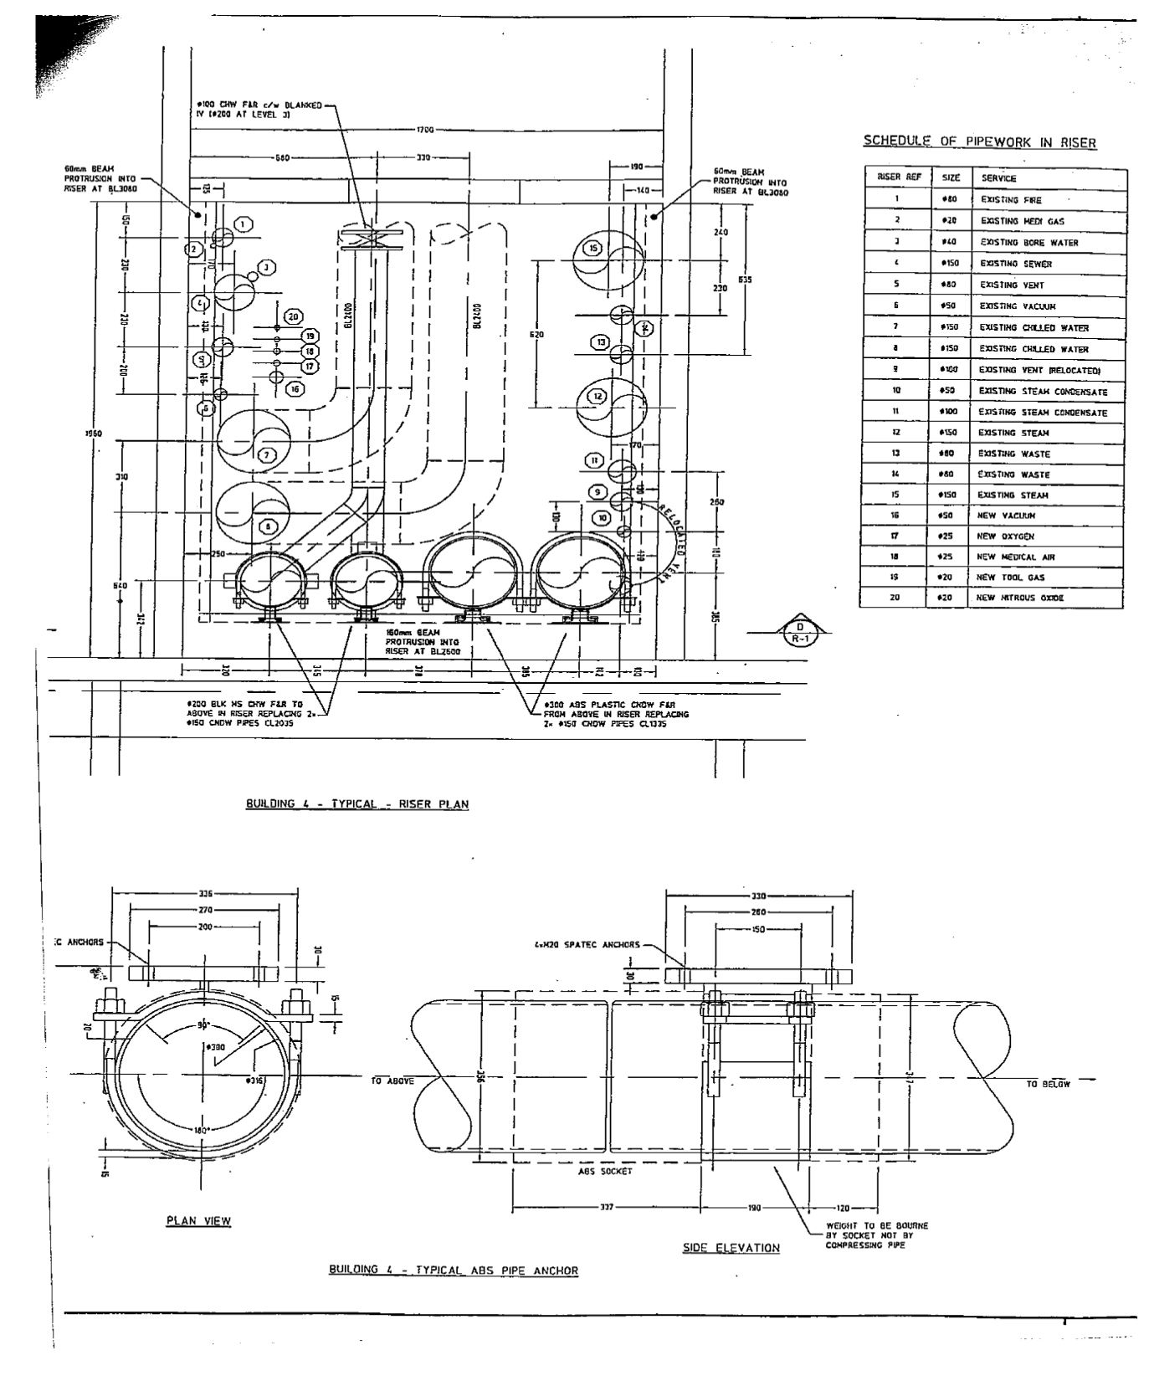
Extreme Co-ordination

Slide 27
Co-ordination of Installation
Know the Job!
Co-ordination of Installation
  Each service is installed in a way that it does not impede the installation or operation of other services- avoids “first in first served approach”
  Ensures final fix items not covered in early design are co-ordinated, e.g thermostat locations and furnishings
  Ensures continuity of work
  Maximises chances of
    An efficient installation process
    Meeting the programme
    Making a profit!

Slide 28
Sequence- Within a Service- Whole Building
General Principles
        First fix
        Major Risers and branches, Large plant, Brackets, key horizontal distribution runs, fan coil units
  Second Fix
    Connections to plant, equipment and fittings
    pressure tests, insulation
    Valve motors
    Flexible ducting
  Final fix
    Diffusers, grilles, luminaire diffusers, thermostats fixtures, light switches

Slide 29
Sequence
Tower core finishes completed downwards
Services
Tenancy fitout

Slide 30
Sequence
Tower core finishes completed downwards

Slide 31
Sequence
Following this closely can be very tricky- why?

Slide 32
Sequence - Between Services
Wild (1997 5.3.6)
High level followed by low level
Large physical, inflexible services followed by small flexible services
Services with fluids driven by gravity before pumped fluids
Services where friction loss is important
Careful design co-ordination can create alternative sequences
Co-ordination should drive the critical path rather than the critical path driving installation order

Slide 33
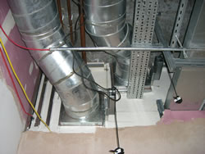
Who goes in first?

Slide 34
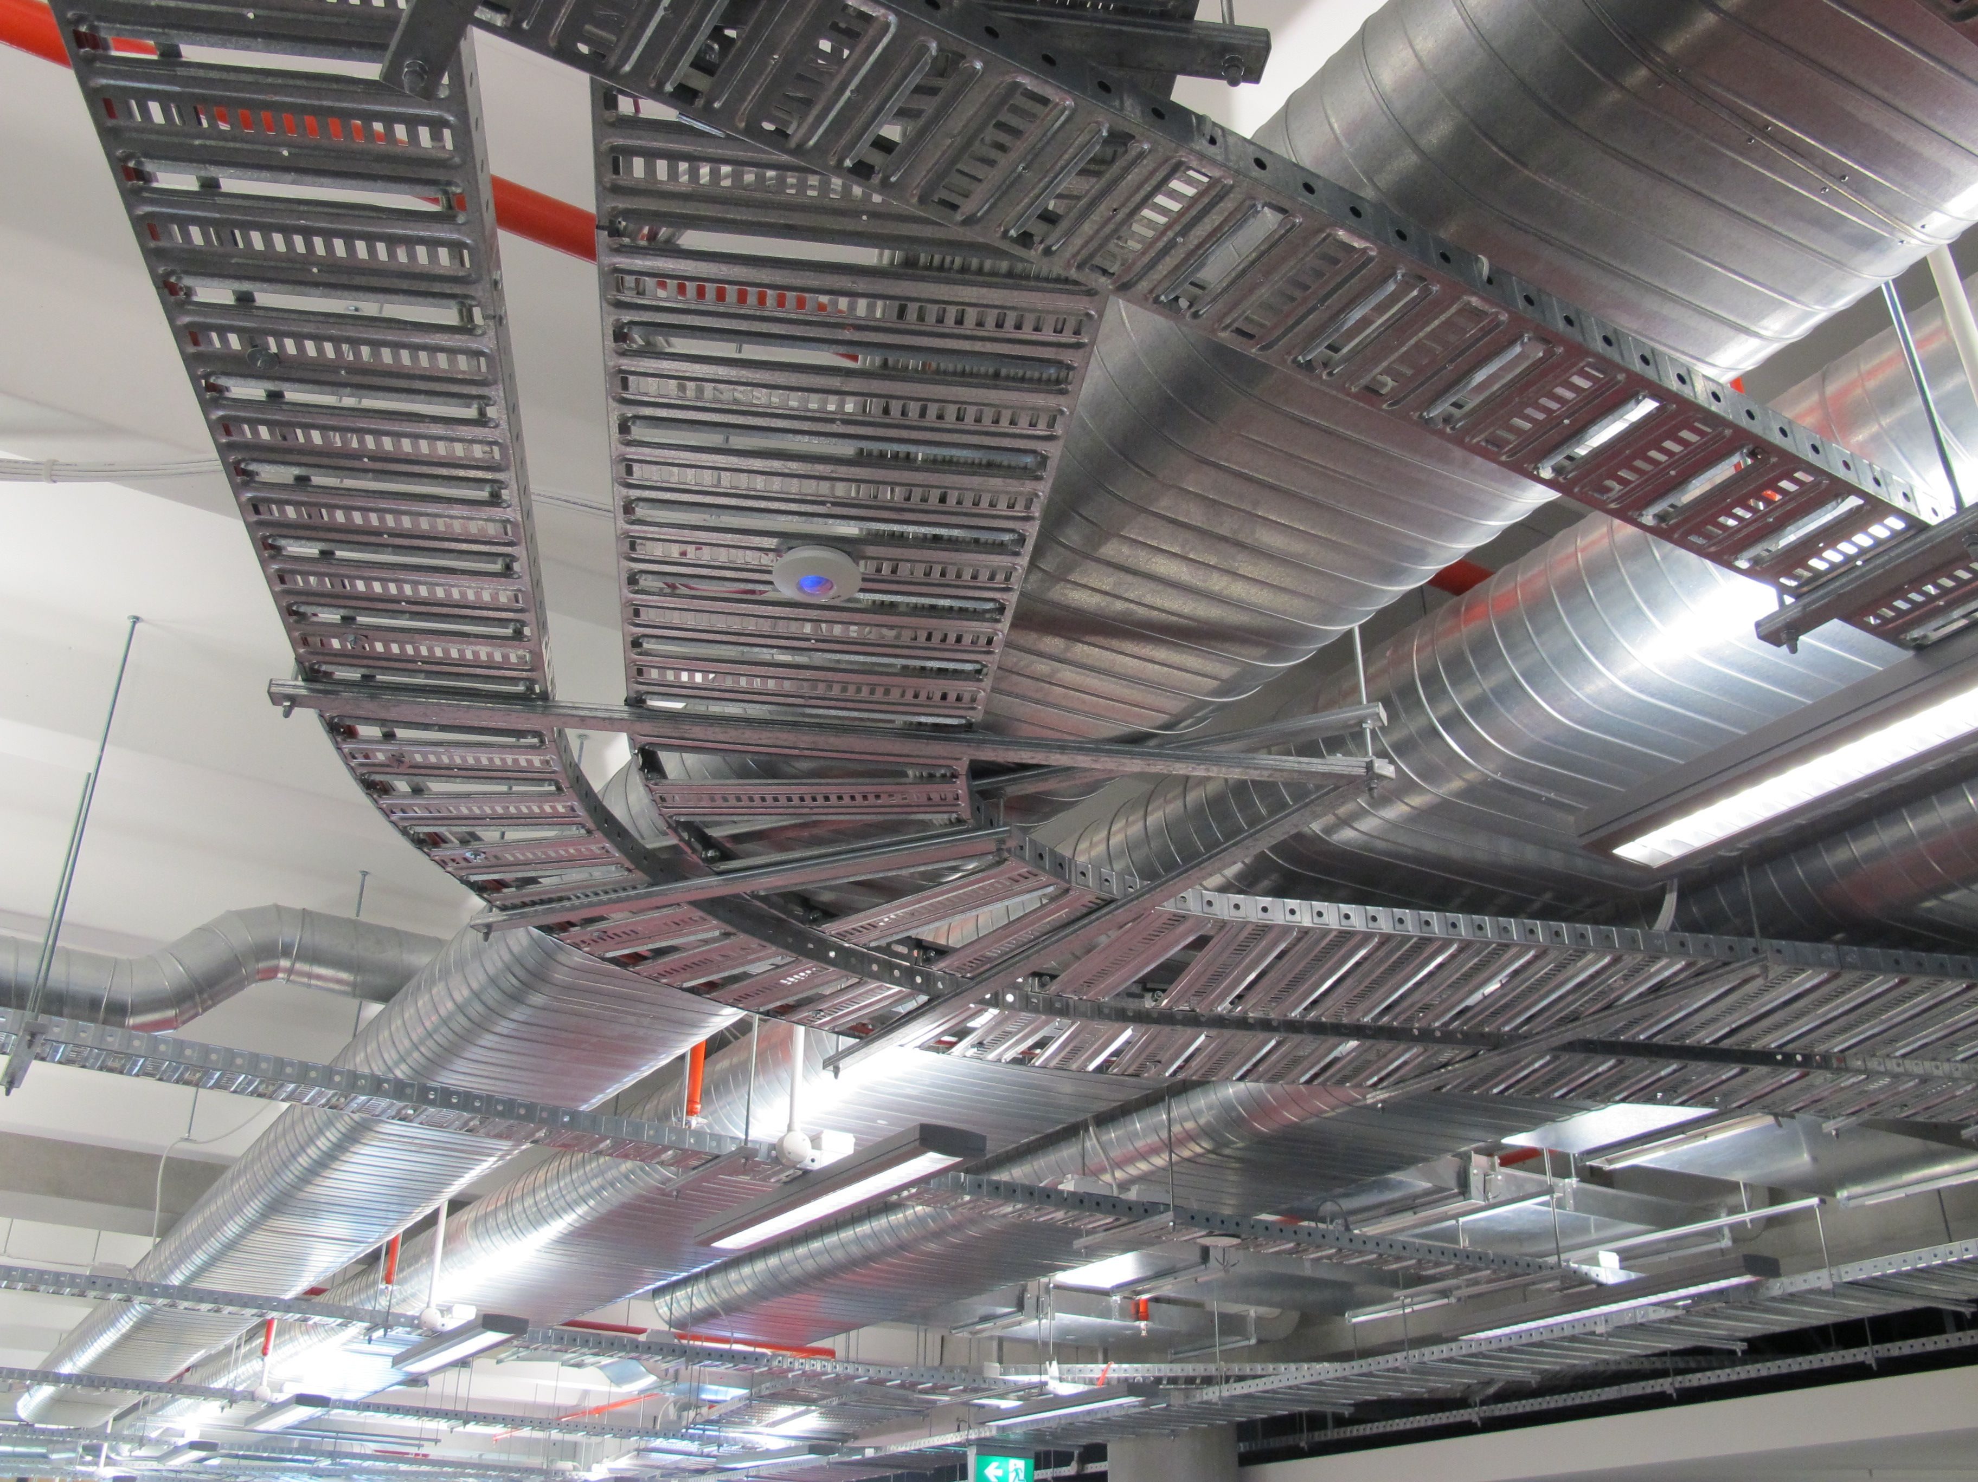

Slide 35
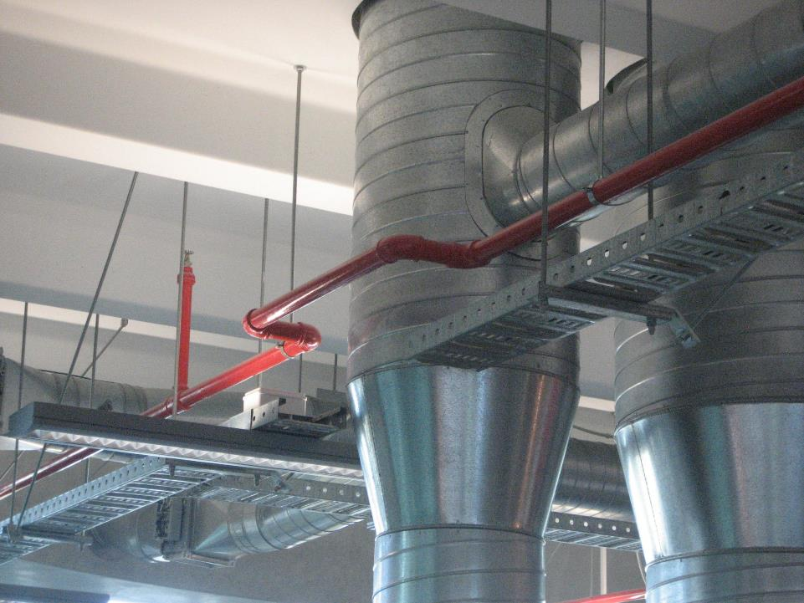

Slide 36
Activity
In your groups look the combined services layout
Which service goes in first and why?
What is the following sequence and why?
What construction must be completed before services installation begins?
What construction needs to take place whilst the series are being installed?
What construction has to wait until services are installed?
How do the procurement methods influence the likelihood of a smooth installation?
What are the risks and who takes them?

